Slide 1


Depositing Research on CLoK
START
INNOVATIVE THINKING
FOR THE REAL WORLD

Slide 2
Contents
CLoK Depositing Checklist
Depositing Research With a DOI
Depositing Research without a DOI
Article
Book Section
  Monograph
  Conference/Workshop item
  Book
  Artefact
  Show/Exhibition
  Performance
  Image
INNOVATIVE THINKING
FOR THE REAL WORLD
BACK
NEXT

Slide 3
CLoK Depositing Checklist
When depositing research outputs on CLoK you must ensure that you have all the correct information at hand to successfully complete the deposit. Ambiguous or incomplete deposits will be referred to the depositor for more information or amendment which will increase the time it takes for a research output to be published on CLoK.
Use the search facility on CLoK and check that the publication you wish to deposit is not already live on the repository. If you find a copy of the record already on CLoK please check the record to see if you can add more information to it or upload a full text version. If you can please contact CLoK with the extra details/full text version.
Ensure you have a correct DOI or PubMed Id (if importing publisher/bibliographic data).
Ensure you have all the correct publication and bibliographical details before you start your deposit.
Ensure you identify UCLan authors amongst any co-authors (to enable you to link the deposit to their identities).
Ensure you have a digital copy of a later version of the work (Authors Accepted Manuscript (Post Print) or the publishers final version) to upload. Check that the copyright holder’s policies permit the uploading of the version to an institutional repository. Use Sherpa/Romeo for journal publisher guidelines on which version they would prefer you to upload, or check the Copyright Transfer Agreement that the publisher has asked you to sign. These sources will also inform you of any Open Access embargo you will need to apply.
If you are unsure please upload any copy of the work you have and the CLoK team will advise as to whether it can be deposited on CLoK.
INNOVATIVE THINKING
FOR THE REAL WORLD
BACK
NEXT

Slide 4
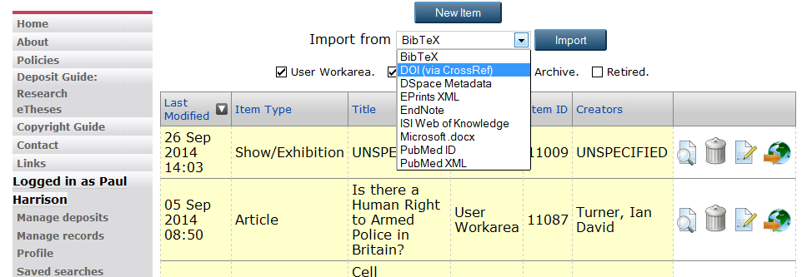
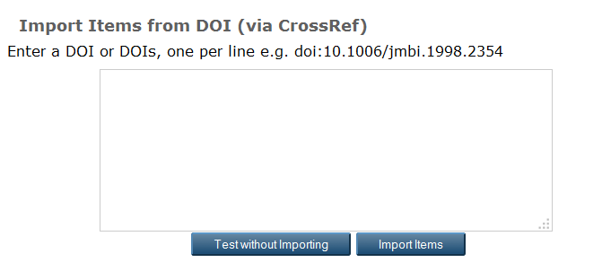
Depositing a research output using the DOI (Digital Object Identifier)
Ensure you are logged into CLoK (UCLan network username and password)
On the ‘manage deposits’ page select the dropdown box (Import from) and select ‘DOI (via crossRef)’ then proceed to select ‘Import’.
You can enter as many as 10 DOI’s at one time The details will be stored in your ‘manage deposits’ screen after you have entered them.
You can then enter the DOI(s) in the field provided using a separate line for each (if depositing more than one). Proceed by ‘importing items’.
This will import details about your output that your publisher has registered with the DOI.
Once you have imported the DOI(s) you will be directed to the ‘Edit Item’ screen where you must check that all the information is correct and where you can upload the relevant full text version of the works.
Click ‘Next’ to see how to upload a research output without the DOI and how to check if the imported DOI has the correct details.
10.1006/jmbi.1998.2354
10.1066/bmi.2010.3596
10.1089/amc.2014.3215
INNOVATIVE THINKING
FOR THE REAL WORLD
BACK
NEXT

Slide 5
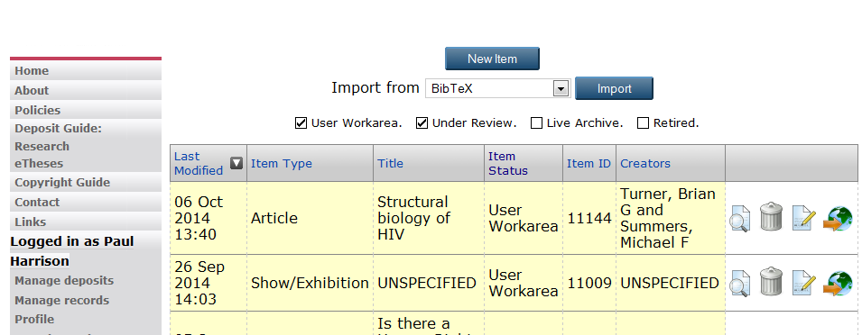
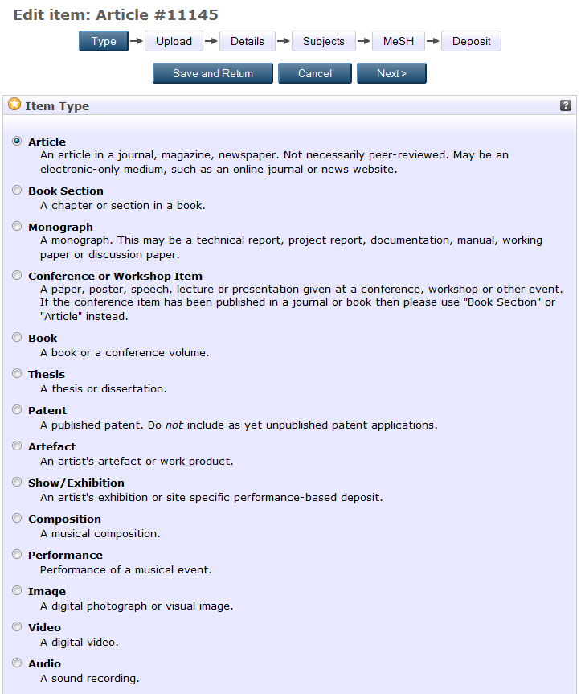
Depositing a Research Output Without a DOI
Ensure you are logged into CLoK (UCLan username and password)
On the ‘Manage deposits’ screen select ‘New Item’.
You will then be directed to the ‘Edit Item’ screen. Here you can choose the type of works you are depositing on CLoK. Select the relevant ‘Item type’ for your works and select ’Next’.
Each item type requires you to enter differing information in the proceeding screens. Please select your ‘Item Type’ from the red box to be directed to the relevant section of this guide.
If you are wanting to deposit an ‘Item Type’ which is not listed below then please contact clok@uclan.ac.uk for instructions.
Article
Book Section
Monograph
Conference/Workshop item
Book
Artefact
Show/Exhibition
Performance
Image
INNOVATIVE THINKING
FOR THE REAL WORLD
BACK

Slide 6
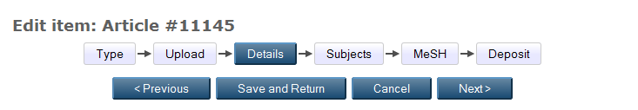
Depositing a Book Section
After selecting ‘Next’ on the CLoK deposit screen you will be directed to the ‘Upload’ screen. At this time it is best practice to upload documents after completing all the necessary details on the record. So, select ‘Next’ to proceed to the ‘Details’ Screen. (We will return to the upload screen later in the deposit process).
You can stop and save your progress at any time by selecting ‘Save and Return’. The record will be stored in your ‘Manage Deposits’ screen for when you are ready to return and complete the record.
The details screen brings up a form which requires completing. (Please note some fields are compulsory marked with a )
Title- The published title of the section of works you are depositing.
Abstract- The published abstract– usually found as part of the publication information.
Creators- Enter the author(s) of the works. Ensure that if the author(s) is a member of UCLan that you select their name from the Autofill suggestion that pops up once you start entering their name(s). This ensures that the email address is correct and that duplicate authors are not created on CLoK due to spelling mistakes and different initials being used.
Contributors- Anyone who has contributed to the works but are not classed as an author.
Schools- School in which the works was produced.
Research Clusters- Ignore this as it is being replaced in line with HEFCE Units of Assessment.
Archive- Not to be selected
NOTE
All the information needs to be completed where possible. If any field does not apply to your work or you cannot find the information on the publishers website then you can leave the field blank.
INNOVATIVE THINKING
FOR THE REAL WORLD
BACK
NEXT

Slide 7
Publication Details
Refereed- Has the works been through refereed? Yes/No.
Status- Current status of the works. Accepted, published etc...
Page Range- Range the works appears in the publication
Title of Book- That the section of your works was published in.
Volume- Volume of publication works appeared in.
Place of
Publication- Where the book was printed
Publisher- Company name in full– no abbreviations
Number
of Pages- Total pages in the book
Identification Any identification numbers associated with the Number- works
Series Name- Name of the series the book is in.
Number- Number of publication the works appeared in.
ISBN- International Standard Book Number
Date- Date of last action in the publishing process (always enter a date )
Date Type- What the last action was
Official URL- Publishers URL or DOI URL
Related URLs- Any other URLs linked with works.
Funders- Funders for the works
Projects- Projects completed by the works
Contact Email Address- To be used if an embargo is set on the
uploaded attachment
References- References of the works.
Uncontrolled Keywords- Listed in the publication details. Used for search criteria.
Additional Information- Information not completed in any previous boxes. (This shows on the CLoK record)
Comments and Suggestions- For repository staff (does not show on CLoK record)
Copyright Information- Any further details or queries with regards copyright. (does not show on the CLOK record
This work may be considered
for the REF- Ignore
I want this work to show on
my webpage- Ignore
INNOVATIVE THINKING
FOR THE REAL WORLD
BACK
NEXT

Slide 8
Depositing a Monograph
After selecting ‘Next’ you will be directed to the ‘Upload’ screen. At this time it is best practice to upload documents after completing all the necessary details on the record. Select ‘Next’ to proceed to the ‘Details’ Screen. (We will return to the upload screen later in the deposit process).
You can stop and save your progress at any time by selecting ‘Save and Return’. The record will be stored in your ‘Manage Deposits’ screen for when you are ready to return and complete the record.
The details screen brings up a form which requires completing. (Please note some fields are compulsory marked with a )
Title- The published title of the works you are depositing.
Abstract- The published abstract– usually found as part of the publication information.
Contents- Contents of the Monograph.
Monograph Type- Choose one.
Creators- Enter the author(s) of the works. Ensure that if the author(s) is a member of UCLan that you select their name form the Autofill suggestion that pops up once you start entering their name(s). This ensures that the email address is correct and that duplicate authors are not created on CLoK due to spelling mistakes and different initials being used.
Corporate Creators- Any companies/organisations involved in the creation of the works.
Editors- Editors of the works.
Contributors- Anyone who has contributed to the works but are not classed as an author.
Schools- School in which the works was produced by.
Research Clusters- Ignore this as it is being replaced in line with HEFCE Units of Assessment.
Archive- Not to be selected.
NOTE
All the information needs to be completed where possible. If any field does not apply to your work or you cannot find the information on the publishers website then you can leave the field blank.
INNOVATIVE THINKING
FOR THE REAL WORLD
BACK
NEXT

Slide 9
Publication Details
Status- Current status of the works. Accepted, published etc...
Institution- Institution works associated with.
Department- Department within the institution.
Place of
Publication- Where the book was printed.
Publisher- Company name in full– no abbreviations.
Identification
Number- Any identification numbers associated with the works.
Number.
of Pages- Total pages in the book
Date- Date of last action in the publishing process (always enter a date )
Date Type- What the last action was
Official URL- Publishers URL or DOI URL.
Related URLs- Any other URLs linked with works.
Funders- Funders for the works.
Projects- Projects completed by the works.
Contact Email Address- To be used if an embargo is set on the uploaded attachment.
References- References of the works.
Uncontrolled Keywords- Listed in the publication details. Used for search criteria.
Additional Information- Information not completed in any previous boxes. (This shows on the CLoK record).
Comments and Suggestions- For repository staff (does not show on CLoK record).
Copyright Information- Any further details or queries with regards copyright. (does not show on the CLOK record).
This work may be considered
for the REF- Ignore
I want this work to show on
my webpage- Ignore
INNOVATIVE THINKING
FOR THE REAL WORLD
BACK
NEXT

Slide 10
Depositing a Conference/Workshop Item
After selecting ‘Next’ you will be directed to the ‘Upload’ screen. At this time it is best practice to upload documents after completing all the necessary details on the record. Select ‘Next’ to proceed to the ‘Details’ Screen. (We will return to the upload screen later in the deposit process).
You can stop and save your progress at any time by selecting ‘Save and Return’. The record will be stored in your ‘Manage Deposits’ screen for when you are ready to return and complete the record.
The details screen brings up a form which requires completing. (Please note some fields are compulsory marked with a )
Title- The published title of the works you are depositing. Compulsory.
Abstract- The published abstract– usually found as part of the publication information.
Presentation Type- Choose one.
Creators- Enter the author(s) of the works. Ensure that if the author(s) is a member of UCLan that you select their name form the Autofill suggestion that pops up once you start entering their name(s). This ensures that the email address is correct and that duplicate authors are not created on CLoK due to spelling mistakes and different initials being used.
Corporate Creators- Any companies/organisations involved in the creation of the works.
Contributors- Anyone who has contributed to the works but are not classed as an author.
Schools- School in which the works was produced by.
Research Clusters- Ignore this as it is being replaced in line with HEFCE Units of Assessment.
Archive- Not to be selected.
NOTE
All the information needs to be completed where possible. If any field does not apply to your work or you cannot find the information on the publishers website then you can leave the field blank.
INNOVATIVE THINKING
FOR THE REAL WORLD
BACK
NEXT

Slide 11
Publication Details
Refereed- Has the works been through refereed? Yes/No.
Status- Current status of the works. Accepted, published etc...
Date- Date of last action in the publishing process (always enter a date).
Date Type- What the last action was
Page Range- Range the works appears in the publication.
Official URL- Publishers URL or DOI URL.
Related URLs- Any other URLs linked with works.
Funders- Funders for the works.
Projects- Projects completed by the works.
Event Details
Event Title- Title of the event.
Event Type- Choose one.
Event Location- City/Country.
Event Dates- Dates of the event.
Contact Email Address- To be used if an embargo is set on the uploaded attachment.
References- References of the works.
Uncontrolled Keywords- Listed in the publication details. Used for search criteria.
Additional Information- Information not completed in any previous boxes. (This shows on the CLoK record).
Comments and Suggestions- For repository staff (does not show on CLoK record).
Copyright Information- Any further details or queries with regards copyright. (does not show on the CLOK record).
This work may be considered
for the REF- Ignore
I want this work to show on
my webpage- Ignore
INNOVATIVE THINKING
FOR THE REAL WORLD
BACK
NEXT

Slide 12
Depositing an Article
(Journal, magazine, newspaper article. May not have been ‘peer reviewed’)
After selecting ‘Next’ you will be directed to the ‘Upload’ screen. At this time it is best practice to upload documents after completing all the necessary details on the record. Select ‘Next’ to proceed to the ‘Details’ Screen. (We will return to the upload screen later in the deposit process).
You can stop and save your progress at any time by selecting ‘Save and Return’. The record will be stored in your ‘Manage Deposits’ screen for when you are ready to return and complete the record.
The details screen brings up a form which requires completing. (Please note some fields are compulsory marked with a )
Title- The published title of the works you are depositing. Compulsory.
Abstract- The published abstract– usually found as part of the publication information.
Creators- Enter the author(s) of the works. Ensure that if the author(s) is a member of UCLan that you select their name form the Autofill suggestion that pops up once you start entering their name(s). This ensures that the email address is correct and that duplicate authors are not created on CLoK due to spelling mistakes and different initials being used.
Contributors- Anyone who has contributed to the works but are not classed as an author.
Schools- School in which the works was produced by.
Research Clusters- Ignore this as it is being replaced in line with HEFCE Units of Assessment.
.
Archive- Not to be selected.
NOTE
All the information needs to be completed where possible. If any field does not apply to your work or you cannot find the information on the publishers website then you can leave the field blank.
INNOVATIVE THINKING
FOR THE REAL WORLD
BACK
NEXT

Slide 13
Publication Details
Refereed- Has the works been through refereed? Yes/No.
Status- Current status of the works. Accepted, published etc...
Journal or
Publication Title-Title of the publication the works appeared in.
ISSN (Print)- International Standard Serial Number.
eISSN- Electronic International Standard Serial Number.
Publisher- Company name in full– no abbreviations.
Official URL- Publishers URL or DOI URL.
Volume- Volume of publication works appeared in.
Number- Number of publication the works appeared in.
Page Range- Range the works appears in the publication.
Date- Date of last action in the publishing process (always enter a date).
Date Type- What the last action was
Identification
Number- Digital Object Identifier.
Related URLs- Any other URLs linked with works.
Funders- Funders for the works.
Projects- Projects completed by the works.
Contact Email Address- To be used if an embargo is set on the uploaded attachment.
References- References of the works.
Uncontrolled Keywords- Listed in the publication details. Used for search criteria.
Additional Information- Information not completed in any previous boxes. (This shows on the CLoK record).
Comments and Suggestions- For repository staff (does not show on CLoK record).
Copyright Information- Any further details or queries with regards copyright. (does not show on the CLOK record.
This work may be considered
for the REF- Ignore
I want this work to show on
my webpage- Ignore
INNOVATIVE THINKING
FOR THE REAL WORLD
BACK
NEXT

Slide 14
Depositing a Book
After selecting ‘Next’ you will be directed to the ‘Upload’ screen. At this time it is best practice to upload documents after completing all the necessary details on the record. Select ‘Next’ to proceed to the ‘Details’ Screen. (We will return to the upload screen later in the deposit process).
You can stop and save your progress at any time by selecting ‘Save and Return’. The record will be stored in your ‘Manage Deposits’ screen for when you are ready to return and complete the record.
The details screen brings up a form which requires completing. (Please note some fields are compulsory marked with a )
Title- The published title of the works you are depositing.
Abstract- The published abstract– usually found as part of the publication information.
Contents- Contents of the book list chapters if you would like them to be searchable.
Creators- Enter the author(s) of the works. Ensure that if the author(s) is a member of UCLan that you select their name form the Autofill suggestion that pops up once you start entering their name(s). This ensures that the email address is correct and that duplicate authors are not created on CLoK due to spelling mistakes and different initials being used.
Corporate Creators- Any companies/organisations involved in the creation of the works.
Editors- Editors of the book.
Contributors- Anyone who has contributed to the works but are not classed as an author.
Schools- School in which the works was produced by.
Research Clusters- Ignore this as it is being replaced in line with HEFCE Units of Assessment.
Archive- Not to be selected.
NOTE
All the information needs to be completed where possible. If any field does not apply to your work or you cannot find the information on the publishers website then you can leave the field blank.
INNOVATIVE THINKING
FOR THE REAL WORLD
BACK
NEXT

Slide 15
Publication Details
Refereed- Has the works been through refereed? Yes/No.
Status- Current status of the works. Accepted, published etc...
Date- Date of last action in the publishing process (always enter a date)
Date Type- What the last action was
Place of .
Publication- Where the book was printed
Publisher- Company name in full– no abbreviations.
Number of Pages-Total pages in the book.
Series Name- Name of the series the book is in.
Volume- Volume of publication works appeared in.
Number- Number of publication works appeared in.
ISBN- International Standard Book Number .
Official URL- Publishers URL or DOI URL.
Related URLs- Any other URLs linked with works.
Contact Email Address- To be used if an embargo is set on the uploaded attachment.
References- References of the works.
Uncontrolled Keywords- Listed in the publication details. Used for search criteria.
Additional Information- Information not completed in any previous boxes. (This shows on the CLoK record).
Comments and Suggestions- For repository staff (does not show on CLoK record).
Copyright Information- Any further details or queries with regards copyright. (does not show on the CLOK record.
This work may be considered
for the REF- Ignore
I want this work to show on
my webpage- Ignore
INNOVATIVE THINKING
FOR THE REAL WORLD
BACK
NEXT

Slide 16
Depositing an Artefact
After selecting ‘Next’ you will be directed to the ‘Upload’ screen. At this time it is best practice to upload documents after completing all the necessary details on the record. Select ‘Next’ to proceed to the ‘Details’ Screen. (We will return to the upload screen later in the deposit process).
You can stop and save your progress at any time by selecting ‘Save and Return’. The record will be stored in your ‘Manage Deposits’ screen for when you are ready to return and complete the record.
The details screen brings up a form which requires completing. (Please note some fields are compulsory marked with a )
Title- The published title of the works you are depositing.
Abstract- The published abstract– usually found as part of the publication information.
Creators- Enter the author(s) of the works. Ensure that if the author(s) is a member of UCLan that you select their name form the Autofill suggestion that pops up once you start entering their name(s). This ensures that the email address is correct and that duplicate authors are not created on CLoK due to spelling mistakes and different initials being used.
Corporate Creators- Any companies/organisations involved in the creation of the works.
Contributors- Anyone who has contributed to the works but are not classed as an
author.
Schools- School in which the works was produced by.
Research Clusters- Ignore this as it is being replaced in line with HEFCE Units of Assessment.
Archive- Not to be selected.
NOTE
All the information needs to be completed where possible. If any field does not apply to your work or you cannot find the information on the publishers website then you can leave the field blank.
INNOVATIVE THINKING
FOR THE REAL WORLD
BACK
NEXT

Slide 17
Publication Details
Media of Output- Choose one.
Date- Date of last action in the publishing process (always enter a date)
Date Type- What the last action was
Official URL- Publishers URL or DOI URL.
Related URLs- Any other URLs linked with works.
Funders- Funders for the works.
Projects- Projects completed by the works.
Contact Email Address- To be used if an embargo is set on the uploaded attachment.
References- References of the works.
Uncontrolled Keywords- Listed in the publication details. Used for search criteria.
Additional Information- Information not completed in any previous boxes. (This shows on the CLoK record).
Comments and Suggestions- For repository staff (does not show on CLoK record).
Copyright Information- Any further details or queries with regards copyright. (does not show on the CLOK record.
This work may be considered
for the REF- Ignore
I want this work to show on
my webpage- Ignore
INNOVATIVE THINKING
FOR THE REAL WORLD
BACK
NEXT

Slide 18
Depositing a Show/Exhibition
After selecting ‘Next’ you will be directed to the ‘Upload’ screen. At this time it is best practice to upload documents after completing all the necessary details on the record. Select ‘Next’ to proceed to the ‘Details’ Screen. (We will return to the upload screen later in the deposit process).
You can stop and save your progress at any time by selecting ‘Save and Return’. The record will be stored in your ‘Manage Deposits’ screen for when you are ready to return and complete the record.
The details screen brings up a form which requires completing. (Please note some fields are compulsory marked with a )
Title- The published title of the works you are depositing.
Abstract- The published abstract– usually found as part of the publication information.
Creators- Enter the author(s) of the works. Ensure that if the author(s) is a member of UCLan that you select their name form the Autofill suggestion that pops up once you start entering their name(s). This ensures that the email address is correct and that duplicate authors are not created on CLoK due to spelling mistakes and different initials being used.
Corporate Creators- Any companies/organisations involved in the creation of the works.
Contributors- Anyone who has contributed to the works but are not classed as an author.
Exhibitors- Exhibitors of the works.
Number of Pieces-. How many pieces in the exhibit/show.
Schools- School in which the works was produced by.
Research Clusters- Ignore this as it is being replaced in line with HEFCE Units of Assessment.
Archive- Not to be selected.
NOTE
All the information needs to be completed where possible. If any field does not apply to your work or you cannot find the information on the publishers website then you can leave the field blank.
INNOVATIVE THINKING
FOR THE REAL WORLD
BACK
NEXT

Slide 19
Publication Details
Media of Output- Choose one.
ISBN- International Standard Book Number .
Date- Date of last action in the publishing process (always enter a date)
Date Type- What the last action was .
Official URL- Publishers URL or DOI URL.
Related URLs- Any other URLs linked with works.
Funders- Funders for the works.
Projects- Projects completed by the works.
Venue Details- Building name/street name/ any other details.
Event Title- Title of the event the performance was performed in.
Event Location- City/County.
Event Dates- Dates of the event.
Contact Email Address- To be used if an embargo is set on the uploaded attachment.
References- References of the works.
Uncontrolled Keywords- Listed in the publication details. Used for search criteria.
Additional Information- Information not completed in any previous boxes. (This shows on the CLoK record).
Comments and Suggestions- For repository staff (does not show on CLoK record).
Copyright Information- Any further details or queries with regards copyright. (does not show on the CLOK record.
This work may be considered
for the REF- Ignore
I want this work to show on
my webpage- Ignore
INNOVATIVE THINKING
FOR THE REAL WORLD
BACK
NEXT

Slide 20
Depositing a Performance
After selecting ‘Next’ you will be directed to the ‘Upload’ screen. At this time it is best practice to upload documents after completing all the necessary details on the record. Select ‘Next’ to proceed to the ‘Details’ Screen. (We will return to the upload screen later in the deposit process).
You can stop and save your progress at any time by selecting ‘Save and Return’. The record will be stored in your ‘Manage Deposits’ screen for when you are ready to return and complete the record.
The details screen brings up a form which requires completing. (Please note some fields are compulsory marked with a )
Title- The published title of the works you are depositing.
Abstract- The published abstract– usually found as part of the publication information.
Creators- Enter the author(s) of the works. Ensure that if the author(s) is a member of UCLan that you select their name form the Autofill suggestion that pops up once you start entering their name(s). This ensures that the email address is correct and that duplicate authors are not created on CLoK due to spelling mistakes and different initials being used.
Corporate Creators- Any companies/organisations involved in the creation of the works.
Contributors- Anyone who has contributed to the works but are not classed as an author.
Producers- Producers of the performance.
Conductors- Conductors of the performance.
Accompaniment- anyone else involved in the performance. E.g. orchestra/musician.
Schools- School in which the works was produced by.
Research Clusters- Ignore this as it is being replaced in line with HEFCE Units of Assessment.
Archive- Not to be selected.
NOTE
All the information needs to be completed where possible. If any field does not apply to your work or you cannot find the information on the publishers website then you can leave the field blank.
INNOVATIVE THINKING
FOR THE REAL WORLD
BACK
NEXT

Slide 21
Publication Details
Status- Current status of the works. Accepted, published etc...
Media of Output- Choose one.
Publisher- Company name in full– no abbreviations.
Date- Date of last action in the publishing process (always enter a date)
Date Type- What the last action was
Official URL- Publishers URL or DOI URL.
Related URLs- Any other URLs linked with works.
Funders- Funders for the works.
Projects- Projects completed by the works.
Venue Details- Building name/street name/ any other details.
Event Title- Title of the event the performance was performed in.
Event Location- City/County.
Event Dates- Dates of the event.
Contact Email Address- To be used if an embargo is set on the uploaded attachment.
References- References of the works.
Uncontrolled Keywords- Listed in the publication details. Used for search criteria.
Additional Information- Information not completed in any previous boxes. (This shows on the CLoK record).
Comments and Suggestions- For repository staff (does not show on CLoK record).
Copyright Information- Any further details or queries with regards copyright. (does not show on the CLOK record.
This work may be considered
for the REF- Ignore
I want this work to show on
my webpage- Ignore
INNOVATIVE THINKING
FOR THE REAL WORLD
BACK
NEXT

Slide 22
Depositing an Image
After selecting ‘Next’ you will be directed to the ‘Upload’ screen. At this time it is best practice to upload documents after completing all the necessary details on the record. Select ‘Next’ to proceed to the ‘Details’ Screen. (We will return to the upload screen later in the deposit process).
You can stop and save your progress at any time by selecting ‘Save and Return’. The record will be stored in your ‘Manage Deposits’ screen for when you are ready to return and complete the record.
The details screen brings up a form which requires completing. (Please note some fields are compulsory marked with a )
Title- The published title of the works you are depositing.
Abstract- The published abstract– usually found as part of the publication information.
Creators- Enter the author(s) of the works. Ensure that if the author(s) is a member of UCLan that you select their name form the Autofill suggestion that pops up once you start entering their name(s). This ensures that the email address is correct and that duplicate authors are not created on CLoK due to spelling mistakes and different initials being used.
Corporate Creators- Any companies/organisations involved in the creation of the works.
Contributors- Anyone who has contributed to the works but are not classed as an author.
Schools- School in which the works was produced by.
Research Clusters- Ignore this as it is being replaced in line with HEFCE Units of Assessment.
Archive- Not to be selected.
NOTE
All the information needs to be completed where possible. If any field does not apply to your work or you cannot find the information on the publishers website then you can leave the field blank.
INNOVATIVE THINKING
FOR THE REAL WORLD
BACK
NEXT

Slide 23
Publication Details
Status- Current status of the works. Accepted, published etc...
Media of Output- Choose one.
Publisher- Company name in full– no abbreviations.
Date- Date of last action in the publishing process (always enter a date)
Date Type- What the last action was
Official URL- Publishers URL or DOI URL.
Related URLs- Any other URLs linked with works.
Funders- Funders for the works.
Projects- Projects completed by the works.
Contact Email Address-To be used if an embargo is set on the uploaded attachment.
References- References of the works.
Uncontrolled Keywords- Listed in the publication details. Used for search criteria.
Additional Information- Information not completed in any previous boxes. (This shows on the CLoK record).
Comments and Suggestions- For repository staff (does not show on CLoK record).
Copyright Information- Any further details or queries with regards copyright. (does not show on the CLOK record.
This work may be considered
for the REF- Ignore
I want this work to show on
my webpage- Ignore
INNOVATIVE THINKING
FOR THE REAL WORLD
BACK
NEXT

Slide 24
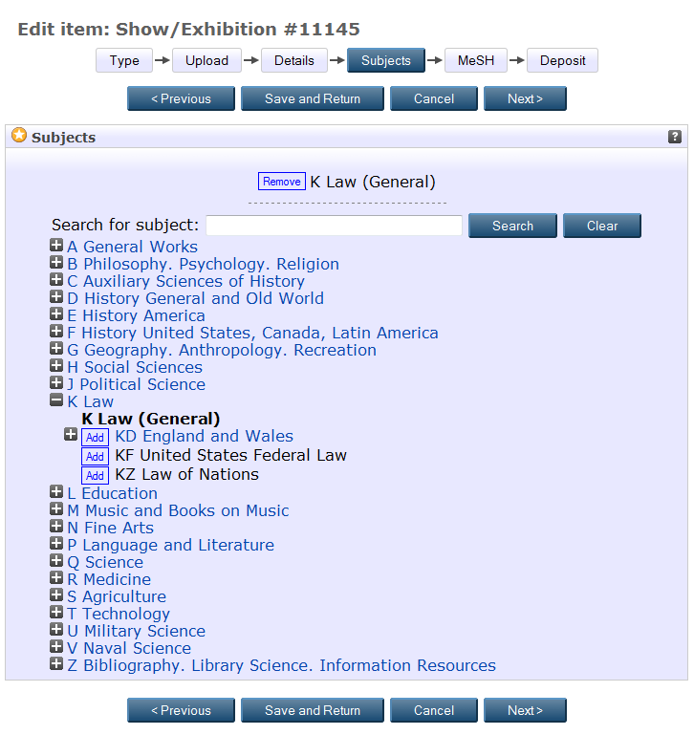
Depositing a Research Output (Subjects Screen)
After selecting ‘Next’ on the ‘Details’ screen you will proceed to the Subjects’ screen. Here you need to select the relevant subject for the works you have deposited.
INNOVATIVE THINKING
FOR THE REAL WORLD
BACK
NEXT

Slide 25
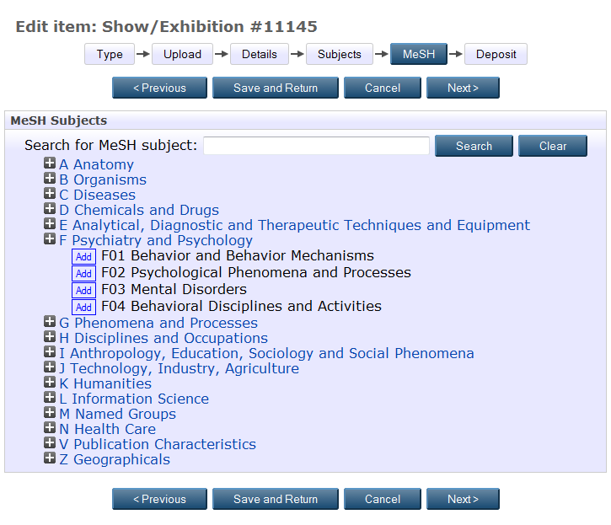
Depositing a Research Output (MeSH screen)
MeSH (Medical Subject Heading). Only complete this section if your works are medical related, by selecting the appropriate heading then clicking ‘Next’.
If your works is not medical related please just click ‘Next’.
INNOVATIVE THINKING
FOR THE REAL WORLD
BACK
NEXT

Slide 26
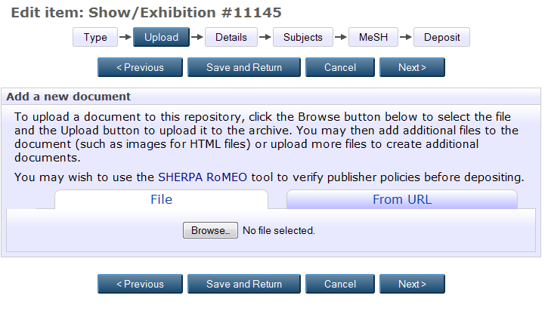
Depositing a Research Output (Upload Screen)
Once you have navigated back to the ‘Upload’ screen you can now upload a version of the works you have just completed the metadata for.
Possible versions/files to upload (Please ensure PDF files are uploaded only):
  Authors Pre-Print (version before the works has been refereed). Usually you allowed to upload this version on to CLoK without any embargos or restrictions. (Check Sherpa/Romeo).
  Authors Post-Print - Also known as Author’s Accepted Manuscript (version after it has been refereed, but before it has been typeset by the publisher). Please upload this copy in every instance and the CLoK administrators will check copyright before making the record live.
  Published Version/PDF– The copy the publisher has sent you or the downloaded version from the publishers website. Use Sherpa/Romeo to check if copyright permits the upload of this version before doing so.
Click ‘Browse’ and select the relevant PDF you wish to upload
Once the PDF is uploaded select ‘Show Options‘ (right of the uploaded PDF) and complete the fields.
Content– Select the version of the PDF you have uploaded.
Type- The file type you have uploaded. This is usually ‘PDF’ but for some images/graphics/videos this may be different.
Description– A short brief description of what you have uploaded. For instance ‘12345_Harrison’ (Record number and author surname).
Visible to– Depending on the copyright you can choose for the article to be available to anyone who accesses CLoK (Anyone), UCLan staff and students only (Registered Users) or Repository staff (this option will hide the uploaded file on the website)
License– If the publication comes with a Creative Commons license please choose the relevant one.
Embargo expiry date– If a publication has an embargo with it please select the embargo expiry date then set the ‘Visible to’ field to repository staff only.
Once the relevant fields have been completed select ‘Update Metadata’ and then navigate to the ‘Deposit’ screen.
INNOVATIVE THINKING
FOR THE REAL WORLD
BACK
NEXT

Slide 27
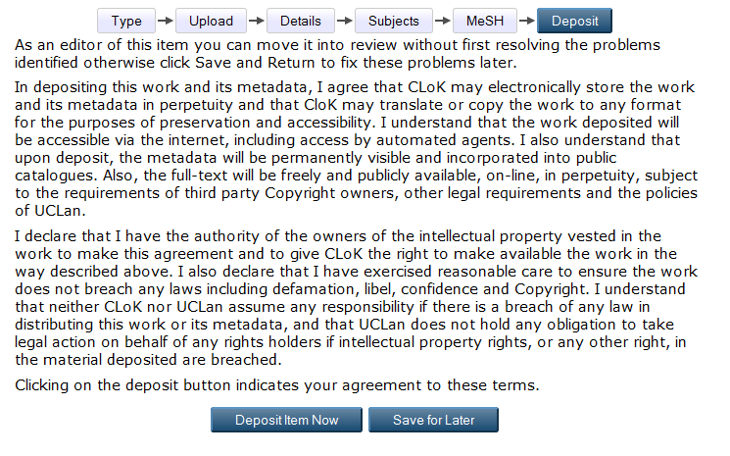
Depositing a Research Output (Deposit Screen)
Once you are happy with your submission select ‘Deposit item now’.
Your research output will not go live onto the CLoK website until it has been verified by the administrators. If there are any errors the record will be returned to your ‘Manage deposits’ screen and you will be notified what you need to do via email.
INNOVATIVE THINKING
FOR THE REAL WORLD
BACK
NEXT

Slide 28
ANY QUESTIONS?
CONTACT CLoK
Press Escape to exit guide
INNOVATIVE THINKING
FOR THE REAL WORLD

