Slide 1
Edge of darkness
Exhibition of photographs by Ian Beesley
1st March to 16th April 2017
Bradford Cathedral

Slide 3
The edge of darkness
In 1876 John Ruskin observed that the whole system of climate had
been changed by industrial activity and that mankind would never ever
witness the sunsets that he and Turner had witnessed in the early 1800s.
Twilight has been particularly effected by pollution.
This exhibition follows the three stages of twilight,
civil twilight, light still visible in the sky, street lights come on,
nautical twilight, dimming light and traditionally the time when sailors
begin to navigate by the stars,
astronomical twilight, stars are clearly visible.
We travel from the east coast to the west coast.
and as darkness descends, to reflect the way our eyes adjust to the dimming light,
the images change from colour to black and white

Slide 4
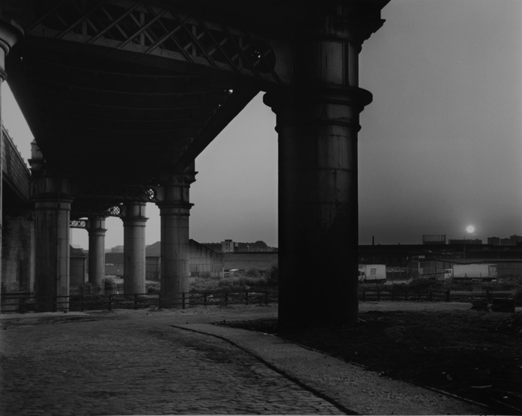
Castlefield viaduct
The edge of darkness creeps
Towards the ledge of light
And tomorrow morning seeps
Across the floor of night.

Slide 5
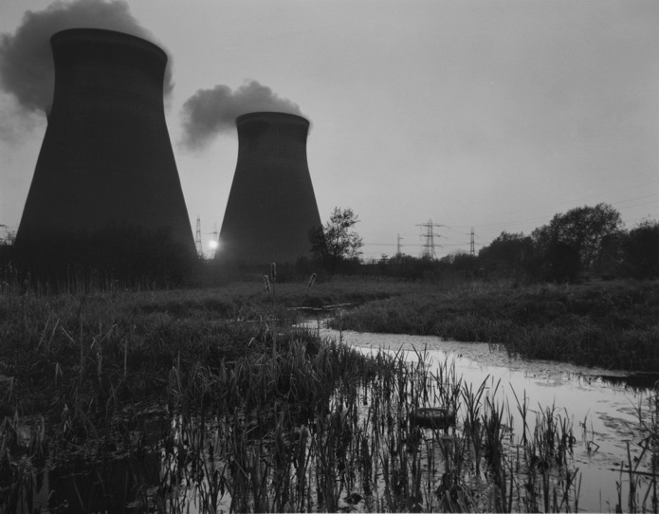
Ferrybridge
power station

Slide 6
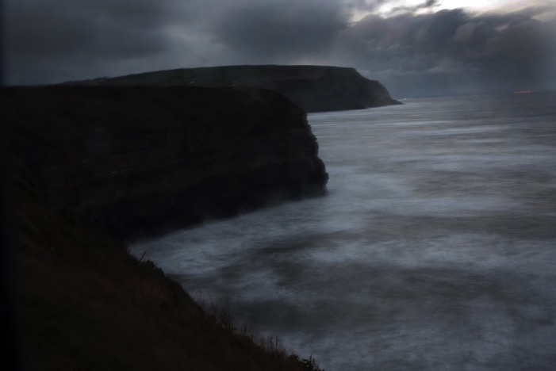
This is the sunrise Ruskin never saw.
This is the sunset Turner never painted.
They saw something fiercer, more like
A parrot landing on the sea
With its wings on fire.
Cliffs at Staithes

Slide 7
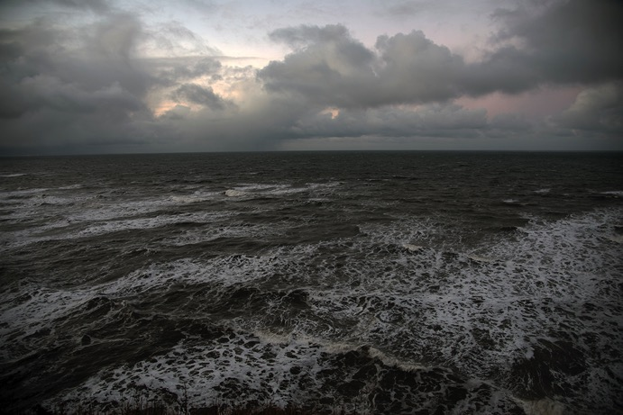
The North sea

Slide 8
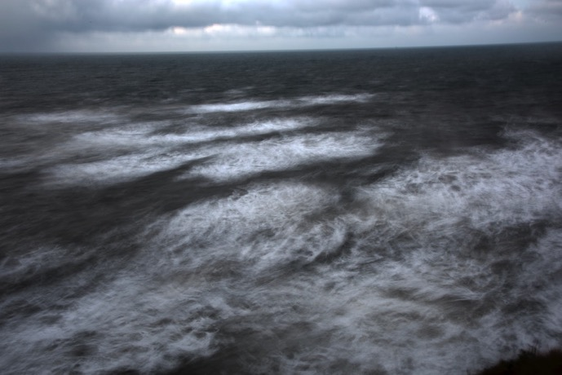
The North sea

Slide 9
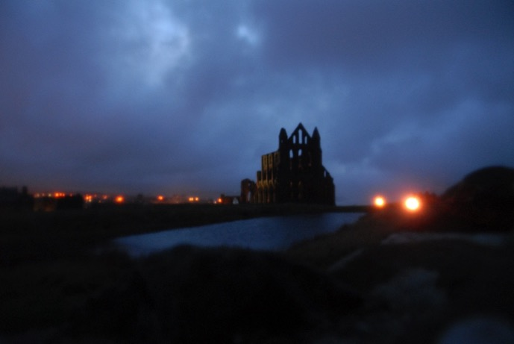
Whitby Abbey

Slide 10
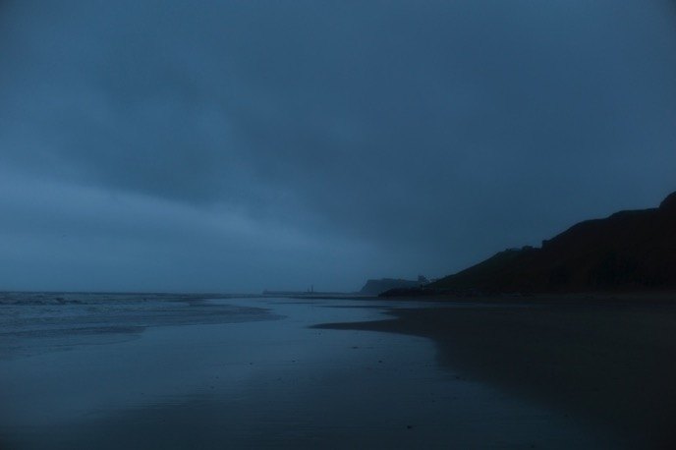
Sandsend

Slide 11
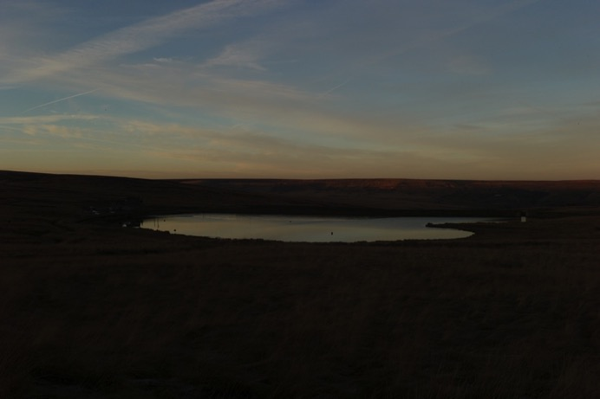
Marsden moor

Slide 12
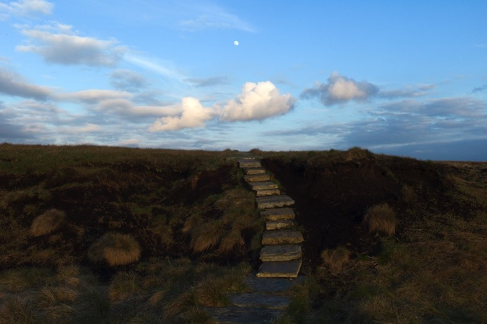
Moonrise Saddleworth moor

Slide 13
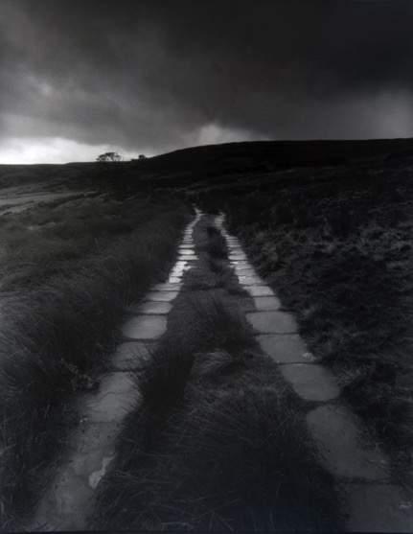
Haworth moors

Slide 14
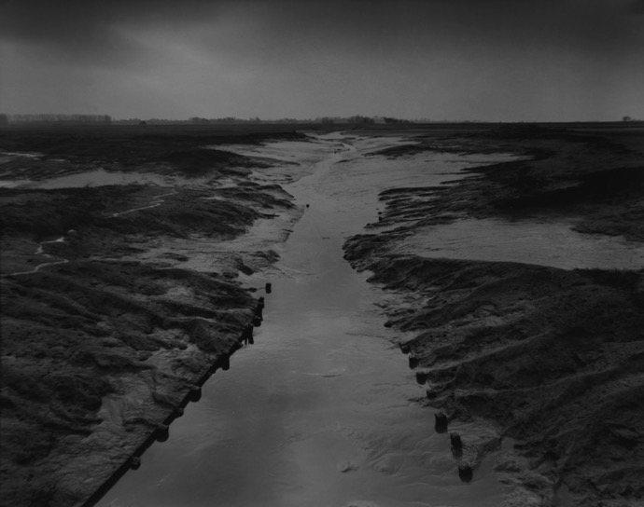
River Ribble

Slide 15
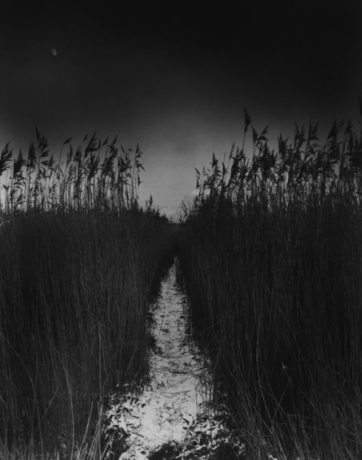
Moonrise
Blacktoft sands

Slide 16
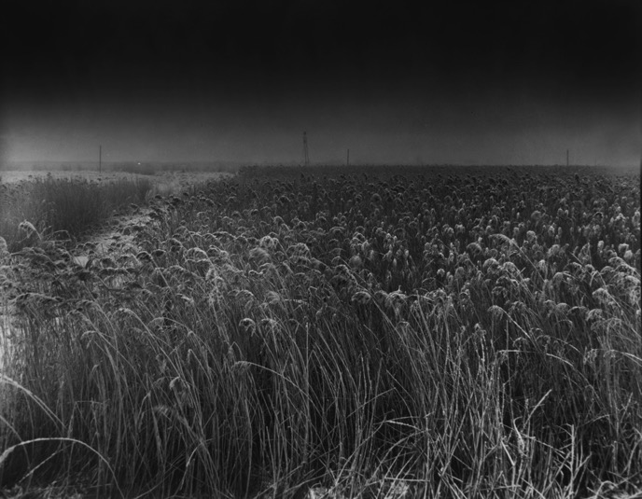
Goole fields

Slide 17
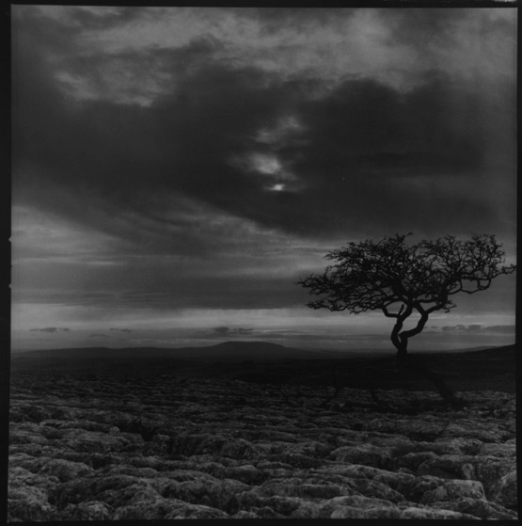
Clint & grykes

Slide 18
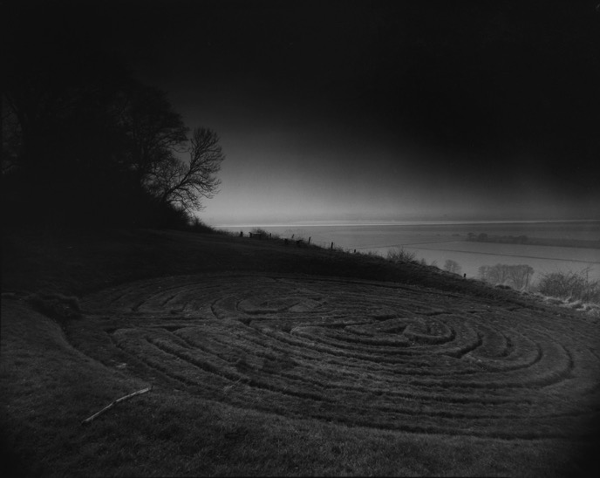
Julian’s bower

Slide 19
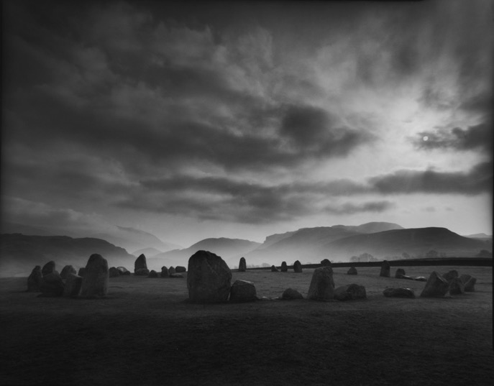
Castlerigg
stone circle

Slide 20
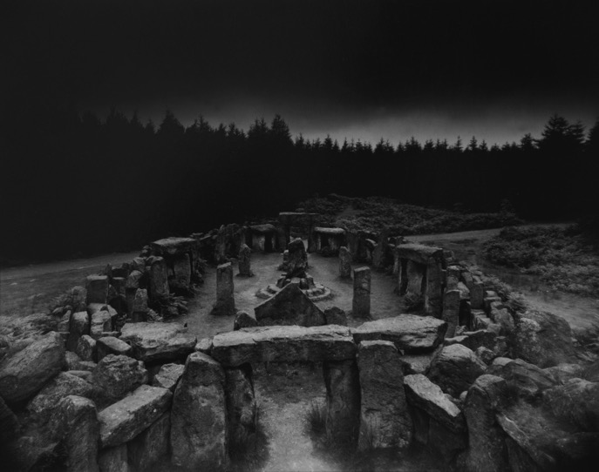
Druids wood
Nr Masham

Slide 21
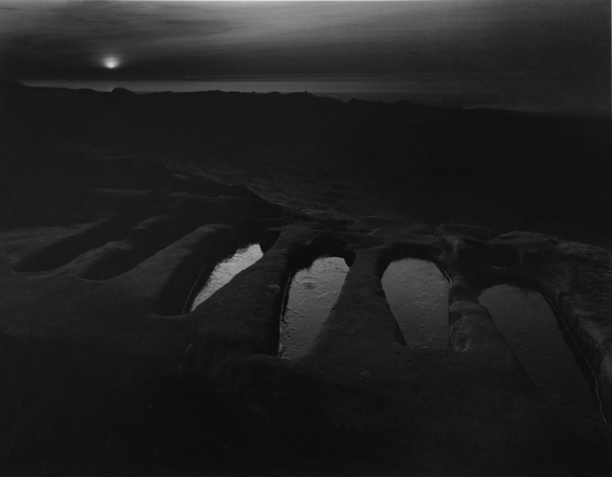
Half-moon bay
Heysham head

Slide 22
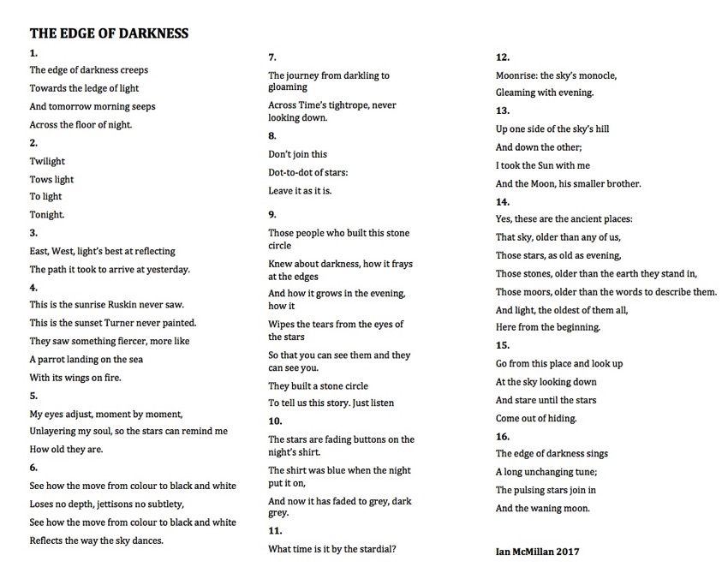

Slide 23
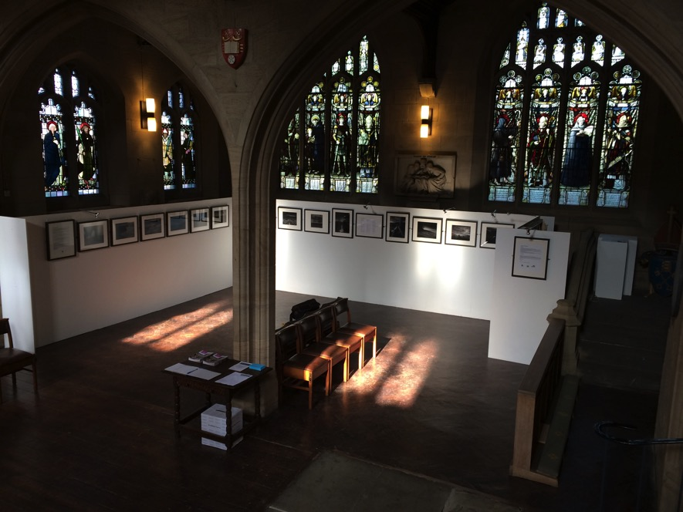

Slide 24
