Slide 1
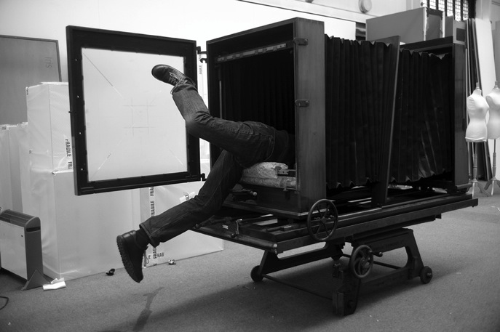

Ian Beesley reader practitioner in visual representation

Slide 2
The big big camera
The big big camera manufactured by the company of Hunter Penrose of London
somewhere around 1920, has been in the collections of Gallery Oldham
since it was retrieved from Rome Mill in Springhead in 1990,where it had been used
in the printing of wallpaper.
These cameras were made specifically for the printing industry and consequently
once installed were probably never moved again.
As the artist in residence for Gallery Oldham, I spent a couple of months getting
the camera to work and then took it out on location photographing the local area.

Slide 3
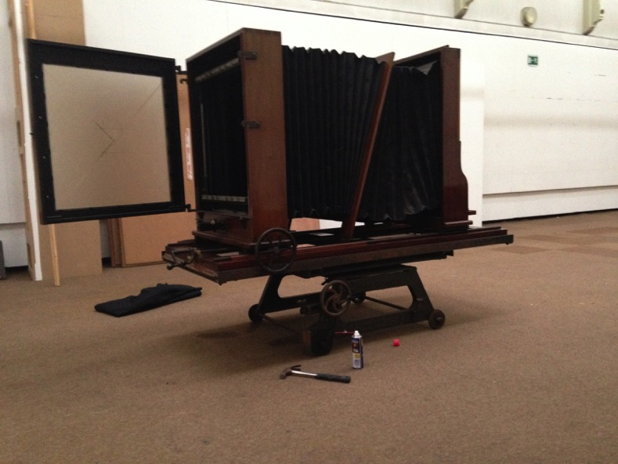
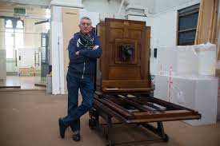

Slide 4
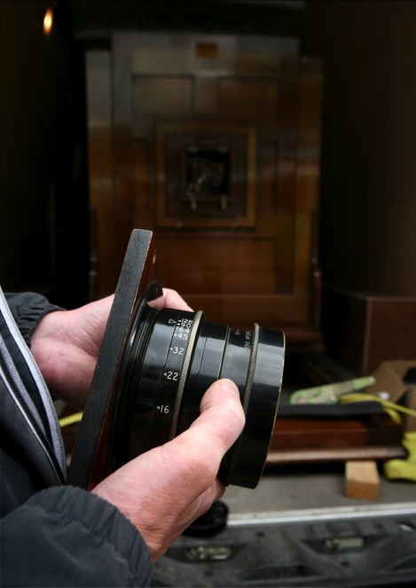

Slide 5
The process
This work involved specialist restoration of the lens as well as a good deal of cleaning.
Most importantly I had to overcome the challenges of using a camera that was
designed for huge negatives 24 inches by 24 inches square.
The film plates for this camera no longer available, so I adapted two different
photographic techniques to produce images.
Using conventional film I adapted the camera to take twenty sheets of 5”x4” film in a
grid of five across and four down.
All the plates will be exposed at the same time to produce a giant “joiner” photograph.
Exposures are tricky, the camera has
no shutter so the film is exposed by removing the lens cap for the required
number of seconds or in some cases minutes.

Slide 6
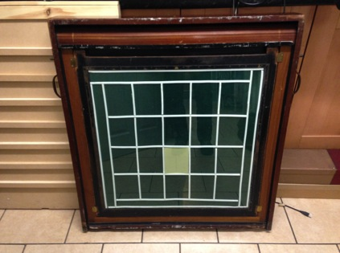

Slide 7
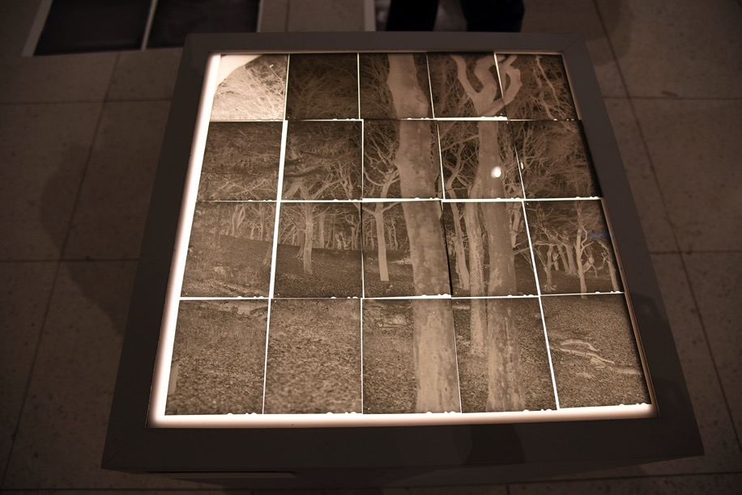

Slide 8
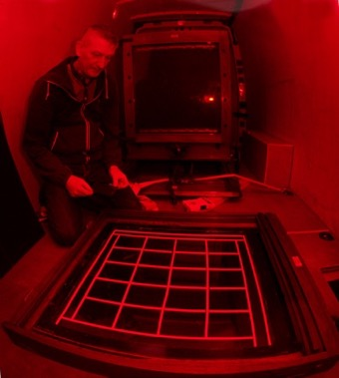
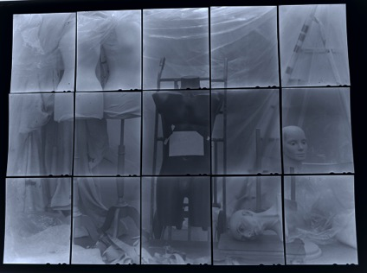

Slide 9
Everything in the process is done by hand, from the loading of the film to the
developing and printing of the images, to create each of these
large joiner images it takes at least one day.

Slide 10
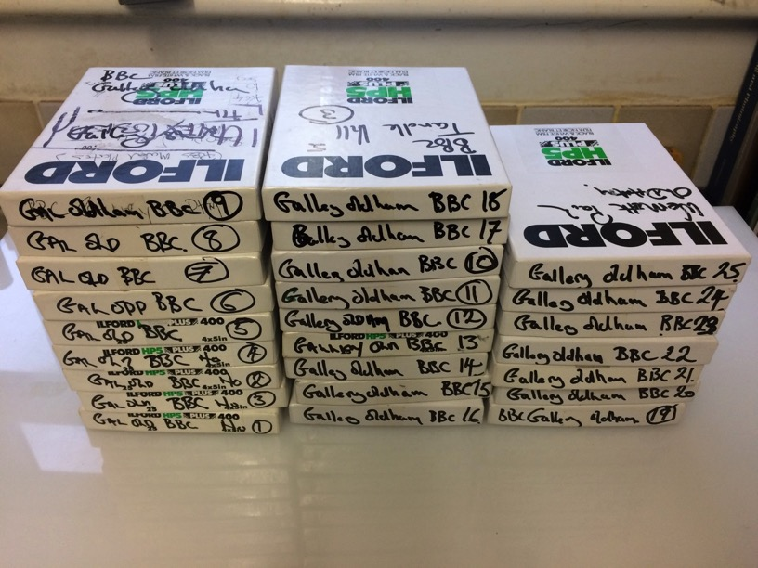

Slide 11
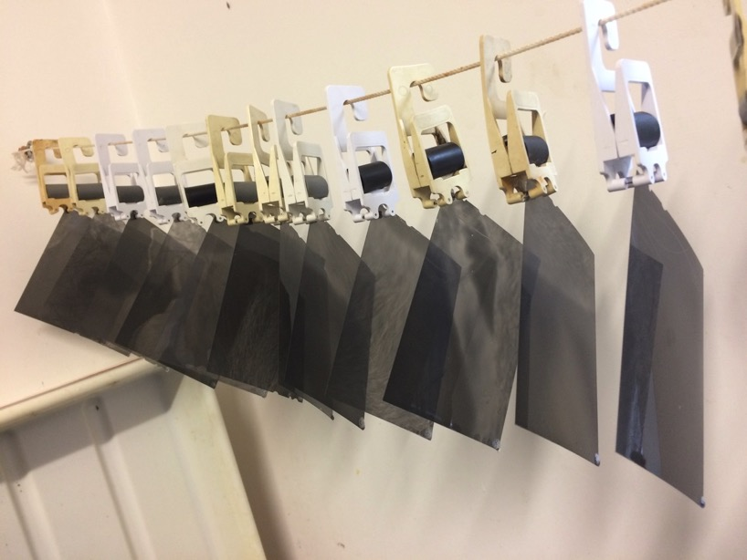

Slide 12
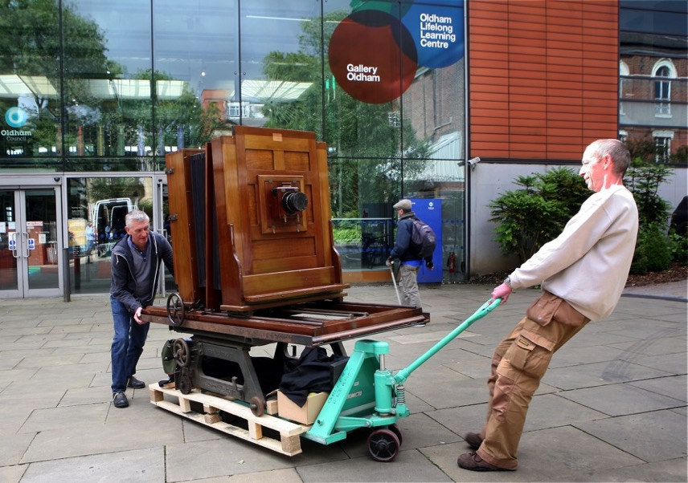

Slide 13
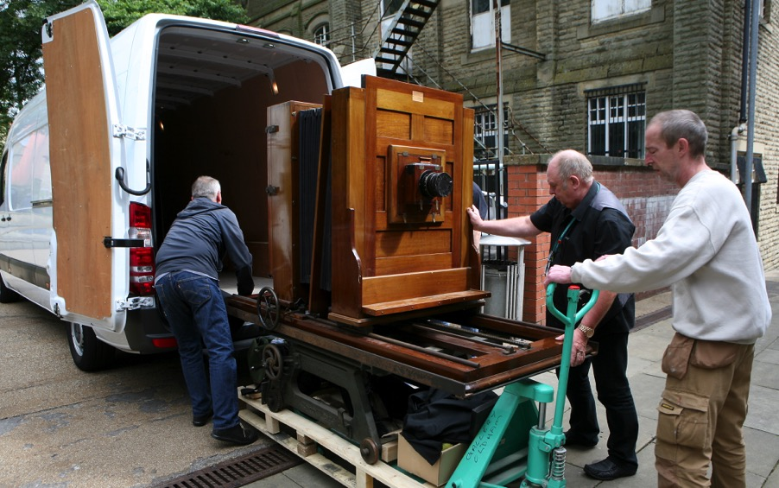

Slide 14
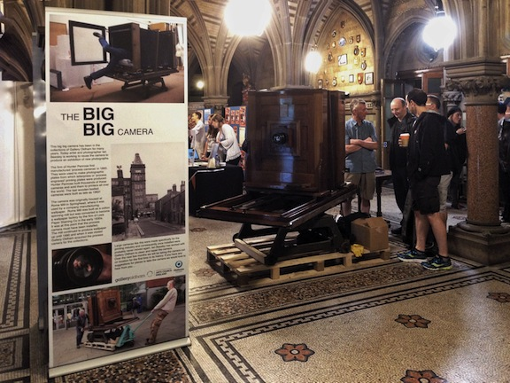

Slide 15
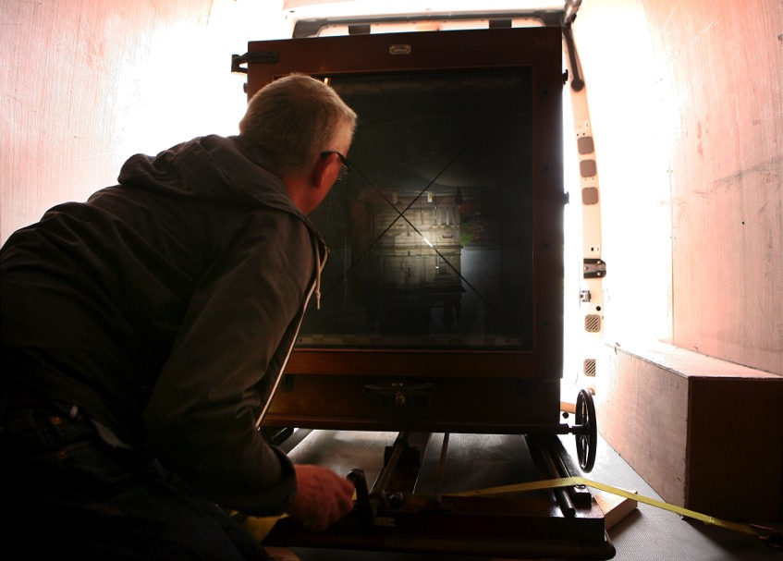

Slide 16
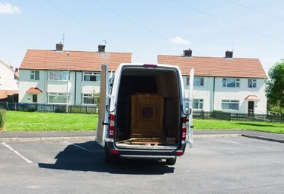
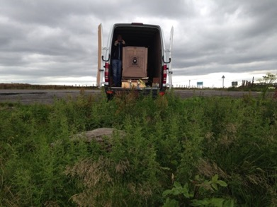

Slide 17
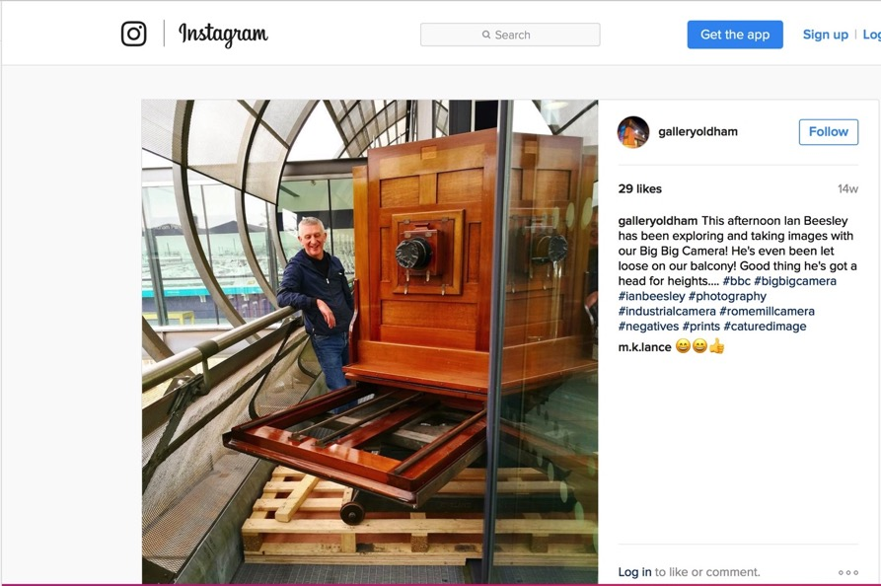

Slide 18
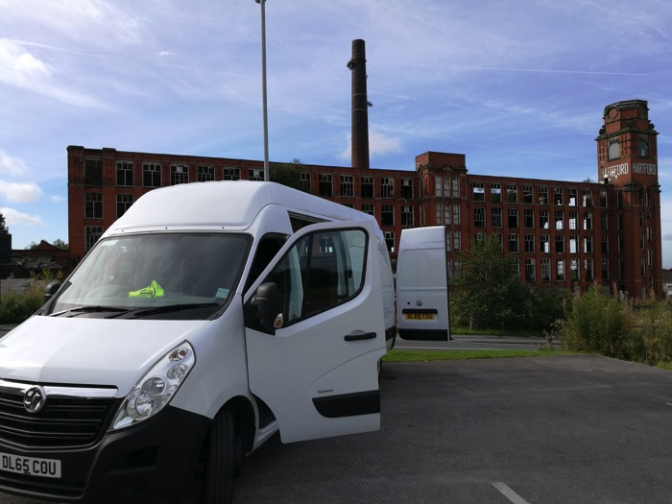

Slide 19
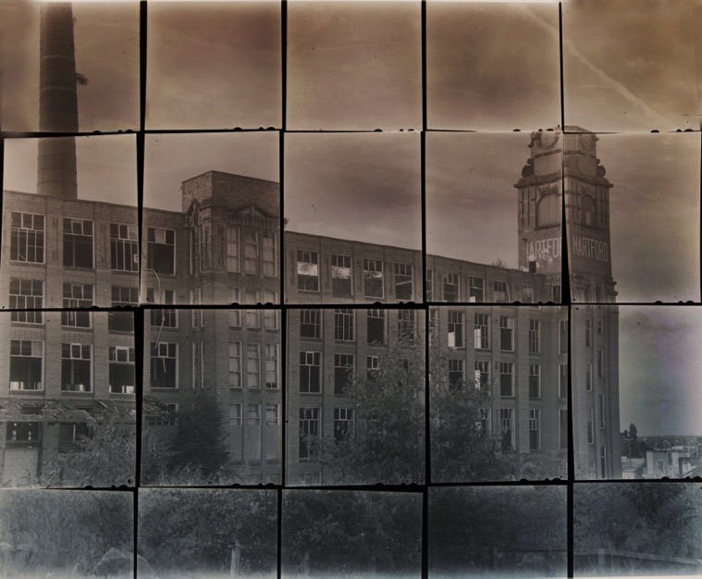

Slide 22
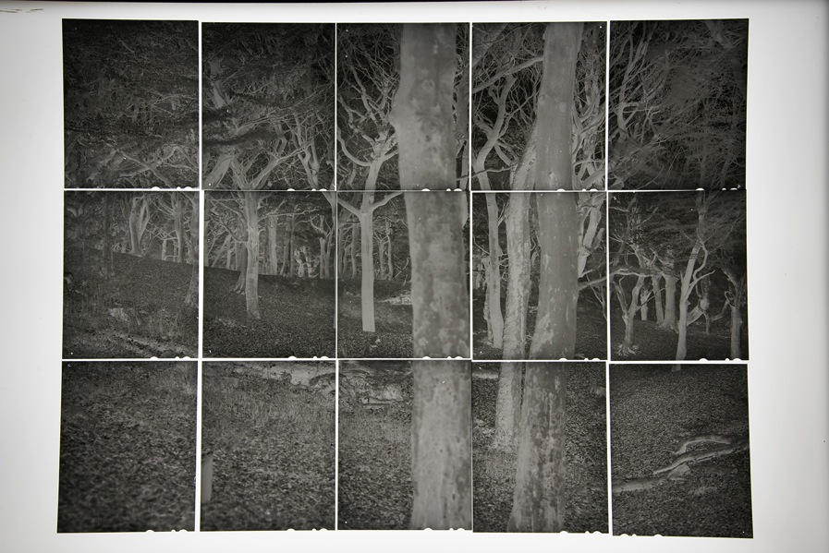

Slide 23
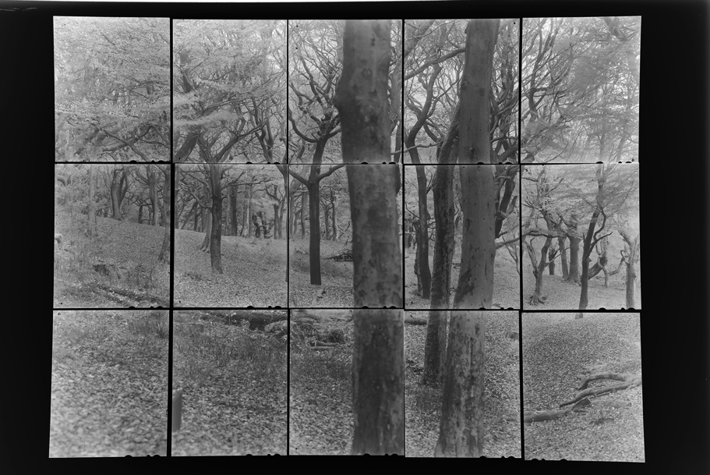

Slide 24
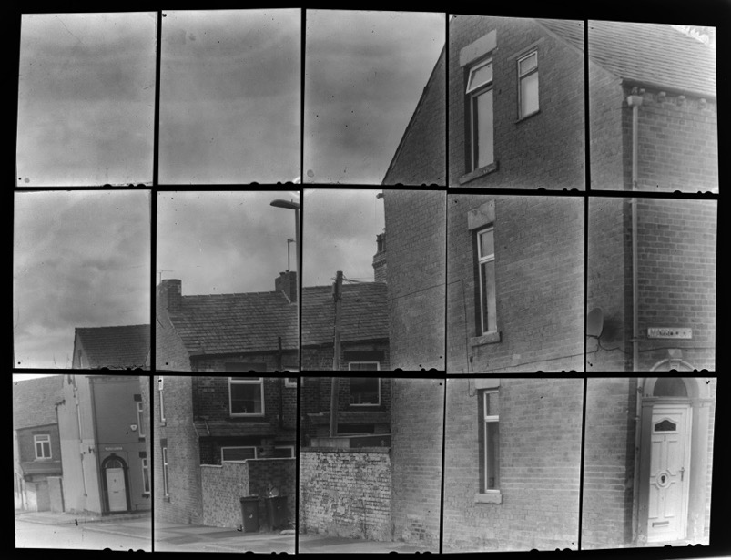

Slide 26
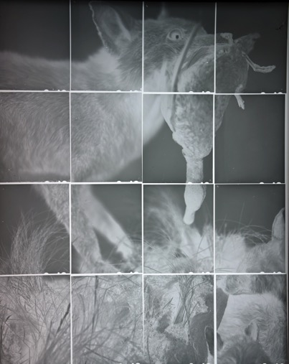

Slide 28
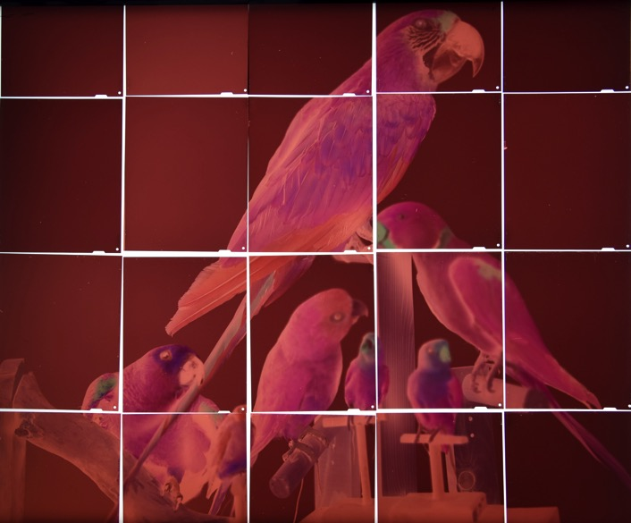

Slide 29
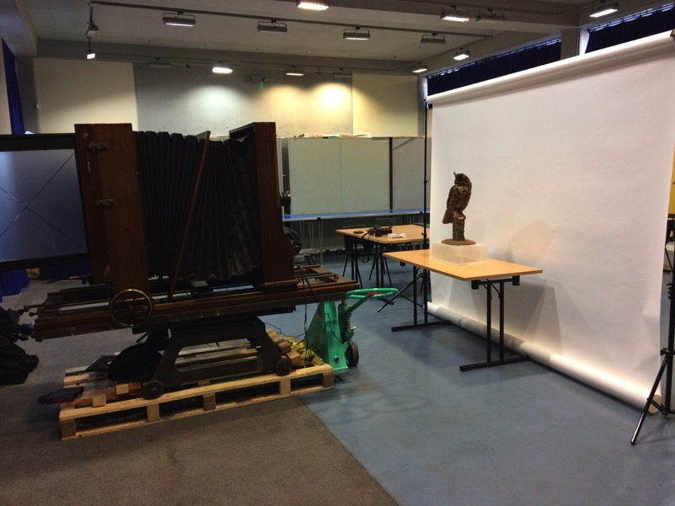

Slide 30
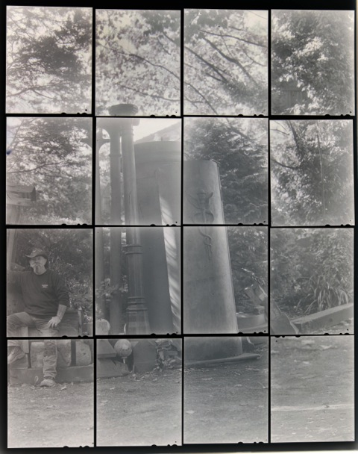

Slide 31
The second technique employed was the creation of paper negatives.
Photographic printing paper was loaded into the camera and exposed as if it was film.
Photographic printing paper though available in large sizes
it is much slower to react to light than film, exposure times of 45 to 90 seconds are not usual.
The images produced do not have the definition or sharpness of film,
but possess the appearance of photographs similar to the very earliest
photographs produced in the 1830/40s.

Slide 32


Slide 33
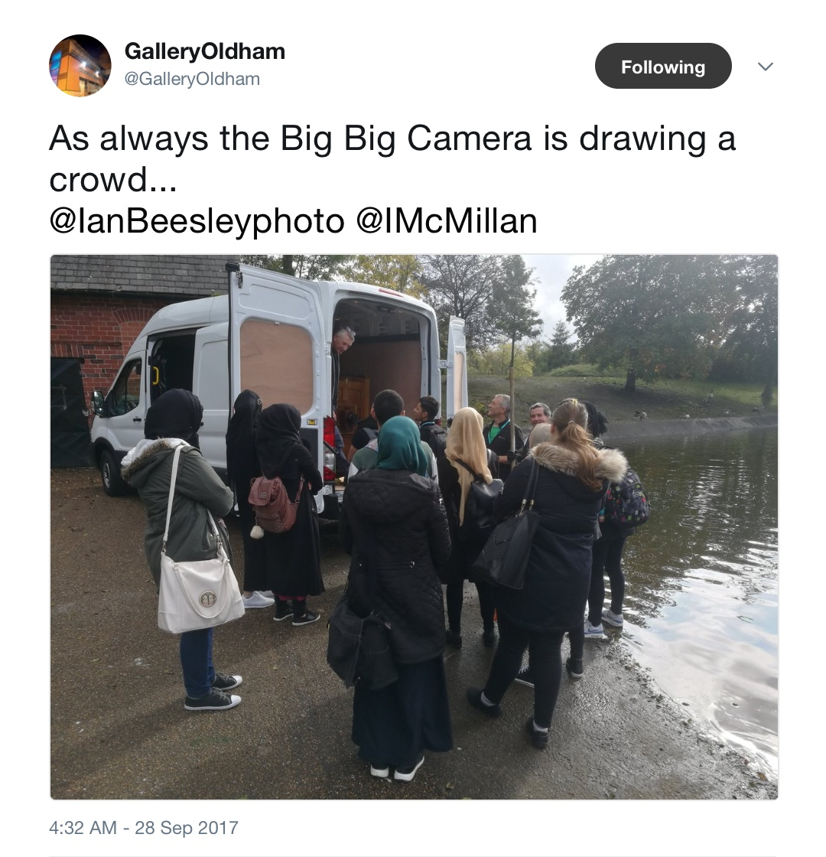

Slide 34
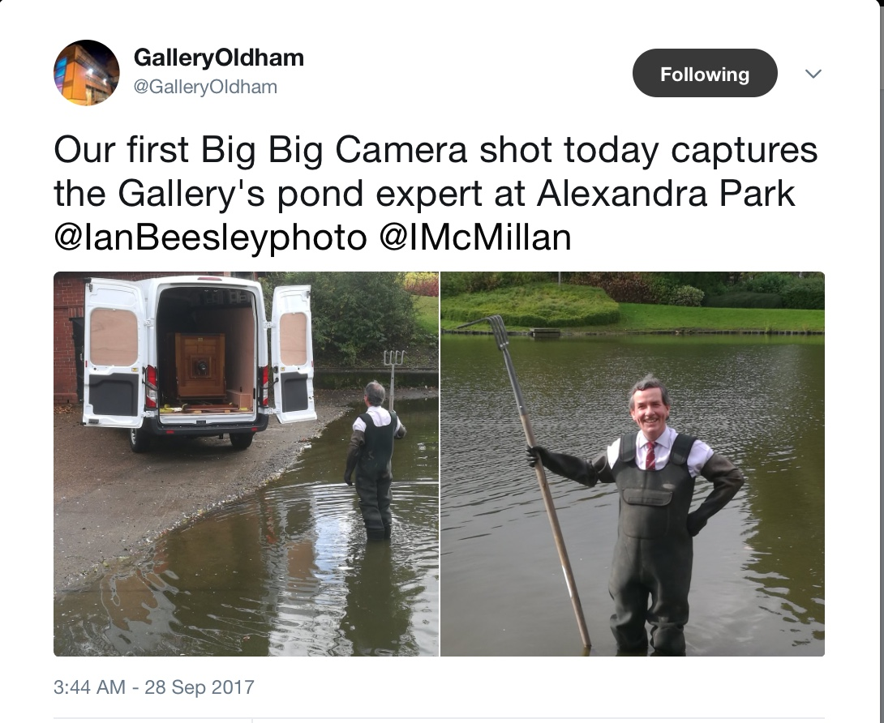

Slide 35
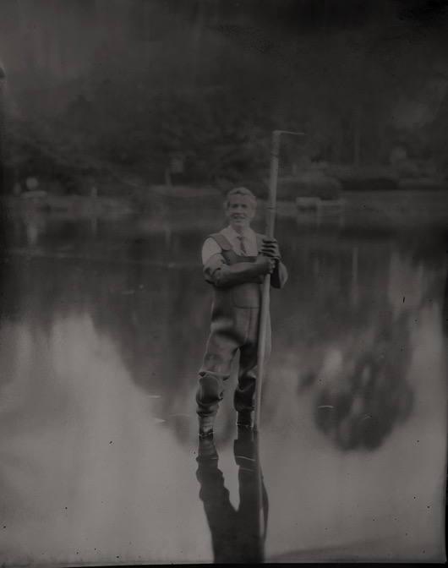

Slide 36
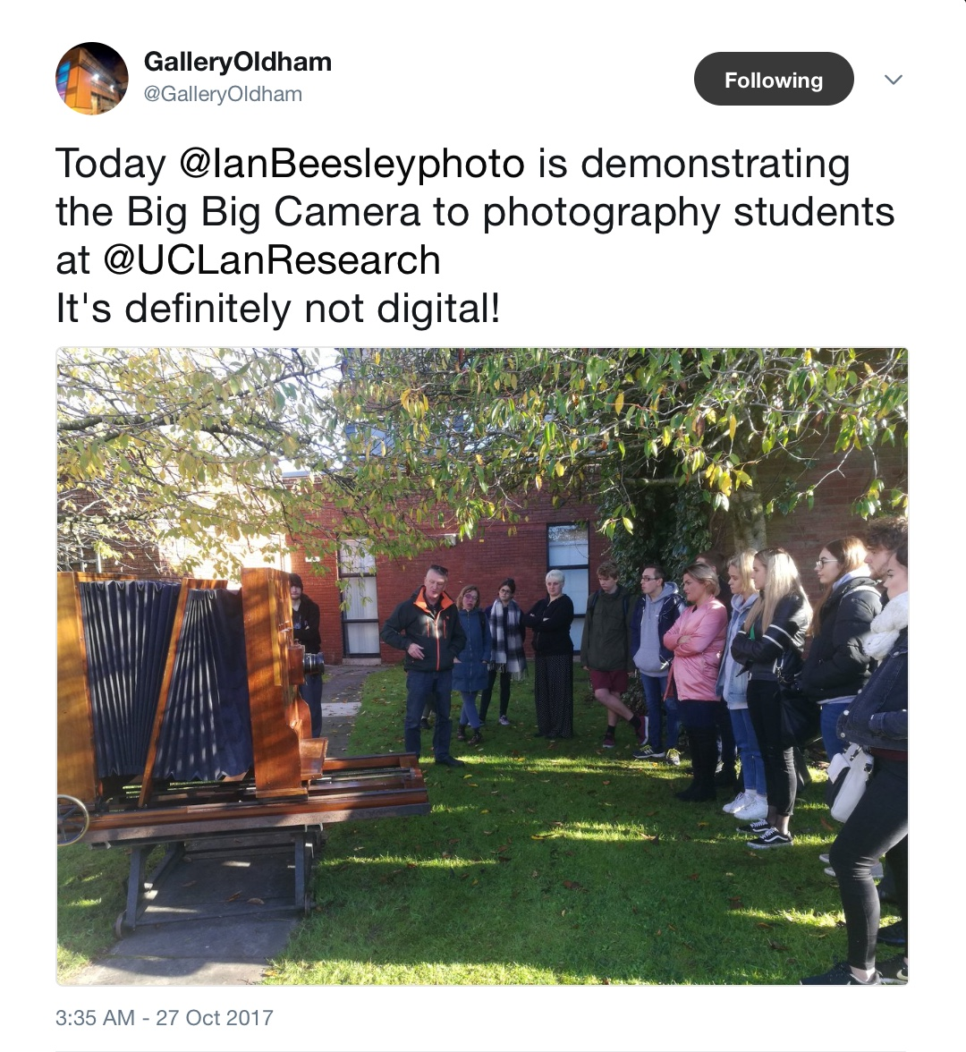

Slide 37
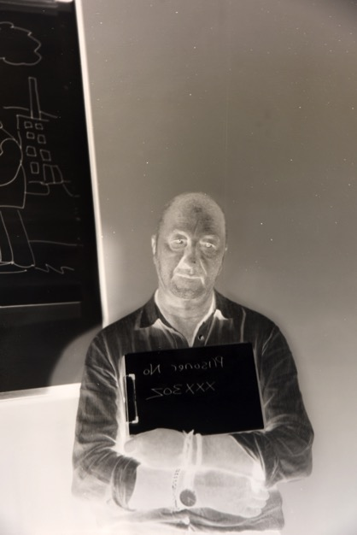

Slide 38
The exhibition
This exhibition explores and contemporises some of the aspects of photography that
are now being lost in the digital age,
from the sheer physicality of the equipment, to the delicate relationship with light
and the uncertainty of a successful the creation of a unique photographic image,
this is photography in its purest but most demanding form.

Slide 39
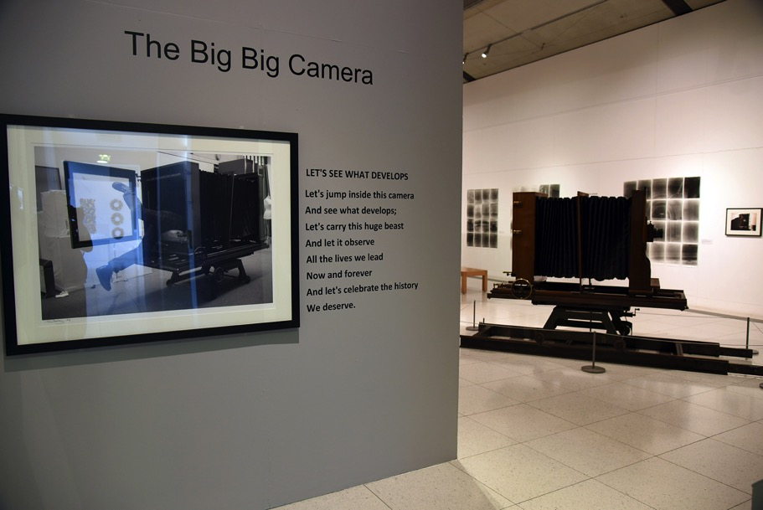

Slide 40
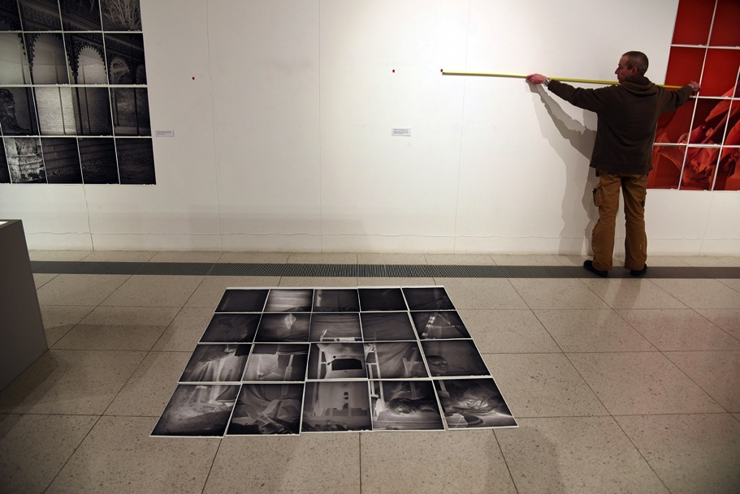

Slide 41
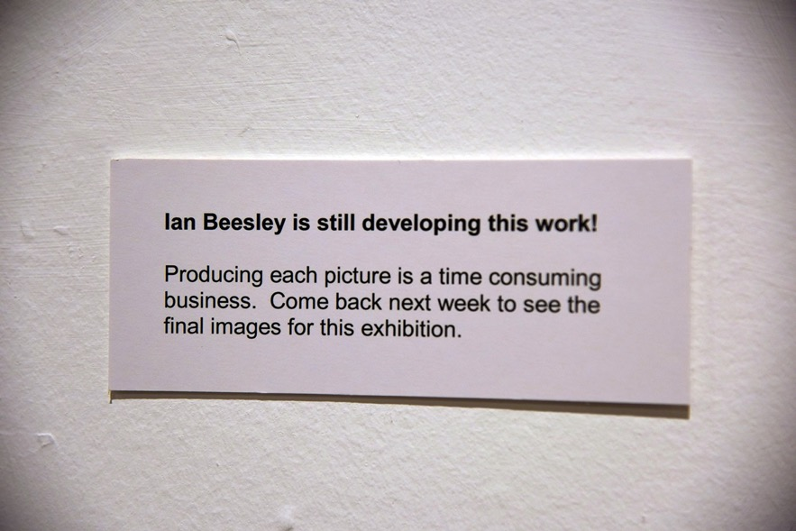

Slide 42
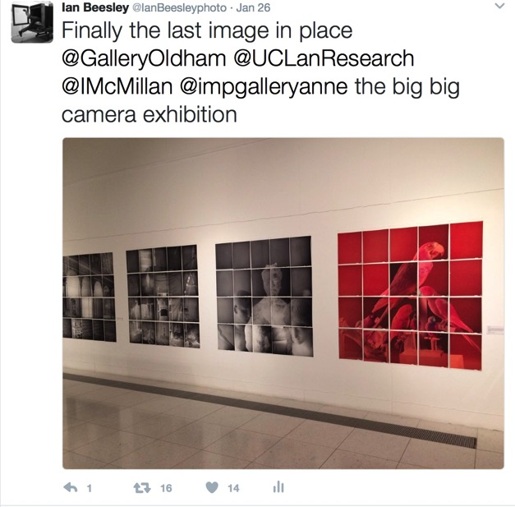

Slide 43
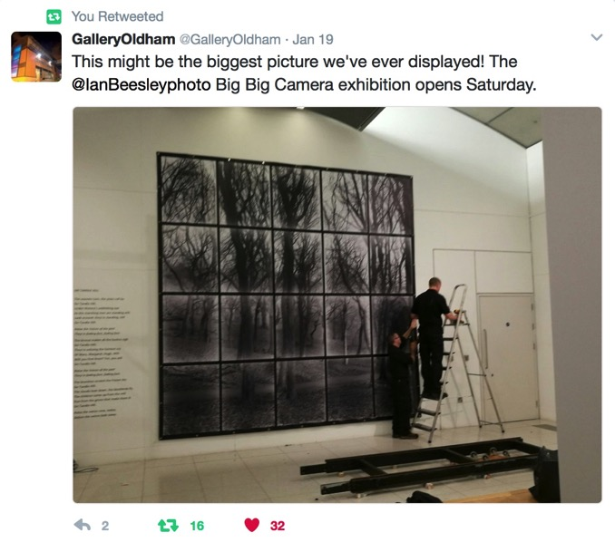

Slide 44
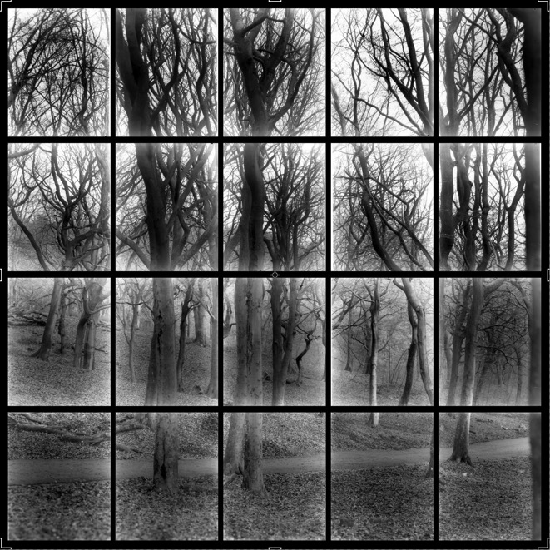

Slide 45
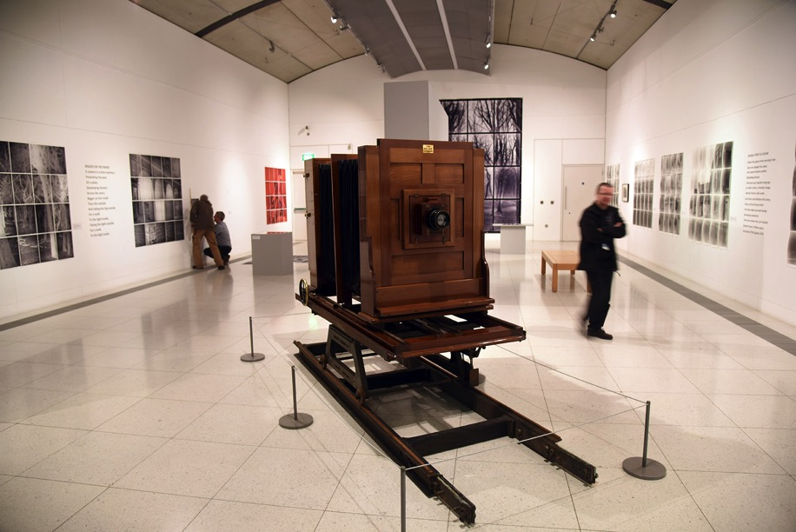

Slide 46
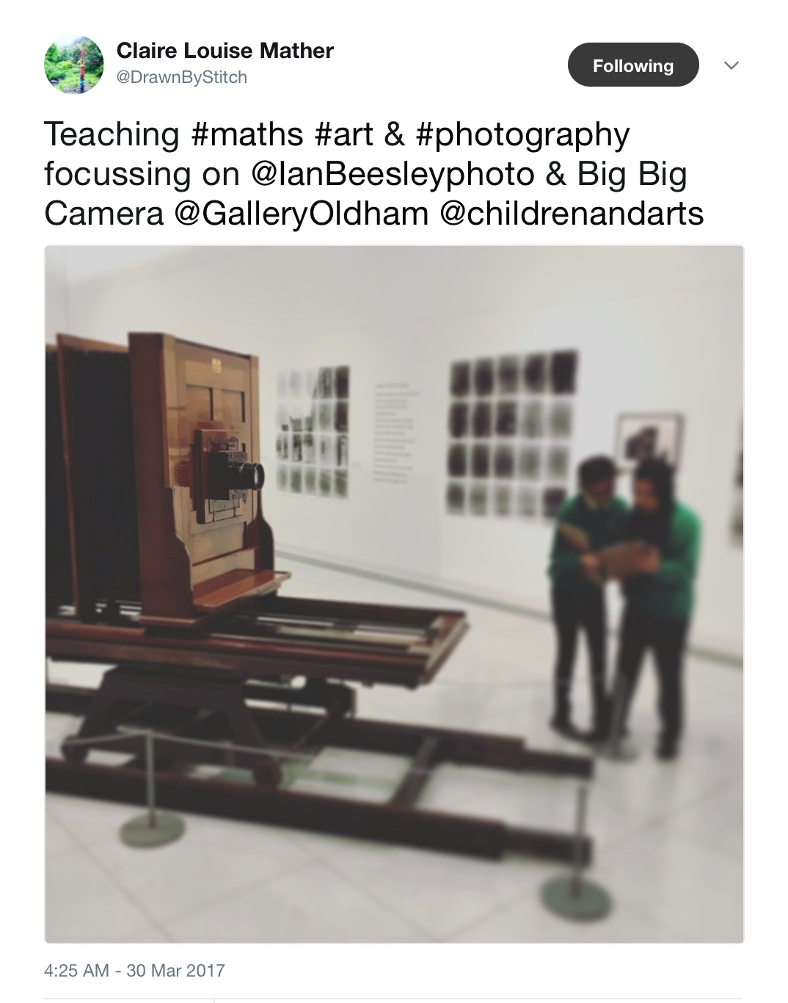

Slide 47
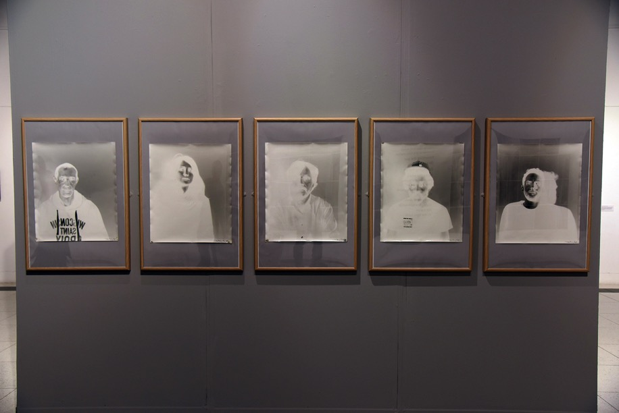

Slide 48
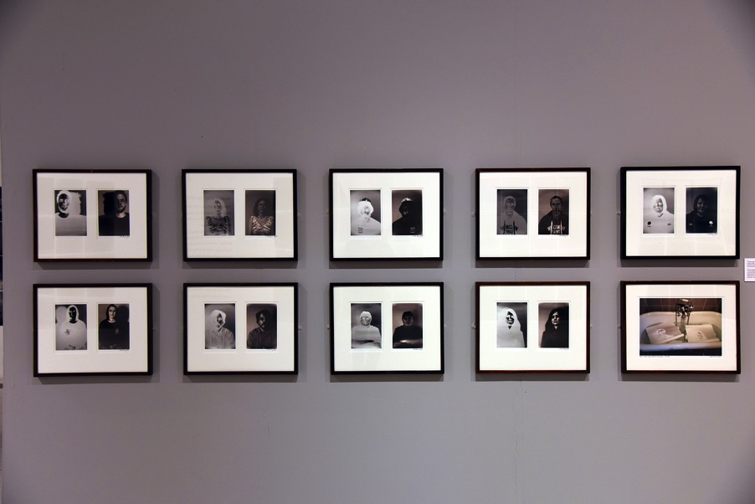

Slide 49
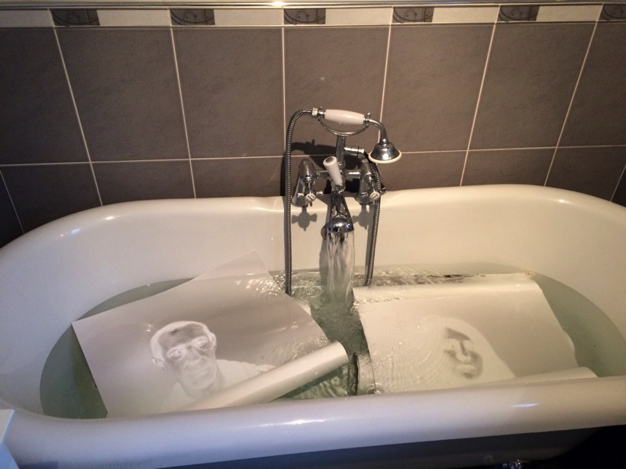

Slide 50
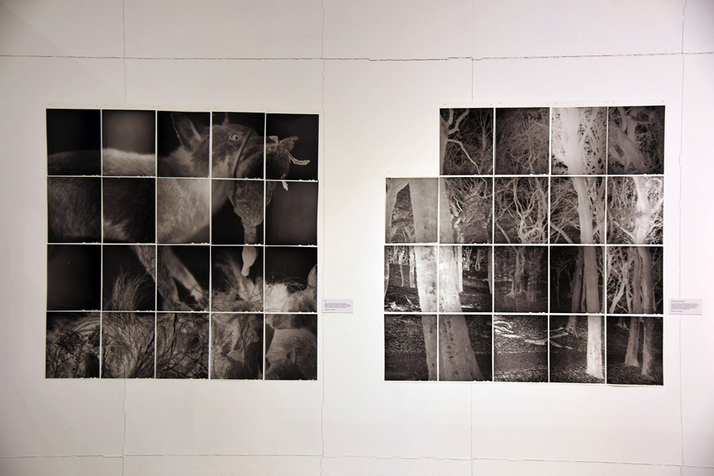

Slide 51
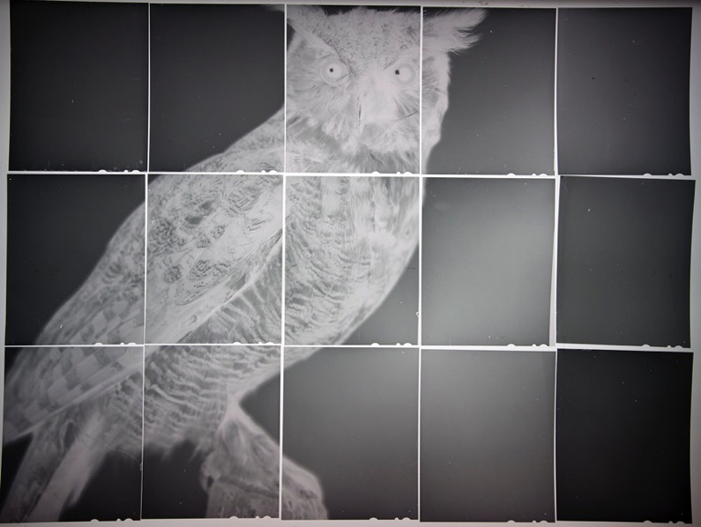

Slide 52
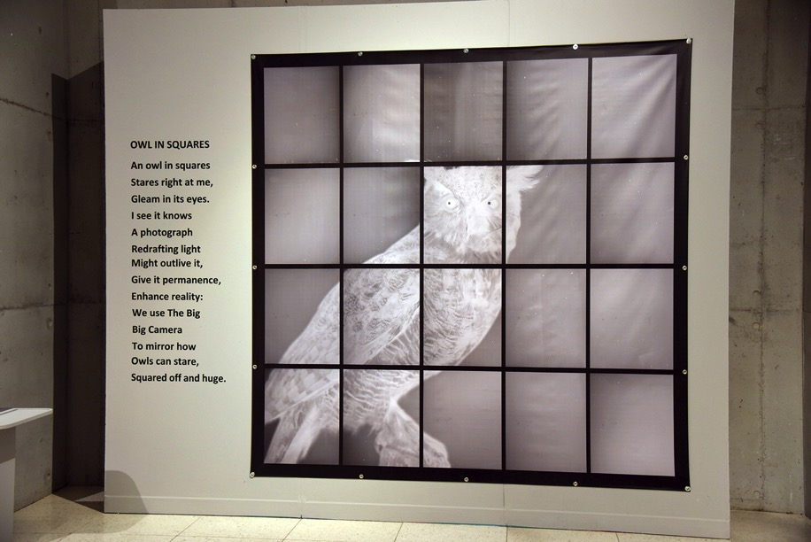

Slide 53
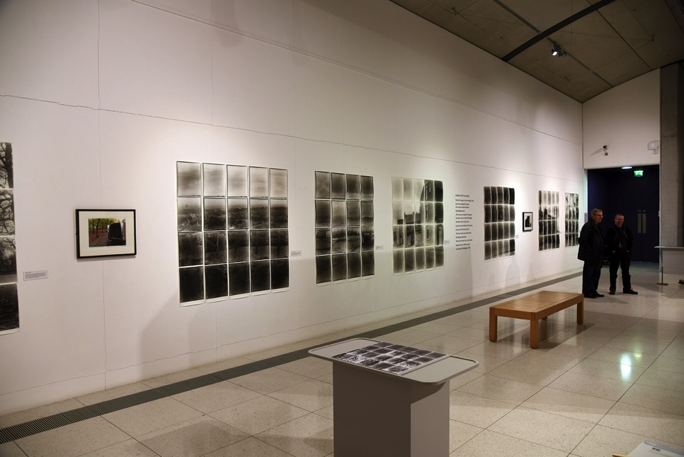

Slide 54
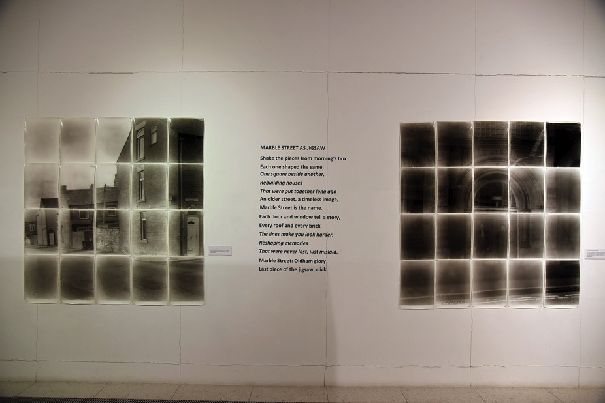

Slide 55
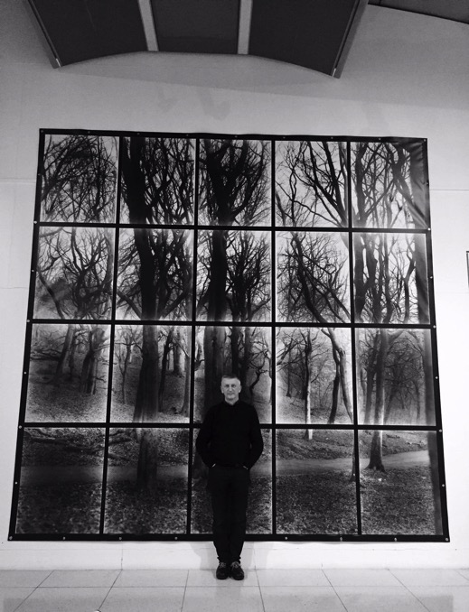

Slide 56


Slide 57
