Slide 1
Women are funny

Slide 2
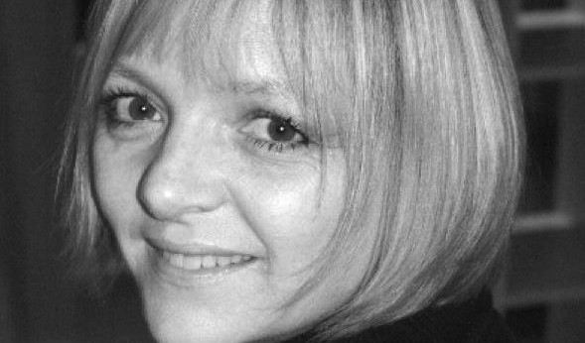
Sarah Ann Kennedy
Notes:
Talk through who you are. What work you have made, Crapston Villas, Pond Life, Peppa Pig and Ben and Holly’s Little Kingdom.

Slide 3
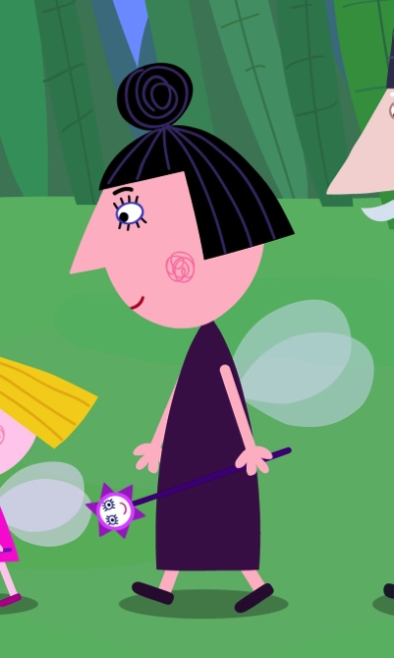
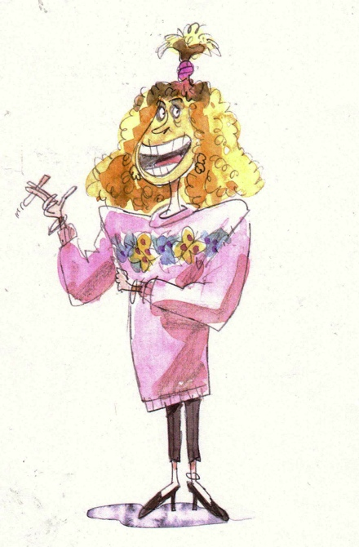
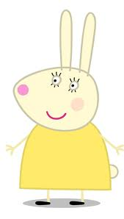
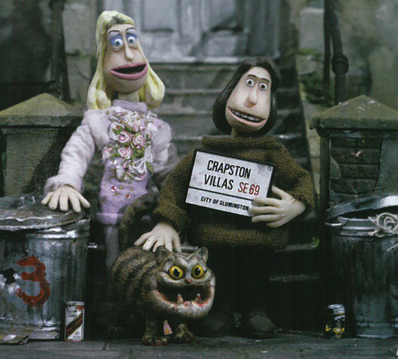
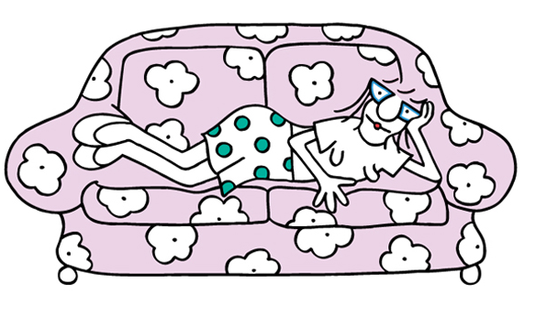
Characters

Slide 4
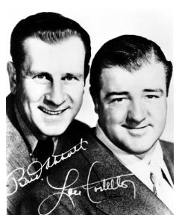
Is a ‘straight man’ necessary?
The ‘straight man’ in stand up comedy or sitcom gives the eccentric character a presence to play against. It has long been accepted as an essential part of the process. “Well the straight guy is never given enough credit ….(Bud) Abbot gets no credit for framing a gag, for the architecture, for the support, for the drive. He does everything except the punchline; he’s amazing.” Mel Brooks. It is thought that if all or both characters were larger than life, they compete rather than compliment. Would scripted comedy work without this element or is it an essential part of the process?

Slide 5
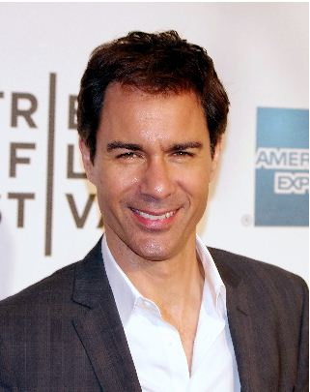
The Straight man
Will and Grace - Will
Frasier – Ros
Mary Tyler Moore Show – Lou
Absolutely Fabulous – Saffron
Cosby Show – Clair
The Office – Pam
I love Lucy - Ricardo
Notes:
Mention that it might appear that on the face of it, earlier shows were more revolutionary. I love Lucy or the Mary Tyler Moore Show.

Slide 6
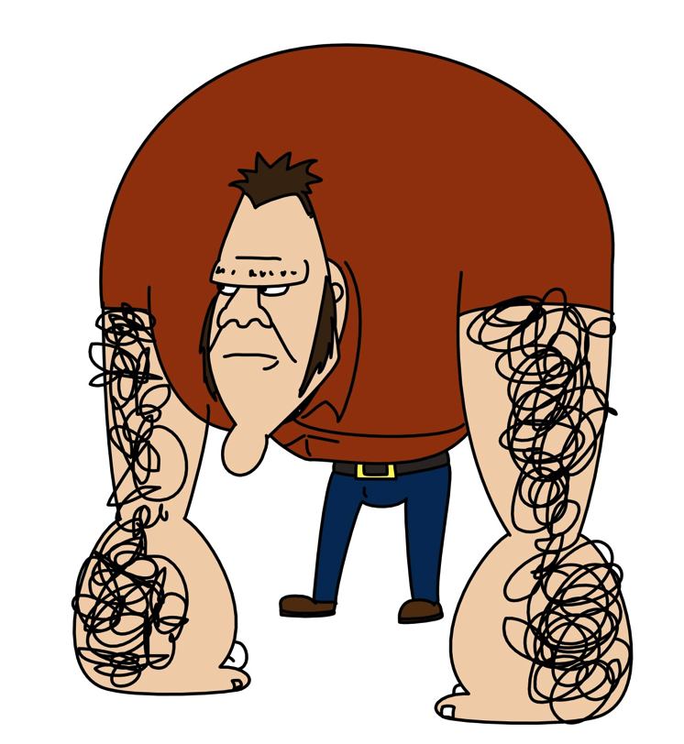
Homesick
Too many larger than life characters. The main protagonist should have been more natural and more sympathetic and she is currently too cartoony. There is no juxtaposition between the live action and the animation so there is no difference comedy difference between the pace of the live action and the animation. It is about two women and written by a woman.

Slide 7
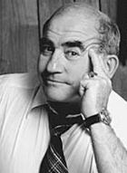
The Straight man
Fawlty Towers – Polly
Will and Grace – Will
Frasier – Ros
Mary Tyler Moore Show – Lou
Absolutely Fabulous – Saffron
Cosby Show – Clair
The Office – Pam
I love Lucy - Ricardo
Notes:
Mention that it might appear that on the face of it, earlier shows were more revolutionary. I love Lucy or the Mary Tyler Moore Show.

Slide 8
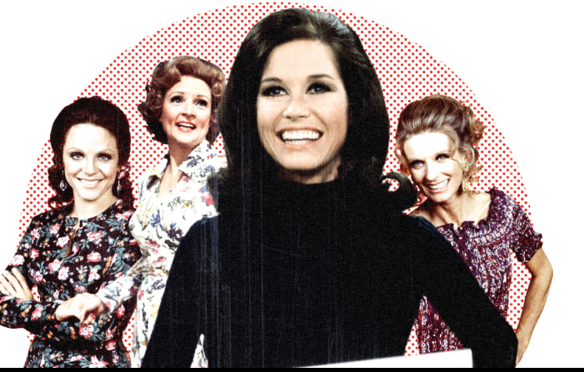
Was TV more innovative in the seventies?
According to Linda Artel and Susan Wengraf in their book Positive Images. Screening Women’s Films , Mary Tyler Moore wasn’t a positive role model. “She appears to be coy that it’s like she doesn’t want to be taken seriously and she is playing at being clever and therefore not threatening.”

Slide 9
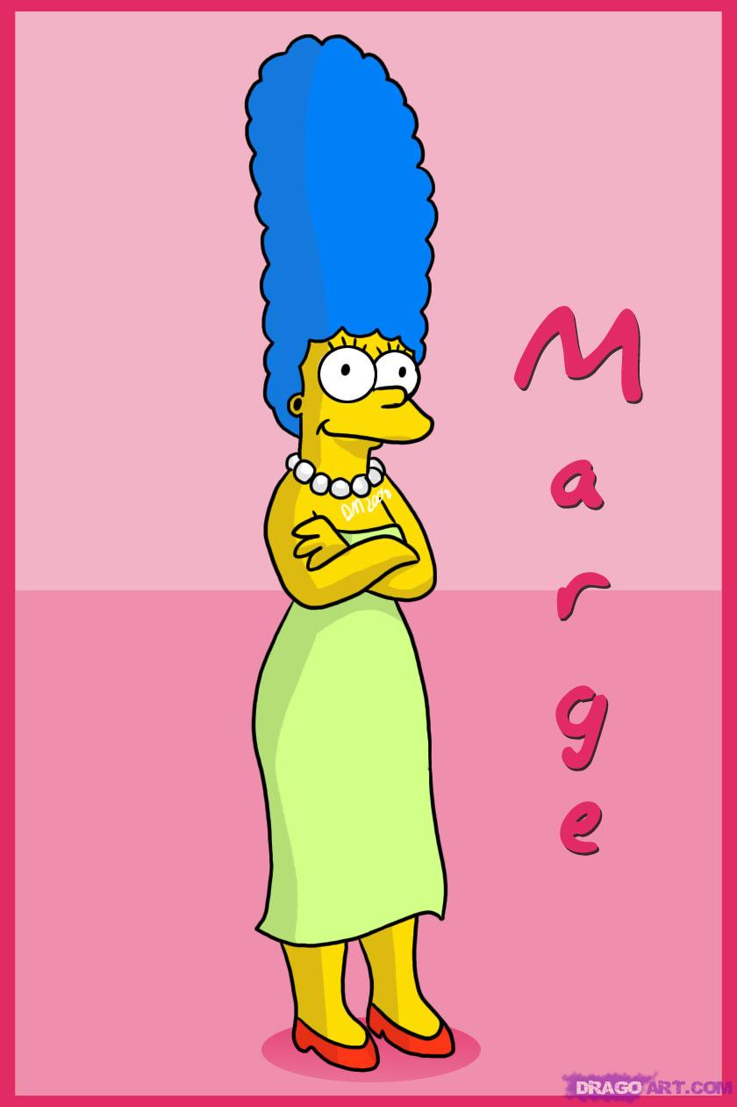
Straight Character in Animation
Simpsons – Marge Simpson
Family Guy – Lois
Flintstones – Wilma Flintstone
Peppa Pig – Mummy Pig
American Dad – Francine
Pond Life – Belle
Wait till your father gets home - Irma
Notes:
There is one thing in common here. All the characters are women and primarily mothers.

Slide 10
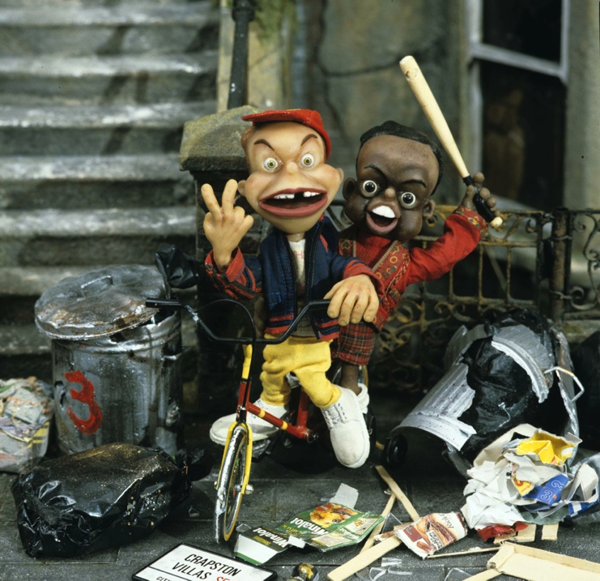
Voice of Reason
In all animated adult cartoons the straight role is played by a woman.
The character is usually competent and often motherly.
Where are the funny and flawed women characters?

Slide 11
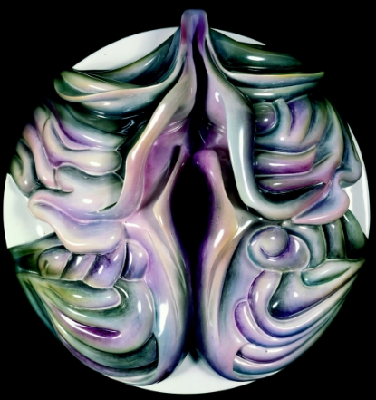
Have we progressed since Laura Mulvey wrote her seminal paper in 1975?
This might have been written in response to main stream live action Hollywood films but it can be applied to any other story based film medium in a patriarchal society. In her essay Laura Mulvey didn’t just make women aware of the male gaze in Hollywood cinema and what this means in relation to psychoanalysis theory, she used it to advance understanding of patriarchal society in the seventies, and gave clues and aims for how she would like to see cinema and the representation of women progress.
Notes:
Take a seemingly innovative character like Mary Tyler Moore, who was seen to be incredibly revolutionary at the time maybe wasn’t so revolutionary according to Linda Artel and Susan Weingraf. Laura also felt the way forward for women film makers was to embrace a more independent way of working so women weren’t dependent on the main steam system

Slide 12
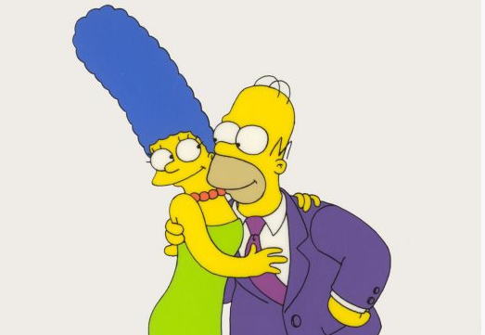
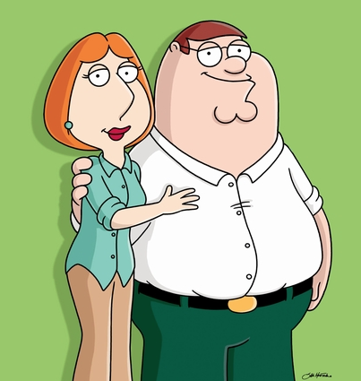
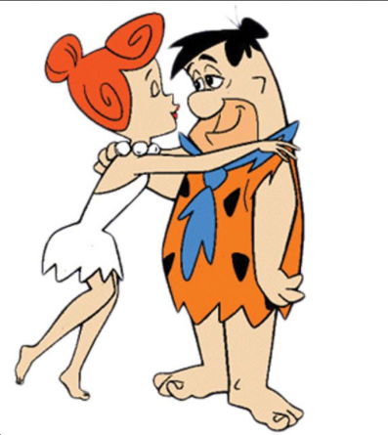
Spot the difference!
Notes:
Do most of us think that society has moved on from the seventies? Are we still living in the same roles? Are their more opportunities for women? Do women have more freedom and more options? If you look around you at the people and families you know. Are the mothers like this? i.e stay at home mums, calm, patient and sexual.

Slide 13
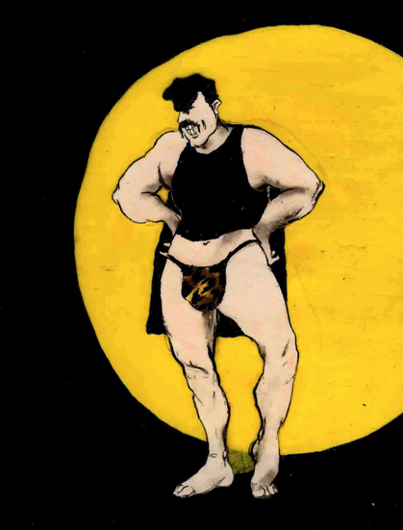
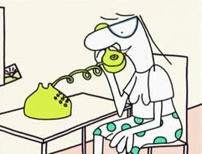
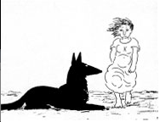
Putting Themselves in the Picture
Sandra Law wrote a paper in 1992 using Laura Mulvey’s essay as a starting point to illustrate how three women animators, Joanna Quinn, Candy Guard and Alison de Vere used their own experiences to create stories and characters.
Notes:
All these women created images using their own voices. These were created using female voices. These weren’t stories about women created by men but stories about women by women.

Slide 14
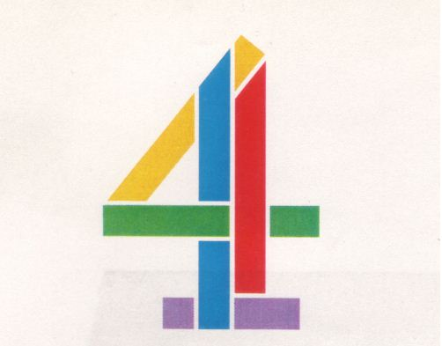


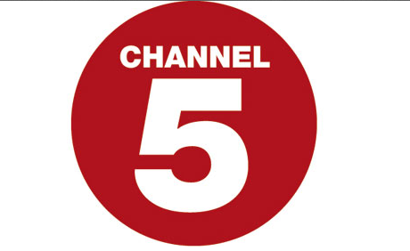
Commissioning in UK
All three of these women were commissioned by the Channel 4 animation department run by Claire Kitson. There was a remit for innovation and Channel 4 delivered. She commissioned a variety of work by men and women most of which went on to win awards.

Slide 15
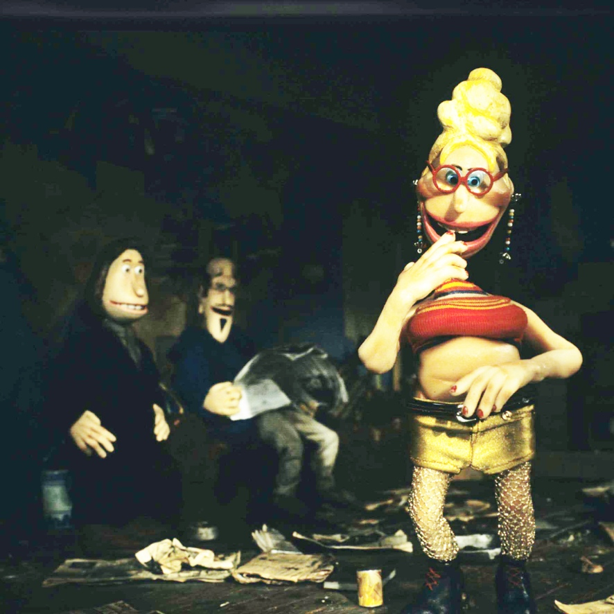
Key Women Players in UK 1990 and their roles.
Ruth Lingford – Harvard
Candy Guard – Pond Life
SA Kennedy – Crapston Villas
Susie Templeton – Peter and The Wolf
J Quinn – Body Beautiful
An Vrombaut – 64 Zoo Lane.

Slide 16
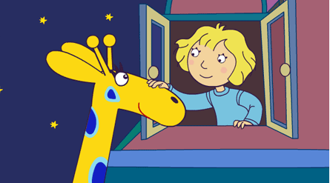
Mainstream animated work created by women in UK
An Vrombaut – 64 Zoo Lane
Sarah Ann Kennedy – Crapston Villas
Candy Guard – Pond Life

Slide 17
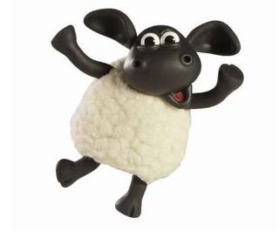
Animated shows created by women today
An Vrombaut is the sole creator of 64 Zoo Lane
Valerie Walsh is one of the creators of Dora The Explorer
Jackie Cockle is the sole creator of Timmy Time
Rebecca Sugar first female sole creator of Steven Universe, a series on Cartoon Network.

Slide 18
Animated Features by Women
Brave – Brenda
Arthur Christmas – Sarah Smith

Slide 19
Controversy?
Family Guy isn’t edgy and it isn’t controversial. It isn’t using our desire to push the envelope against us. Family Guy is the most socially conservative thing out there.

