Slide 1
Is the straight role in comedy essential and why is it usually played by a women in animation?

Slide 2
Sarah Ann Kennedy University of Central Lancashire
Notes:
Talk through who you are. What work you have made, Crapston Villas, Pond Life, Peppa Pig and Ben and Holly’s Little Kingdom.

Slide 3
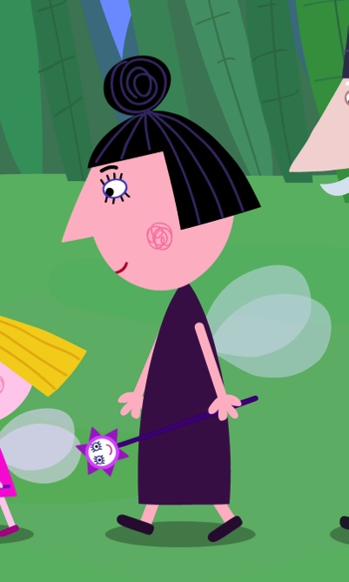
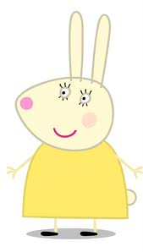
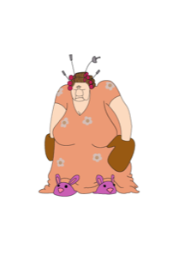
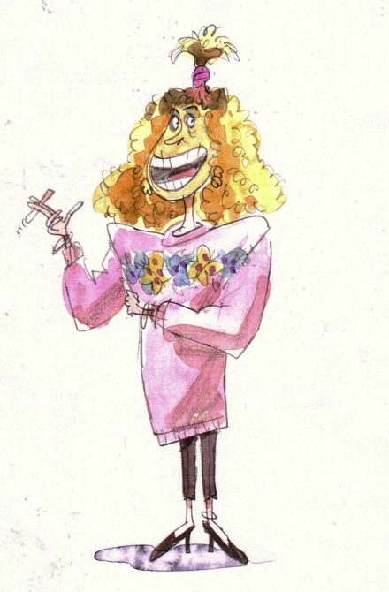
About me!
I am the course leader of BA(hons) and MA Animation at the University of Central Lancashire. I am also the voice of Miss Rabbit in Peppa Pig and Nanny Plum in Ben and Holly’s Little Kingdom. I was also the creator of adult animation series Crapston Villas and Nights. I have recently finished a short taster for a sitcom with animation inserts called Homesick.

Slide 4
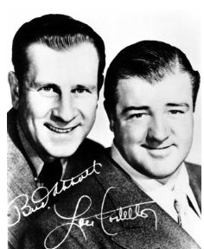
Is a ‘straight man’ necessary?
The ‘straight man’ in stand up comedy or sitcom gives the eccentric character a presence to play against. It has long been accepted as an essential part of the process. “Well the straight guy is never given enough credit ….(Bud) Abbot gets no credit for framing a gag, for the architecture, for the support, for the drive. He does everything except the punchline; he’s amazing.” Mel Brooks. It is thought that if all or both characters were larger than life, they compete rather than compliment. Would scripted comedy work without this element or is it an essential part of the process?

Slide 5
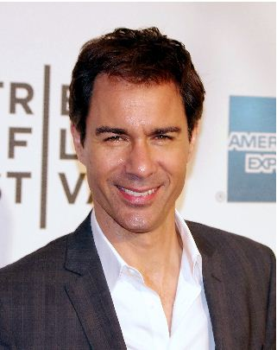
The Straight man
Will and Grace - Will
Frasier – Ros
Mary Tyler Moore Show – Lou
Absolutely Fabulous – Saffron
Cosby Show – Clair
The Office – Pam
I love Lucy - Ricardo
Notes:
Mention that it might appear that on the face of it, earlier shows were more revolutionary. I love Lucy or the Mary Tyler Moore Show.

Slide 6
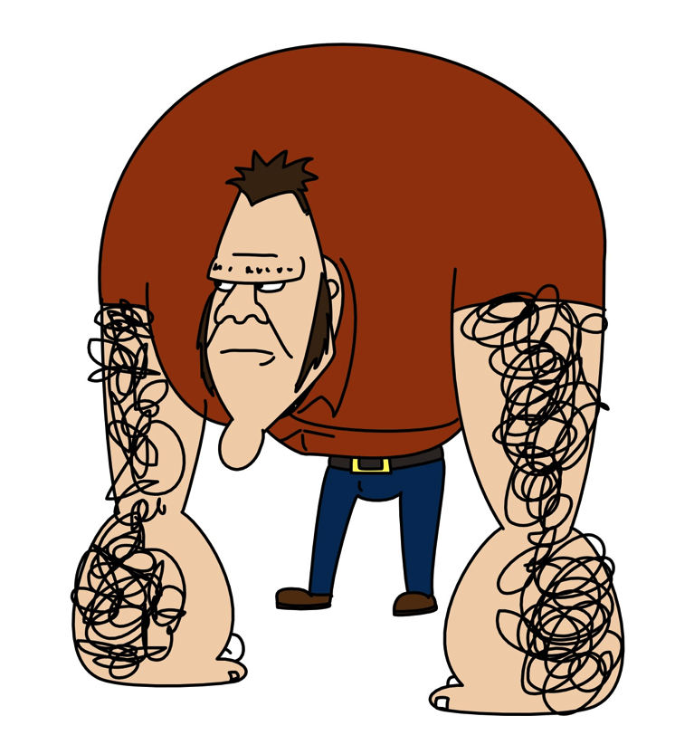
Homesick
Too many larger than life characters. The main protagonist should have been more natural and more sympathetic and she is currently too cartoony. There is no juxtaposition between the live action and the animation so there is no difference comedy difference between the pace of the live action and the animation. It is about two women and written by a woman.

Slide 7
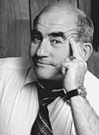
The Straight man
Fawlty Towers – Polly
Will and Grace – Will
Frasier – Ros
Mary Tyler Moore Show – Lou
Absolutely Fabulous – Saffron
Cosby Show – Clair
The Office – Pam
I love Lucy - Ricardo
Notes:
Mention that it might appear that on the face of it, earlier shows were more revolutionary. I love Lucy or the Mary Tyler Moore Show.

Slide 8
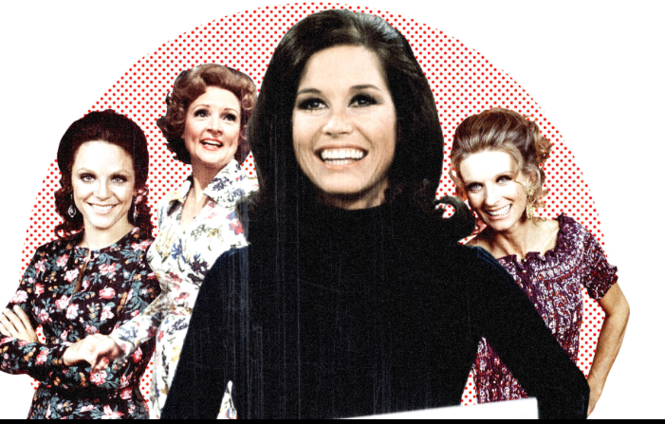
Was TV more innovative in the seventies?
According to Linda Artel and Susan Wengraf in their book Positive Images. Screening Women’s Films , Mary Tyler Moore wasn’t a positive role model. “She appears to be coy that it’s like she doesn’t want to be taken seriously and she is playing at being clever and therefore not threatening.”

Slide 9
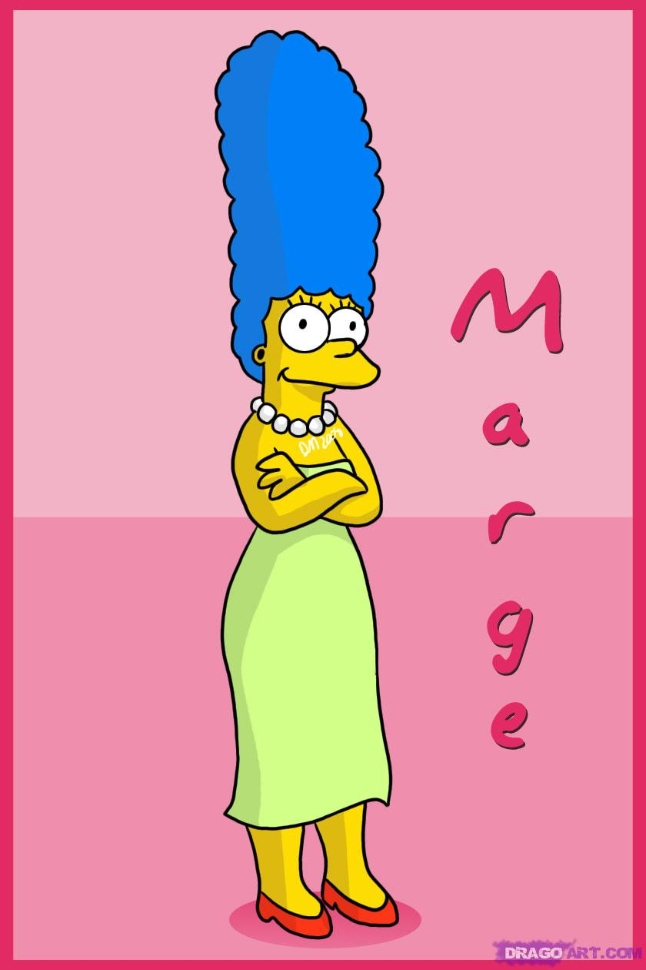
Straight Character in Animation
Simpsons – Marge Simpson
Family Guy – Lois
Flintstones – Wilma Flintstone
Peppa Pig – Mummy Pig
American Dad – Francine
Pond Life – Belle
Wait till your father gets home - Irma
Notes:
There is one thing in common here. All the characters are women and primarily mothers.

Slide 10
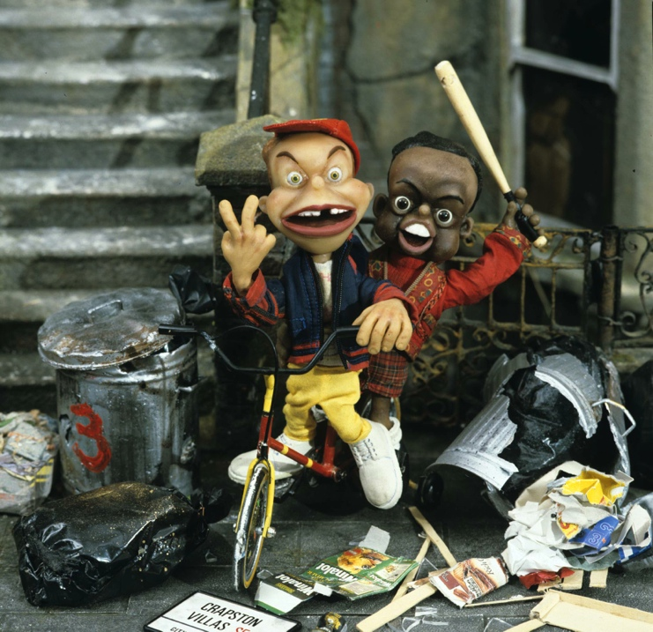
Voice of Reason
In animated adult cartoons the straight role is usually played by a woman.
The character is usually competent and often motherly.
Where are the funny and flawed women characters?

Slide 11
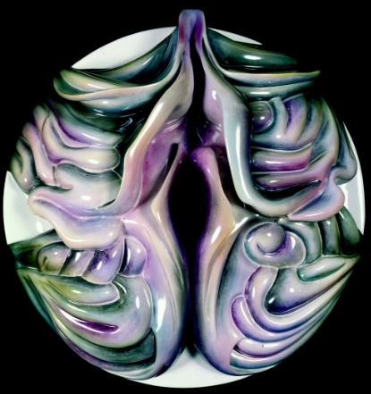
Have we progressed since Laura Mulvey wrote her seminal paper in 1975?
In her essay Laura Mulvey didn’t just make women aware of the male gaze in Hollywood cinema and what this means in relation to psychoanalysis theory, she used it to advance understanding of patriarchal society in the seventies, and gave clues and aims for how she would like to see cinema and the representation of women progress. Laura Mulvey highlighted the fact that the main stream film industry in the seventies was dominated by men. Therefore any female characters created would be solely created by men from their point of view. Coining the phrase ‘ the male gaze.’
Notes:
Take a seemingly innovative character like Mary Tyler Moore, who was seen to be incredibly revolutionary at the time maybe wasn’t so revolutionary according to Linda Artel and Susan Weingraf. Laura also felt the way forward for women film makers was to embrace a more independent way of working so women weren’t dependent on the main steam system

Slide 12
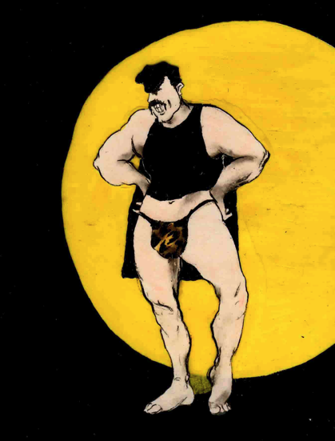
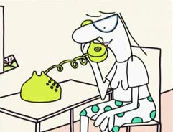
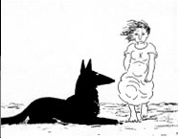
Putting Themselves in the Picture
Sandra Law wrote a paper in 1992 using Laura Mulvey’s essay as a starting point to illustrate how three women animators, Joanna Quinn, Candy Guard and Alison de Vere used their own experiences to create stories and characters.
Notes:
All these women created images using their own voices. These were created using female voices. These weren’t stories about women created by men but stories about women by women.

Slide 13
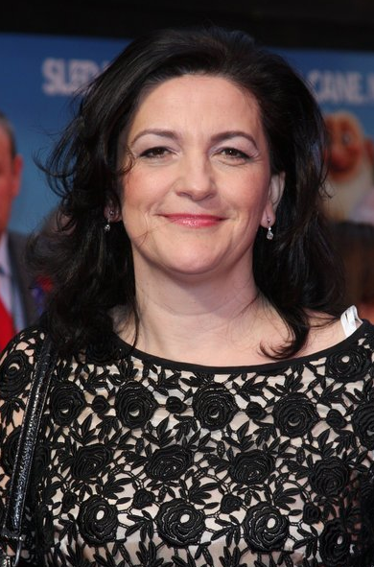
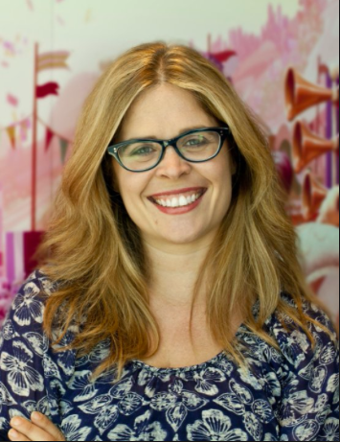
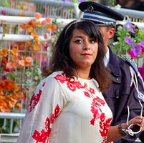
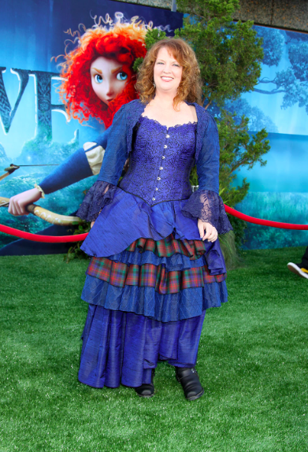
Animated Features by Women
Arthur Christmas Sarah Smith
Frozen
Jennifer Lee
Persepolis
Marjene Statrapi
Brave
Wreck it Ralph (writer)
Brenda Chapman

Slide 14
Mainstream animated work created by women in UK
Bobs Birthday
64 Zoo
Crapston Villas
Pond Life
Timmy Time
Sarah and Duck
Charlie and Lola
Alison Snowdon and David Fine
An Vrombaut
Sarah Ann Kennedy
Candy Guard
Jackie Cockle
Sarah Gomes and Tim O Sullivan
Lauren Child developed by
Kitty Taylor and Claudia Lloyd.

Slide 15
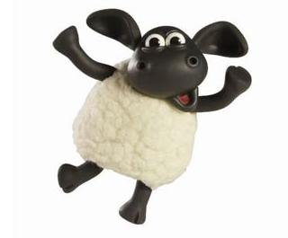
Animated shows created by women today UK and USA
Dora The Explorer
Bobs Birthday
64 Zoo Lane
Crapston Villas
Pond Life
Timmy Time
Sarah and Duck
Charlie and Lola
Steven Universe
Co creator Valerie Walsh
Alison Snowdon and David Fine
An Vrombaut
Sarah Ann Kennedy
Candy Guard
Jackie Cockle
Sarah Gomes and Tim O Sullivan
Lauren Child, Kitty Taylor and Claudia Lloyd
Rebecca Sugar first female sole creator of a series on Cartoon Network.

Slide 16
Women short Film makers
Joanna Quinn
Sarah Cox
Ruth Lingford
Susie Templeton
Petra Freeman
Sylvie Bringas
Gaelle Denis
Alison de Vere
Emma Calder
Marjut Rimminen

Slide 17
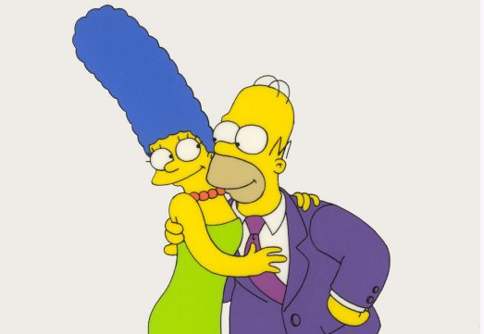
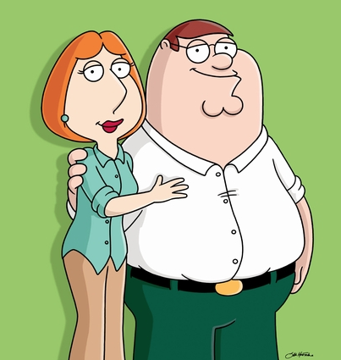
Spot the difference!
Notes:
Do most of us think that society has moved on from the seventies? Are we still living in the same roles? Are their more opportunities for women? Do women have more freedom and more options? If you look around you at the people and families you know. Are the mothers like this? i.e stay at home mums, calm, patient and sexual.

Slide 18
Women’s Symposium Contributors
Candy Guard
Jackie Edwards
Jackie Cockle
Jean Flynn
Jayne Piling
Anna Gregory
Sarah Ann Kennedy
Creator of Pond Life. Novelist
Head of Acquisitions CBBC
Creator of Timmy Time
Creative Producer Cosgrove Hall
Director British Animation Awards
UK Animated Women
Crapston Villas, Peppa Pig
Notes:
Talk through who you are. What work you have made, Crapston Villas, Pond Life, Peppa Pig and Ben and Holly’s Little Kingdom.

Slide 19
Opportunity
Do women have the same opportunities as men?
In the UK there are only 40% in the total workforce which is 4,600
47% Strategic management
46% Creative Development
45% Production
65% Legal
28% Art and Design
21% Animators
27% Editing
81% Distribution, Sales and Marketing
54% Business Management

Slide 20
Opportunity
Do women have the same opportunities as men?
Candy Guard: I made my own work which was actually quite commercial but I felt that once I had finished I felt unemployable but there were men that were at University at the same time as me who made their own film and then went on to be commercial directors but they directed other people’s style.
Jackie Cockle – I never really thought about whether I was a woman in terms of my career. I just though of myself as a creative person. Cosgrove Hall was a very special place
Jackie Cockle: Jean (jean Flynn) and I were quite different weren’t we. There weren’t many of us.
Jean Flynn: No there weren’t many of us.
Jackie Edwards:: There were more opportunities in the eighties and nineties for both men and women. Short films etc. Channel 4 and BBC supported young film makers

Slide 21
Confidence
Anna Gregory: Women know this much and they identify a hole in their knowledge and that’s what they focus on which is why they say they they can’t do something whereas men will say I don’t know this but I do know that so I can do it.
Candy Guard: A lot of women stay as assistants. They don’t seem to say I’m an animator. It’s having the gusto to say I’m an animator
Jean: Well yeah I think there were a few more men than women. I think the reason that the women weren’t successful was they just didn’t have that confidence.
Jackie Cockle: (referring to the seventies) It was very misogynist there were no women in positions of power.

Slide 22
Enabler or Doer
Do women seem to take on the enabler role instead of the ‘mad creative’ role?
Anna Gregory: There are lot of women creating their own series that re both creative and industry but they are struggling for funding all the time. They are making such amazing work. We can showcase work and you can see the amount of creativity not just stop motion but scratch film.
Jackie Edwards: Just in Cbeebies we get over 1000 submissions and we only commission 4. CITV commission less and do milk shake. I’m not sure if there are more submissions by men or by women but it’s something to think about. It’s heart breaking either way because we can only commission so few.

Slide 23
Enabler or Doer
Candy Guard: If you are a mad female director you are neurotic. I used to feel people were warned about me coming into the studio because I was fussy.
Jackie Cockle: if you are talking about series work the type that Jean and I do. You don’t really want mad directors. You just want work. It’s not necessary the mad director that has ideas because if you are a creative producer you have ideas too.
Candy Guard: I don’t think I was mad but I think what Sarah means is that the women allow the men to make the creative decisions. They enable them.
Jane Piling: In the commercial world this is very much the case. The producer sorts out the schedule, the team and organises the budget whereas the directors does all the creative visual side. There are very few women working in the commercial sector. So just as women are used to dealing with fractious difficult children that’s what happens in the world of commercials so I think that’s where that comes from. It’s also multi tasking which is what producing is. Whereas if you animate you just concentrate.

Slide 24
Enabler or Doer
Sarah Ann Kennedy: Yes but I have heard people say that they became a producer because it was easier to manage everything plus a difficult director than to become a director. I have heard this said from women in the live action industry as well.
Anna Gregory: I think you have to be very focused as a director and this could be seen to be very selfish and this isn’t a very female quality. Look at the director of gravity he was particular down to every single frame as is that seen as feminine. (to Candy) You said you had a vision and you wanted it realised so what is wrong with that.
Candy Guard: Yes I remember worrying that I was coming over as mad because I wanted things to be right

Slide 25
Discrimination
Jean Flynn: No if you’re good you’re good. I wouldn’t want to walk into a job because it was discriminated against. I want to walk into that job because I got it and I was right for it and I’ve beaten everyone else to get it. I remember my mother telling me if you want something enough you will have to work hard to get it particularly if you are a woman. I don’t think I realised how hard then
Anna Gregory: No we want to support women who want to work in this industry and encourage them to get out of their comfort zone. We came in right at the beginning of women working in the industry and we had no knowledge of it. We had to get on with it. Whatever our chosen profession. Don’t think ooh I can’t do this. Get out there. Have a go. It’s like making a roast dinner. If you can make a roast dinner you can do anything.

Slide 26
Discrimination
Jane Piling: If positive discrimination was brought in it would be a bonkers working environment. That said I do think funding bodies like Creative skillset or BFI should be aware of and should be aware of is something triggered off by something Jean said earlier she said that she thought animation was only made by Americans. If you do not see people like yourself doing something you don’t believe you can do it. The gap and the gender perception that boys do science and girls do soft arts and that’s the thing that has got to change. It is positive in one way, these young girls go on about feminism and think it is so last year…last century and therefore there is a greater expectation there should be not discrimination but more work and money put into training to show that science isn’t a boys thing but a girls thing. That is our responsibility
Jackie Edwards: I do think that there are more women working in childrens than men and this shows women that it is possible to do so if you have the patience and if you really want it you can do it. You have to be determined because it is a hard industry, it’s competitive and you have to be resilient but it is possible to do it

Slide 27
Discrimination
Jackie Cockle: If you are brave enough to be positive and you can do anything and not get hung up. If you want it enough just go for it. There is nothing to stop you. If you are driven by creativity and you want to make a show and you are passionate about it. Get on with it
Candy Guard: I think the most important thing is to just make stuff. Now with computers you really can make films and stuff quite cheaply. You’ve got a great set up
Jackie Cockle: The main thing is you have an idea you want to communicate and you’ve got a passion to tell it. No matter what job you choose that’s what drive you.

