Slide 1




The Impact Of Poor Housing On Child Poverty And Children’s Life Chances
Willie Slavin
Chair of West Cumbria Child Poverty Forum
Chair of The Whitehaven Foyer
Suzanne Wilson (MPhil, MSc, BSc)
Research Fellow in Social Inclusion and Community Engagement
Westlakes Campus, University of Central Lancashire
‘Tackling Child Poverty: The Way Forward’
Wednesday 13th November 2019

Slide 2
Contents
Background
An overview of West Cumbria
West Cumbria Child Poverty Forum
The impact of poor housing on children's life chances
Key statistics and policies on housing and children’s outcomes
The impact of poor housing measured against the five outcome areas of every child matters established in 2005: being healthy, staying safe, enjoying and achieving, making a positive contribution and achieving economic well being
Case study examples of housing and the impact on children and families
Working towards solutions
Making a difference to children’s lives through partnership working between local authorities and other agencies

Slide 3
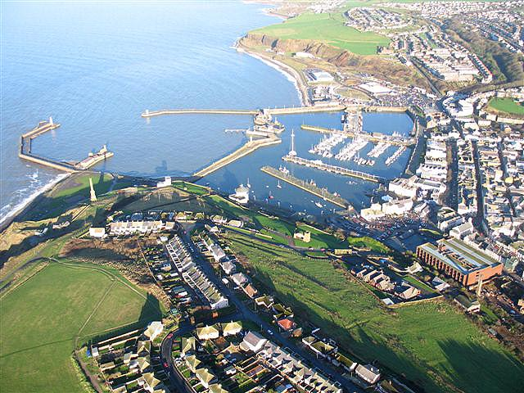
Background

Slide 4
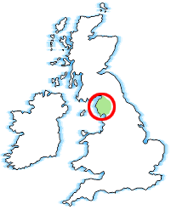
An overview of West Cumbria
Geographically isolated
Post industrial area with Sellafield being a major employer
Polarised social demography
Pockets of very high deprivation
Limited services
Below regional and national averages of educational and employment

Slide 5
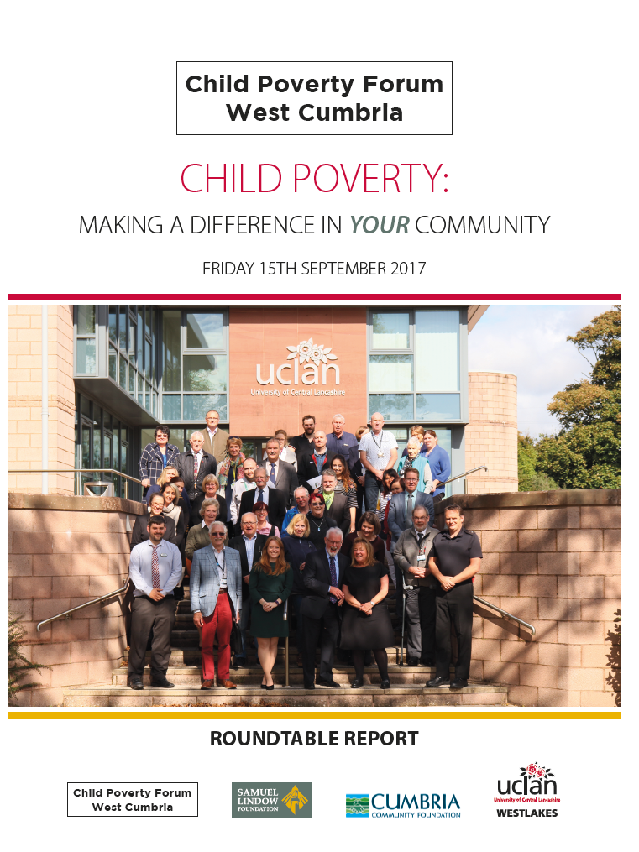
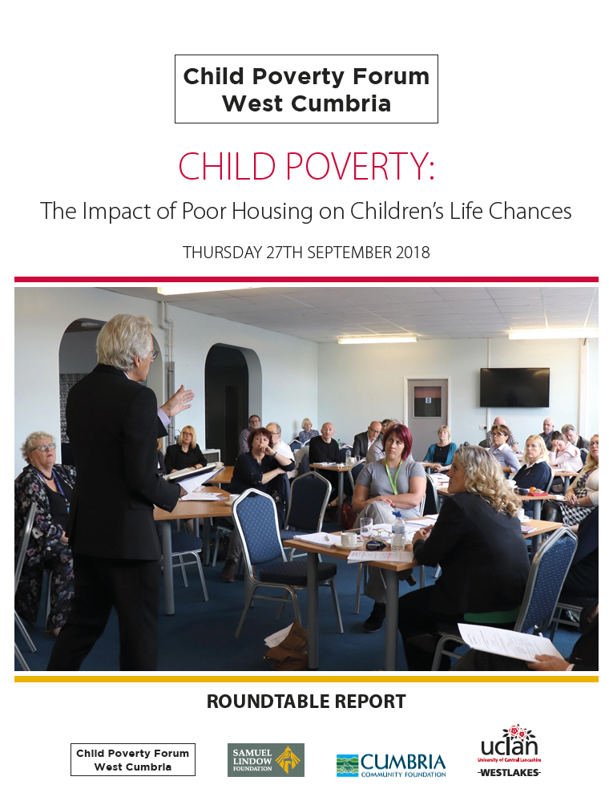
West Cumbria Child Poverty Forum
WCCPF is an un-constituted group of professionals from a range of sectors, who meet periodically to share information surrounding child poverty on a local, national and international level. There is representation from Allerdale and Copeland Borough Councils, Cumbria County Council Children’s Services, Howgill Family Centre, Barnardo’s Allerdale, and UCLan.
The aim of the Forum is to share information and expertise and raise the profile of child poverty in West Cumbria, keeping the issue at the forefront of the public, and the statutory services.

Slide 6
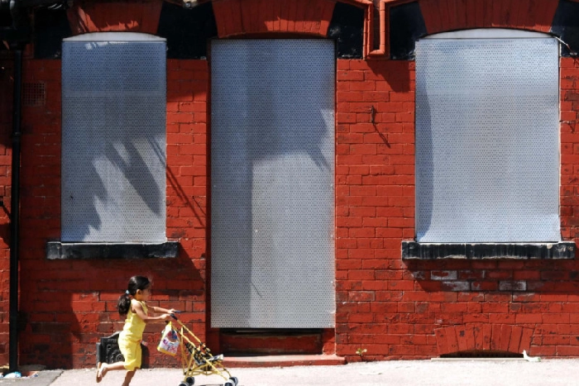
The impact of poor housing on children's life chances

Slide 7
Key Statistics in Housing and Children’s Outcomes
A study by The National Centre for Social Research showed the impact of both poor housing and overcrowding.
25% of children living in poor housing had long standing illness
29% of children living in poor housing were bullied
5% of children living in poor housing aged 8-18 had been in trouble with the police compared to 3% of children with short term exposure to poor housing
12% of children who lived in overcrowded conditions could not do homework
Children in overcrowded houses also reported feeling unhappy about their health
Barnes, M., Lyon, N. and Conolly, A. (2006) The living standards of children in bad housing, London: National Centre for Social Research.

Slide 8
The impact of poor housing measured against the outcome areas of every child matters
Being healthy | Poor housing conditions increase a the risk of severe ill-health or disability by up to 25 per cent during childhood and early adulthood. Mental health issues such as anxiety and depression have also been linked to unfit housing. Children living in damp homes are between one and a half and three times more prone to coughing and wheezing than children living in dry homes.
Staying safe | Almost half of all accidents involving children are related to physical conditions in and around the home. Families living in a property that is in a poor physical condition are more likely to experience a domestic fire and less likely to own a smoke alarm.
Enjoying and achieving | Poor housing conditions have a damaging impact on children’s learning at home and school, and school attendance. The lower educational attainment and health problems associated with bad housing in childhood impact on opportunities in adulthood, increasing the likelihood of unemployment or working in low-paid jobs.
Making a positive contribution | Poor housing conditions may also contribute to the emergence of problem behaviour. Behavioural difficulties in childhood, which may be attributable to or exacerbated by bad housing, can manifest themselves in offending behaviour later in life.
Achieving economic well being | Living in bad housing as a child results in a higher risk of low educational achievement. This in turn has long-term implications for economic well-being in adulthood because of the increased the likelihood of unemployment or working in insecure or low-paid jobs.
Notes:
Almost half of all childhood accidents are associated with physical conditions in the home.
Families living in properties that are in poor physical condition are more likely to experience a domestic fire.

Slide 9
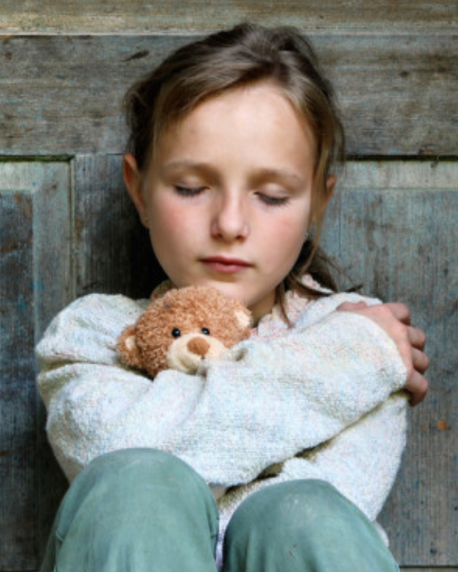
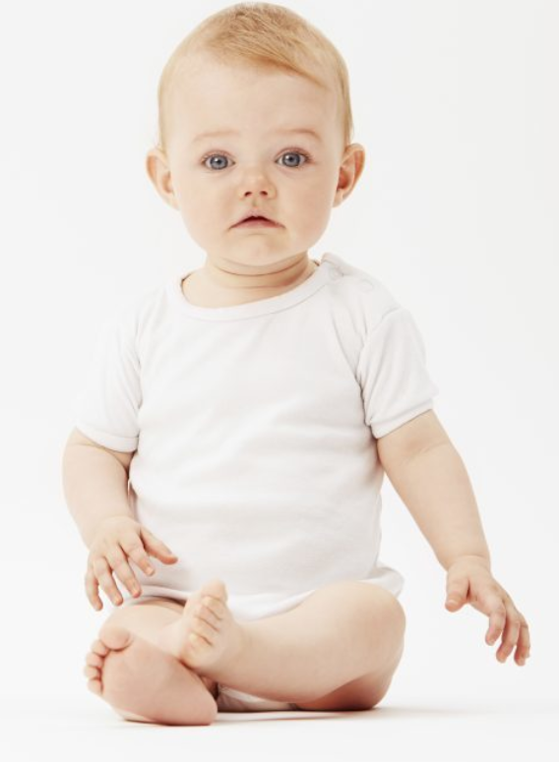
Case study examples of housing and the impact on children and families
Olivia (7 years old): Private rented accommodation, overcrowding, arrears, debt, damp, social isolation for Olivia, along with no private space.
Baby George: Social rented housing, water damage, poor communication with social landlords, declining parental mental health, unsuitable floor for baby George to crawl.

Slide 10
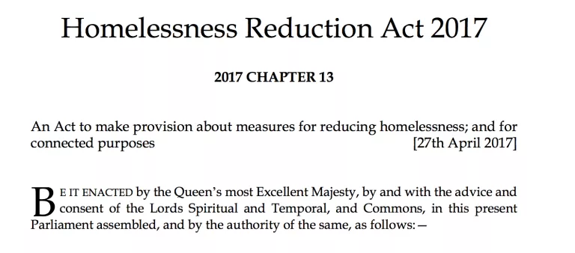

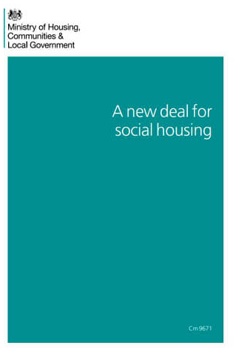
Key Legislation Relating to Housing and Children’s Outcomes
Social Housing Green Paper (emerging)
Homeless Reduction Act
Decent Homes Standard
However:
Are limited in scope (for example, does not include issues such as damp)
Are too technical and neglects the human impact of poor housing
Powers of enforcement:
Statutory legislation = funded centrally
Powers = not centrally

Slide 11
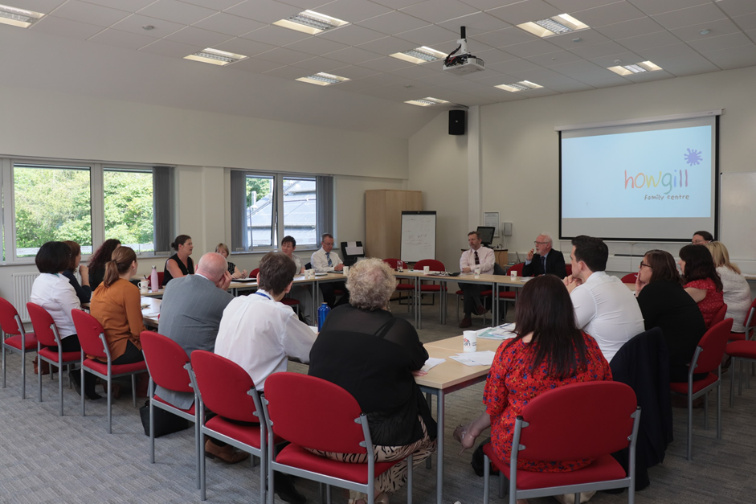
Making a difference to children’s lives through partnership working between local authorities and other agencies

Slide 12
The Process
Child Poverty Roundtable
(September 2017)
Attendees: Key stakeholders, including elected members, civil servants, third sector organisations
Focus: The challenges facing families experiencing poverty
Social Housing Roundtable
(November 2018)
Attendees: Key stakeholders, including elected members, civil servants, third sector organisations
Social Housing and Child Poverty Seminar and Workshop
(June 2019)
Attendees: Social housing associations, local authorities and children’s services
Focus: Facilitated discussion about collaborative approaches to ensuring social housing can best support families experiencing poverty
Focus: The challenges facing families in social housing

Slide 13
Outcomes
Child Poverty at the Forefront of Policy: Housing association are encouraged to adopt their own children’s charter, or to work with local authorities to use theirs. Local authorities responsible for challenging child poverty, such as the Children’s Trust Board, will acknowledge the importance of working with housing authorities in future plans.
An Institutional Promise to Support Families Facing Hardship: Delegates pledged to feedback learning from the seminar to all in the organisation. They will encourage staff, from the strategic board level, to the operational level, to be cognizant to how they can best support families facing hardship.
Include Housing in Multi-Agency Meetings: Third sector children’s services have pledged to share relevant referral forms (including early help) and invite housing associations to mutli-agency meetings. Housing association have pledged to attend and fully engage with these meetings.
Continue to work with WCCPF: All parties have pledged to nominate a child poverty champion to receive monthly updates on the latest news in child poverty, acknowledging that WCCPF can provide impartial local expertise. WCCPF have pledged to continue to work with all parties and to facilitate future meetings to reflect and review working practices.

Slide 14
Thank you for your time. Any questions?
Email: swilson21@uclan.ac.uk
Facebook: www.facebook.com/ConnectedCommunitieCumbria/
Twitter: https://twitter.com/SuzyWilsonUCLan
Phone: 01946 517226 / 07929266679

Slide 15

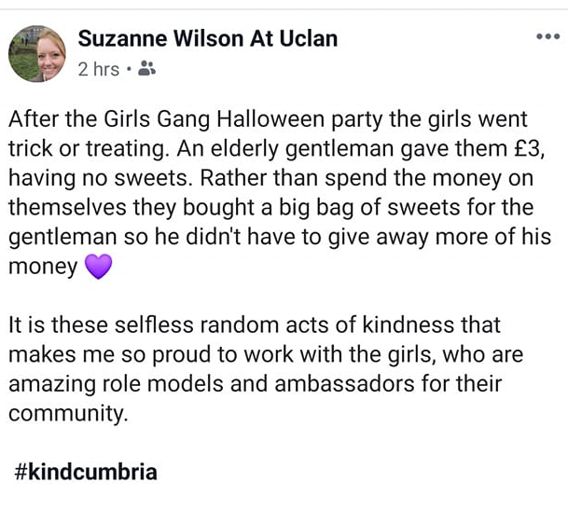

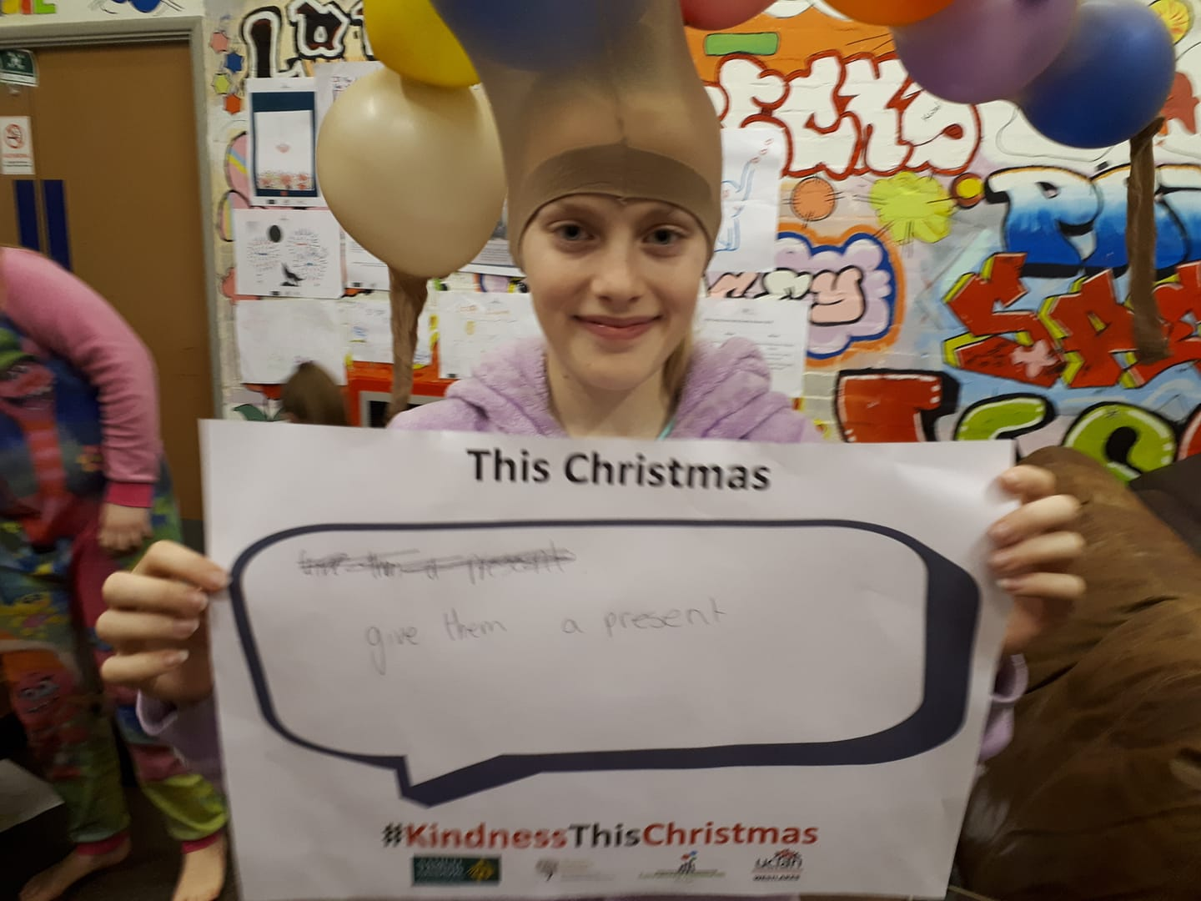
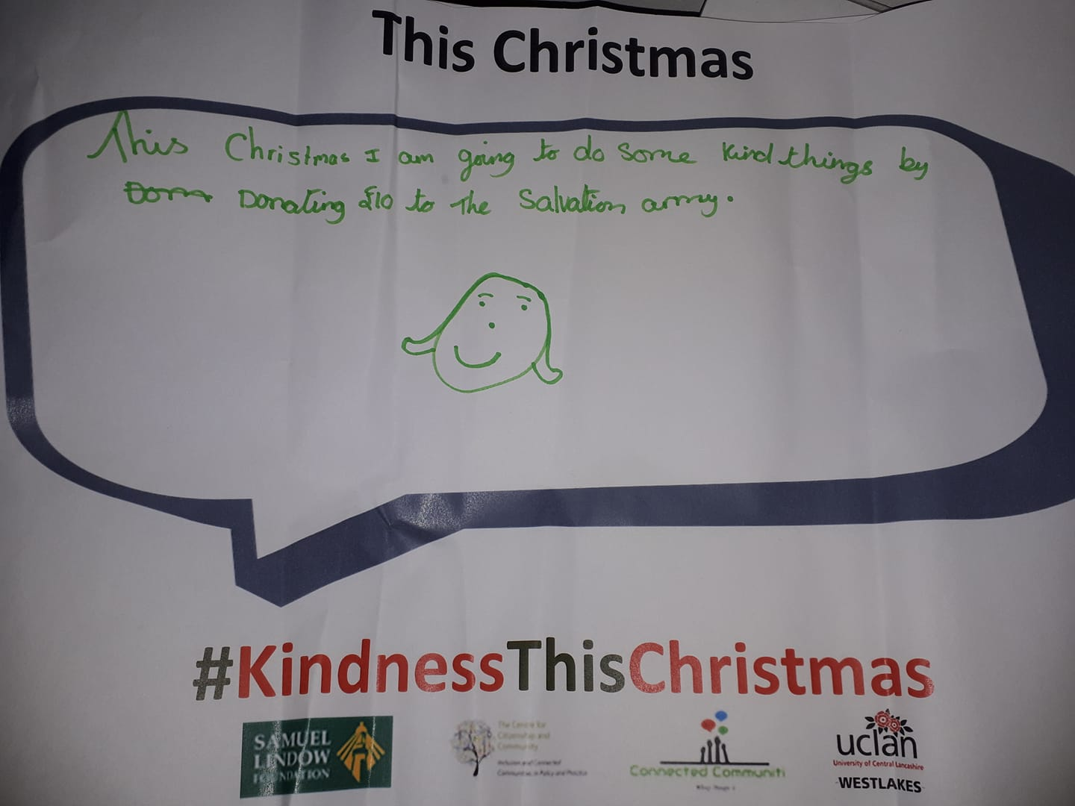
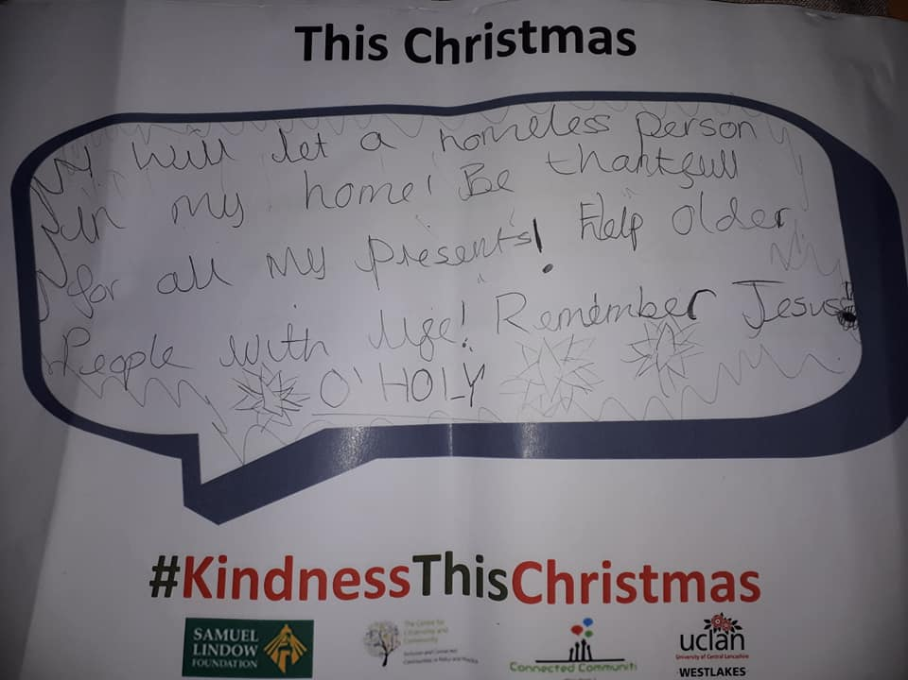
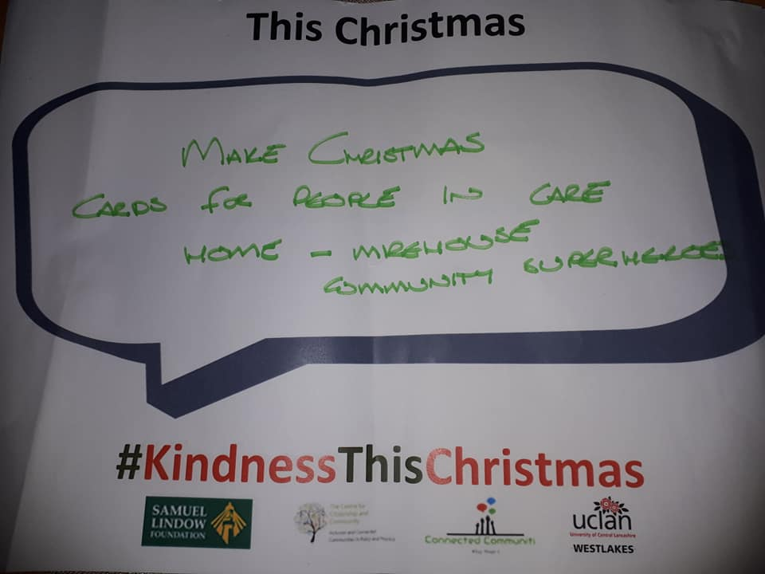
Kind Cumbria Day

