Slide 1


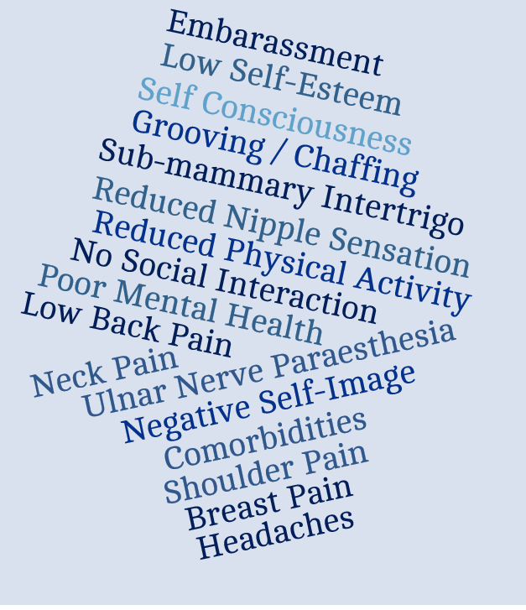
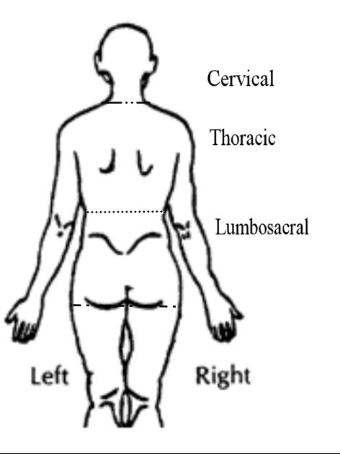
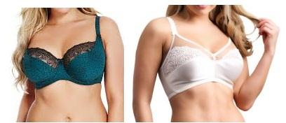

Can non-specific back pain (nsbp) amongst larger breasted women be
effectively managed through changing breast support garment?
Lauren Haworth, Karen May, Dr Jessie Janssen, Prof James Selfe, Dr Ambreen Chohan
Email: LHaworth6@uclan.ac.uk Tel: 01772 892547
INTRODUCTION
RESULTS
The problem
In spite of professional bra fitting services, 75-100% of women still wear the wrong size bra ^{[1]}.
Larger breasted women (D±) regularly seek medical intervention for chronic NSBP ^{[2]} as long-term wearing of an ill-fitting bra can result in a myriad of symptoms. (Fig. 1).
Treatment strategies for this patient group are mostly surgical, but accessibility is limited via the NHS ^{[3]}.
Bra Fit Assessment Fail Rates
Asymptomatic Usual = 100%, PFB = 67% Symptomatic Usual = 100% PFB = 87.5% Optifit = 4.2%
Breast Support
Asymptomatic: Significant changes relating to static and dynamic breast support were seen immediately (PFB), but were not maintained over time (PFB₂₈).
Symptomatic: Significant changes relating to static breast support were seen immediately in both bras (PFB & Optifit), but only in the Optifit bra after the intervention period (Optifit₂₈).
Spinal Posture
No significant postural changes post-intervention.
Pain & Disability Measures (symptomatic)
Both bras provided symptomatic relief with the Optifit improving to a greater extent (Table 1 & Fig. 4).
What is the current solution?
Conservative management strategies recommend the introduction of a correctly fitted bra [3].
NRS | PFB₂₈ | Optifit₂₈
Pain | 13% ↓ | 23% ↓*
Stiffness | 10% ↓ | 42% ↓*
Discomfort | 23% ↓* | 33% ↓*
Cervical
PFB₂₈ 0%
Optifit₂₈ 50% ↓
This study aimed to investigate the immediate and short-term biomechanical, psychosocial and pain responses to change in breast support garment amongst larger breasted women with (symptomatic) and without (asymptomatic) NSBP.
Fig. 1: The myriad of painful symptoms, physical function and psychological factors to consider using a multidisciplinary team approach when managing a larger breasted woman with pain associated to breast size and / or poor bra fit.
SF-MPQ-2 | PFB₂₈ | Optifit₂₈
Continuous | 23% ↓ | 44% ↓*
Intermittent | 41% ↓* | 62% ↓*
Neuropathic | 37% ↓ | 38% ↓
Affective | 10% ↑ | 30% ↓
Total | 23% ↓ | 45% ↓*
Thoracic
PFB₂₈ 0%
Optifit₂₈ 36% ↓*
METHODS
Participants: Asymptomatic (n=24) and Symptomatic (n=24), D+ cup size, were screened using adapted version of Red flags screening tool ^{[4]}.
Test Conditions:
Asymptomatic: Tested in Usual bra, Professionally-fitted bra [PFB], PFB after 4 week intervention period [PFB₂₈]
Symptomatic: Tested in Usual bra, Professionally-fitted bra [PFB], PFB after 4 week intervention period [PFB₂₈], Optifit bra [Optifit], and Optifit bra after 4 week intervention period [Optifit₂₈] (Fig.2) in randomised order (Fig.3). The Optifit bra has an alternative 3 dimensional measurement and fitting approach.
Tasks: Kinematic data collected during standing, and a drop jump from 20cm high step.
Outcome Measures:
Asymptomatic: Bra fit assessment ^{[5]}, breast and spinal kinematics.
Symptomatic: Bra fit assessment, breast and spinal kinematics, clinical pain, function and disability questionnaires
Lumbosacral
PFB₂₈ 26% ↓
Optifit₂₈ 37% ↓
NDI | PFB₂₈ | Optifit₂₈
 | -14% ↓* | 35% ↓*
Table 1: Percentage change in clinical outcome measures when comparing post-intervention and baseline scores. * denotes statistical / clinical significance.
Fig. 4: Change in prevalence of pain at three anatomical regions when comparing post-intervention and baseline measures.
* denotes statistical significance.
CLINICAL IMPACT
The Optifit bra has the potential to:
  Provide clinical benefit for larger breasted women with NSBP by enabling them to successfully follow conservative clinical guidelines.
  Provide a potential solution to the problems associated with current bra sizing and fitting principles.
  Offer economic cost-saving for the NHS through better patient management.
Fig. 2: An example PFB bra (top) & Optifit bra (bottom)
4 Week
Intervention
(bra 1)
Data Collection Session [2]
(bra1₂₈ & bra 2)
Data Collection Session [1]
(Usual &
bra 1)
4 Week Intervention (bra 2)
Data Collection Session [3]
(bra 2₂₈)
FUTURE WORK
Determine the size and scale of the problem, considering physical symptoms, functional and psychosocial factors.
Explore the Optifit bra’s effectiveness as a conservative intervention for breast reduction surgery patients.
Fig. 3: Schematic diagram to represent study design for symptomatic participant groups
REFERENCES: [1] McGhee et al., Clin Biomech. 2018; 51: 99–104. [2] Coltman et al., Clin Biomech. 2018; 53: 46–53. [3] NHS England et al., 2019; Evidence-Based Interventions: Guidance For CCGs. [4] Greenhalgh & Selfe., Red Flags II: a guide to solving serious pathology of the spine; 2010. [5] McGhee & Steele., J Sci Med Sport. 2010; 13 (6): 568–72.
Funding: This research was funded through a Futures internship (UCLan), a University Research Internship Scheme placement (UCLan), and a University Investment Voucher (UCLan). The Optifit bras were provided in-kind by the manufacturer.

