Slide 1
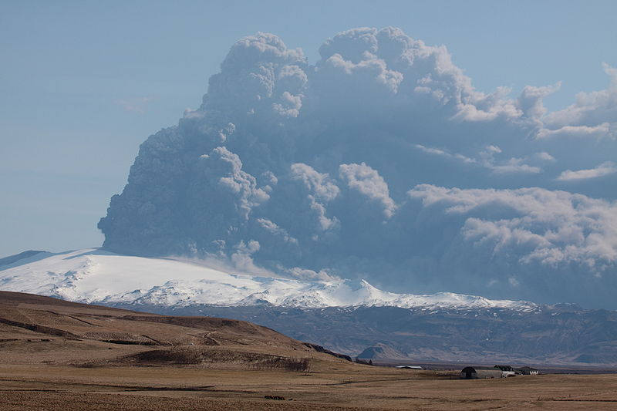
The impact of the volcanic ash cloud on air passengers
Dr Jo Guiver
Institute of Transport and Tourism

Slide 2

The Context
Air Travel increasing and life-styles developing which are dependent on air travel
Air travel is unsustainable for a number of reasons:
  Fuel consumption
  Emissions at high levels
  The costs not reflecting its externalities
  Encouraging ever-longer and more frequent trips

Slide 3
Travel Disruption
When journeys take longer or are not possible
Resolutions:
  Temporal: take longer, change time/frequency
  Spatial: change origin, destination or route
  Modal: change mode
  Delegation: someone else fulfills commitments
Resilience requires redundancy of resources

Slide 4
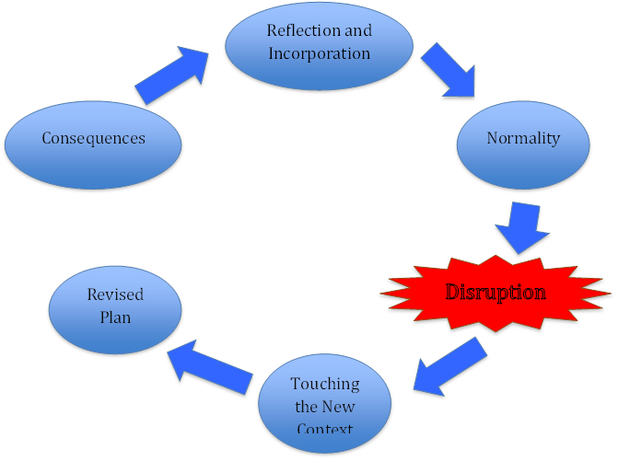
Stages of Disruption

Slide 5
The Crisis
21st March
  Eruption of Eyjafjallajokull volcano after 200 years, 500 people evacuated
14th April
  2am 800 people evacuated as volcano erupts again
  2pm Met Office send urgent message to National Air Traffic Services
  8pm NATS suspend flights in and out of UK air space, starting with Scotland
  Norway, Finland and Sweden also taking action

Slide 6
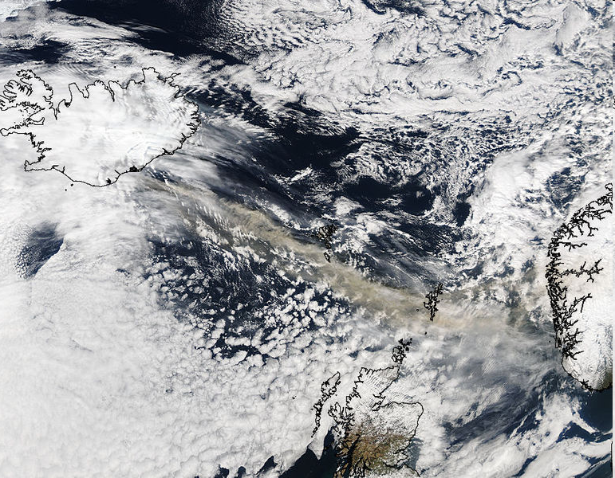
15th April 2010

Slide 7
The Crisis
15th April
  9am announced that British air space will be closed between 12 and 6pm, Ryan Air announces it will cancel flights for four days
  Closing: Denmark and Ireland, later: Netherlands, Belgium and Southern Sweden, 15:00 Lille and Reims
16th April
  Closing; France, Lithuania, Hungary, Germany, Eastern and Southern Europe start
  Tales of heroic travellers' trips across Europe start to emerge

Slide 8
The Crisis
17th April
  Closing: Paris and Brest regions, Dusseldorf, Frankfurt, Munich, Karlsruhe and Bremen Milan and Padua, later: Geneva and Zurich, Estonia and Poland, Praha, Slovakia, Hungary and Vienna
  Liverpool, Newcastle, Leeds and Bradford plan to re-open

Slide 9
The Crisis
18th April
  Northern Spain regulated, not closed
  Madrid, Bordeaux and Marseille begin to open
  Air spaces above 200FL open in Maastricht, Rhein, Bremen region, all Spain, France, Austria, Poland, Italy, Switzerland, Milano and Padova
  British Airways Chief, Willie Walsh lands after test flight above Atlantic

Slide 10
The Crisis
19th April
  Opened: Germany, Maastricht, France, Czech Republic, Romania, Bratislava and Switzerland above certain flight levels, Ukraine, Spain and Bulgaria, Austria ‘at pilot’s discretion’
  Willie Walsh says "current blanket restrictions on airspace are unnecessary"
  Giovanni Bisignani, director general of the Air Transport Association criticises governments’ approach and estimates costs to industry at $200 million a day
  PM announces Navy task Force to be sent for stranded passengers

Slide 11
The Crisis
20th April
  New procedures adopted, most European air space open, except UK until 20:00
21st April
  Most Europe open except parts of: Northern Scotland, Sweden, Finland and Brittany
22nd April
  Virtually all back to normal
4^{th-}17th May
  sporadic disruption to some areas at some altitudes over Iceland, Ireland, Scotland, England, France, Portugal, Spain, Italy, Morocco, the Netherlands

Slide 12
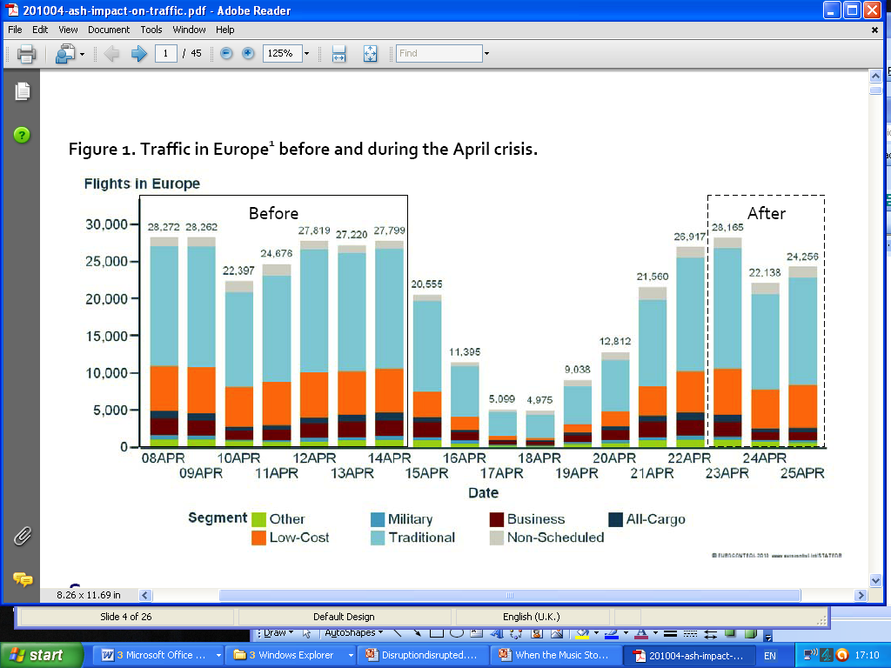
Flights
European Organisation for the Safety of Air Navigation (EUROCONTROL) 2010

Slide 13
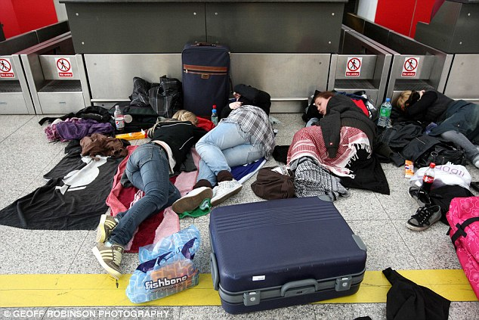
News
Notes:
Like the reports in December
The disruption of flights kept the media busy, while stranded passengers up loaded photos and personal stories to the web. The images that circulated focused on people stranded airports and the queues and congestion on other ‘alternative’ routes such as the ferries from France to Britain, but not the mundane images of those stuck at home or in hotels either enjoying an extended holiday or trying to continue to work remotely.
Join me for a moment at the end of a long day at a conference in Washington. I sit down in my hotel room and connect up to the internet. It’s quite nice having a bit of time to email family and friends. I open a message from New Zealand ‘hope you’re not affected by the ash cloud’. What’s this about I wonder. I haven’t seen or heard the news for some days. What ash cloud? Immediately I turn to the BBC news. There is uncertainty. I start to worry. I email my work – what do I do and who do I contact on Sunday if the flight is cancelled? I phone home – better put grandma on stand by in case I can’t get home. On Friday night it seems clear that flying on Sunday is going to be unlikely. I start to look for other possible routes back home – Madrid and Rome remain open. I know I can get home from Madrid but it’s an expensive choice. Saturday, is my only window of opportunity for talking to the out of hours travel agent. I am saved by a friend after several hours of being ‘on hold’ and then getting cut off because the phone card has run out, who downloads skype onto my laptop.

Slide 14
The Survey
Launched 19th April
  On-line survey
  Comments boxes
507 responses
  Business 45%
  Holiday 41%
  Visiting friends and family 14%
  53% within Europe 47% inter-continental
Notes:
We launched the survey on 19th April, the fifth day of disruption, It was an on-line survey and we distributed it through any mailing list, contact or method we could. A once-fellow student printed off fliers and gave them out to people with lap-tops waiting at JFK airport.
The survey was quite long, it took about 10-15 minutes to fill in and because it was new territory we included lots of open questions for people to give more information.
By mid-May we had 507 respondents. We can’t say they were typical of people flying or of people stranded.

Slide 15
Why people fly
Notes:
The survey included questions about why people were flying and their alternatives if flying were not available.
Point out it is mainly instrumental. Many destinations are dependent on ease of travel. Too far away most important reason for inter-continental trips. This is similar to automobility as Illich pointed
‘motorized vehicles create remoteness which they alone can shrink. They create distances for all and shrink them for only a few’ (Illich, 1974)
Something similar could be said about aviation currently.

Slide 16
When flying not possible
Notes:
Another question asked people what they would have done if flying had not been possible for some time before their journeys.
It appears as though the possibility of flying has generated journeys, which otherwise would not be made. However, many comments contradict the replies, suggesting that because the destination has been chosen, the mode of travel is non-negotiable. Some respondents also pointed out how cheap flights have reduced the availability of alternative surface modes.

Slide 17
But …
There isn't much of an alternative way to get to Iceland except in the summer months.
Not really possible to get from Australia to anywhere
Notes:
There isn't much of an alternative way to get to Iceland except in the summer months.
Not really possible to get from Australia to anywhere
Most ferries from Scandinavia to the UK have closed in recent years because of competition from low price airlines.

Slide 18
Notes:
People who never set out and those stuck away.

Slide 19
Notes:
A key element in the survey was how people made contact with other people and who they turned to.
Technologies used dependent on stage of journey
Nb visit office – e.g. airland office at airport
Possibly lose this?

Slide 20
Notes:
Depended where you were – stage and how far away as to possible solution (don’t add up to 100% because some people use lots of modes).

Slide 21
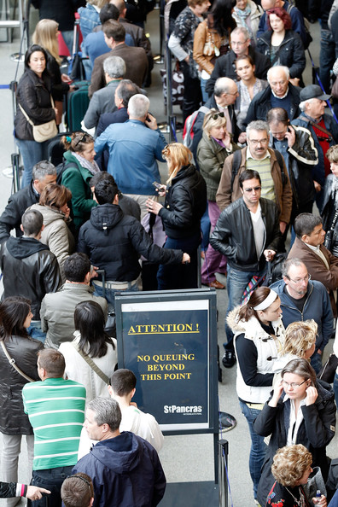

Slide 22
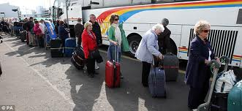

Slide 23
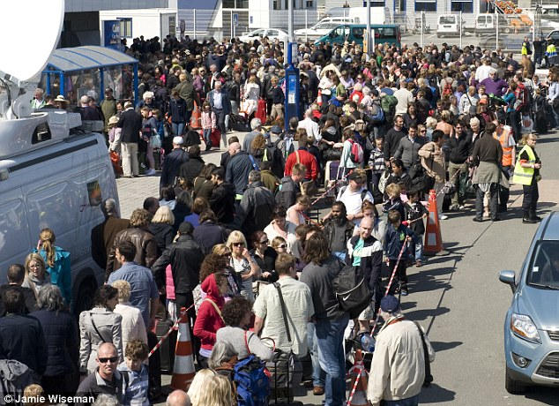

Slide 24
…there is no decent ferry service from Scandinavia to the UK. Just three sailings a week to Esbjerg in Denmark and that's over 1000km from where I live in Sweden. There used to be ferries to Gothenberg in Sweden and Stavanger in Norway, but they closed because they couldn't compete against cheap air travel. … If this crisis leads to a reopening of the ferry routes I will be extremely happy!

Slide 25
I would like to have more fast trains and better connections on trains
Involved night train from Berlin to Basel 5 hours waiting in Basel because swiss railway would not authorize me to board a train without a booking for this train. 4 Trains Basel-Bern-Brig-Milan-Pavia (final destination). had to pay around 230 euro for the trip compared to around 30 euros for the air ticket.

Slide 26
Rebooked to flight, which was cancelled again, rebooked again and hope now to get back to Glasgow tomorrow (23/04). I didn't see any point starting to arrange train/ferry/etc at this moment, but I would have gone for an overland alternative eventually had the flight bans taken much longer than this week.
Notes:
JG
People had to make decisions with imperfect knowledge
How long will I have to stay here?
How long would a journey by other means take?
Can I afford it?
Who can help?
JJ
One of the problems of being stuck elsewhere was the effect of the uncertainty on the ways decisions were made. Those without domestic responsibilities said they would just hire a car and travel around, or stick it out in a cheaper hotel trying to work remotely. Those with dependents, children and elderly relatives, appeared to under a greater obligation to ensure a quicker return. The internet was a godsend in one respect – skype, but not after I had wasted time and money on a series of unconnected phone calls. Being stuck at a weekend, limited the resources I could draw upon. Working on the day of intended departure meant I needed to ensure alternative arrangements were made in advance, whether these were the right choices or not, and relayed back home so the necessary childcare could be put in place to cover my absence.

Slide 27
Who was Contacted

Slide 28
Difficult to contact
Notes:
The most difficult to contact were the airlines, embassies and insurers

Slide 29
Unwilling to help
Notes:
The agencies most likely to found unwilling to help were insurers, embassies and consulates, followed by coach operators and tour guides

Slide 30
Found Alternative Travel Arrangements
Notes:
The agencies most likely to find alternative travel arrangements were transport providers, tour guides travel agents.

Slide 31
Found Alternative Travel Arrangements
Notes:
The agencies most likely to find alternative travel arrangements were transport providers, tour guides travel agents.

Slide 32
Problems
Sent Information:
  Not available
  Inconsistent
  Inaccurate
  Changing
Receiving Information:
  Finding contact details
  Language
  Telephones expensive
  People without laptops (queuing in hotels)
  Different time zones

Slide 33
Too much emphasis placed on internet - some people either because of age, access, could not use internet. Websites crashed. Mobile phones v expensive to use abroad ... for both sender and recipient of call. Lack of information caused high stress.
Notes:
Problem of information flows
Dissemination
Getting through on the ‘phone
Messages being received too late
Inaccurate information on websites
Receiving Information
People away without access to computer
No broadband
Time zones

Slide 34
Everybody said use the internet -don't turn up- but there were queues to get to computers and the sites were obstructive or crashed or had out of date information on them. we spent a fortune on mobile phone coast (calls and internet) as roaming costs are high and you had to go through the whole 'press 1 for..' thing first. often we just got cut off.
Notes:
Everybody said use the internet -don't turn up- but there were queues to get to computers and the sites were obstructive or crashed or had out of date information on them. we spent a fortune on mobile phone coast (calls and internet) as roaming costs are high and you had to go through the whole 'press 1 for..' thing first. often we just got cut off.

Slide 35
35

Slide 36
36

Slide 37
37
Notes:
If give extreme and difficult to cope with score of 5, hard but not intolerable 4, etc the averages work out at
Inconvenience 61 Distress-self 56 Distress-others 60

Slide 38
Opinions

Slide 39
Consequences
Delayed passengers ...
  missed appointments, exams, weddings, work
Back at home .....
  Friends fed pets
  Partners coped with childcare
  Colleagues stood in
Notes:
What was remarkable was how other people were affected by the disruption. Not only were they contacted by strandees, they were often called on to stand in for them. The survey revealed how dependent many travellers are on a home/work back up network.
Flying has created expectations of personal and business schedules based on speed of movement. Holidays and business trips are squeezed into other time-space obligations with little room for system failure and delay.
Individual absence is afforded by the presence of others. Such a disruption to international travel for a sustained period of time, really revealed this interdependency of between the global and local, especially in the home place, but also at work.

Slide 40
The biggest problems were not for me but for my family and colleagues. I'm staying with friends, have a hire car at my disposal, and am actually having a very nice time. But my wife is having to manage the children and her job on her own, she has had to cancel a trip she was going to make ... since I'm not there to take care of the children and my colleagues have had to cover for me which is of course extra work for them.
Notes:
jj
The biggest problems were not for me but for my family and colleagues. I'm staying with friends, have a hire car at my disposal, and am actually having a very nice time. But my wife is having to manage the children and her job on her own, she has had to cancel a trip she was going to make ... since I'm not there to take care of the children and my colleagues have had to cover for me which is of course extra work for them.

Slide 41
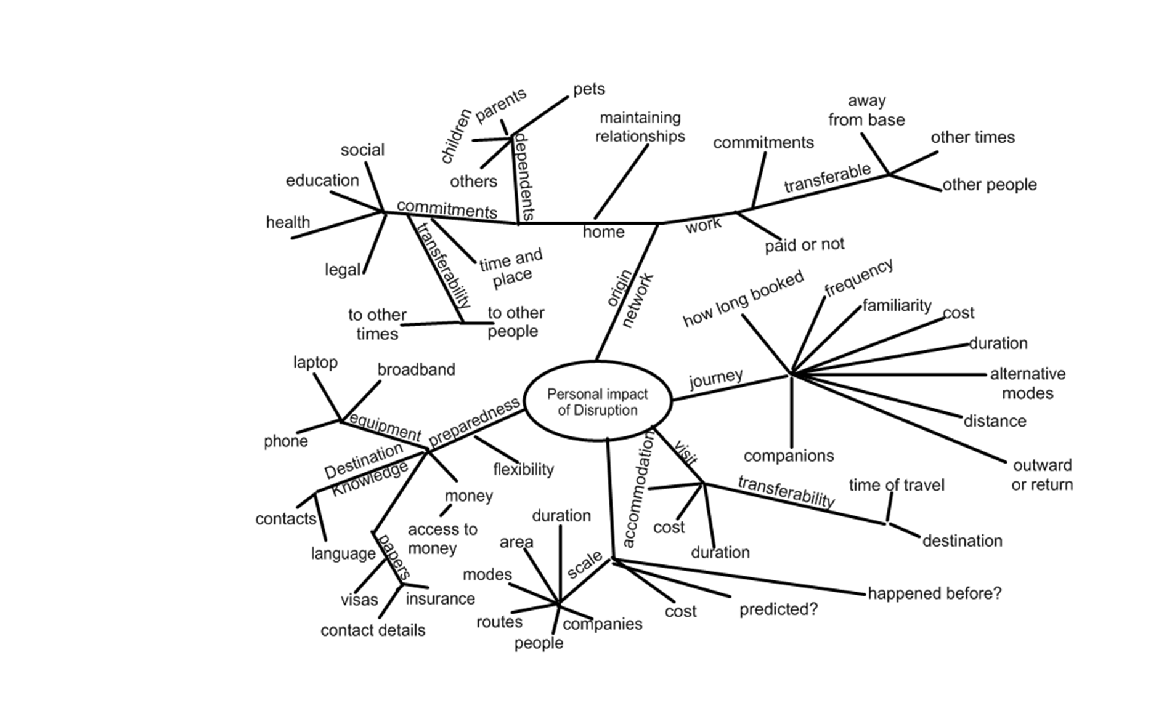

Slide 42
Conclusions: Ash Cloud
No-one died
Probably more people never left home than were stranded
Severe inconvenience for many
Adventure for few
Uncertainty caused distress
Personal resources and situation at home made a big difference to experience
Benefits to non-travellers

Slide 43
Stages of Disruption

Slide 44
Disruption
Are disruptions inevitable?
Do they help improve systems?
Resilience requires some redundancy
Transport can never be a closed system, so disruption is absorbed through other systems: time from other activities, foregone opportunities, etc

Slide 45
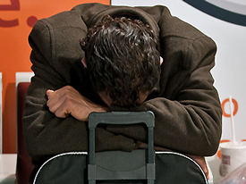
Thank you and any questions?

