Slide 1
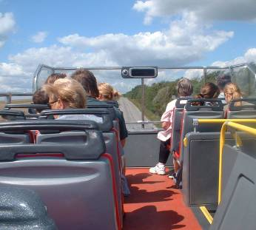

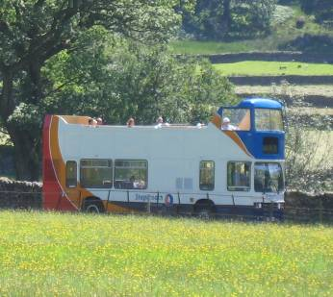
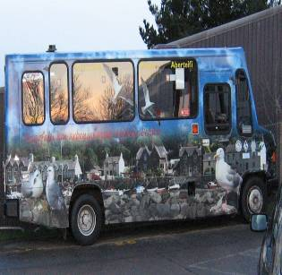
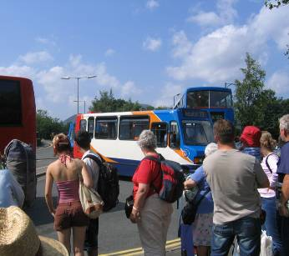
ASSESSING THE VALUE OF BUS SERVICES FOR LEISURE
Dr Jo Guiver
Nick Davies
Institute of Transport and Tourism

Slide 2
Leisure Travel
Different from utility travel:
  Less routine/novelty
  Part of experience
  Discretionary,
    Whether or not to travel
    Where to go
    When to go
    How to go
    Who to go with
  Bundles of choices

Slide 3
Discretionary Travel
Less important than utility?
Often cross-border
More politically expendable?

Slide 4
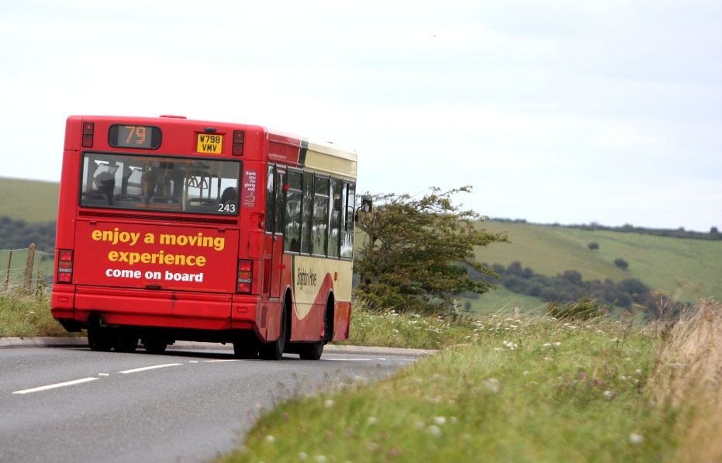
Buses are Boring!

Slide 5
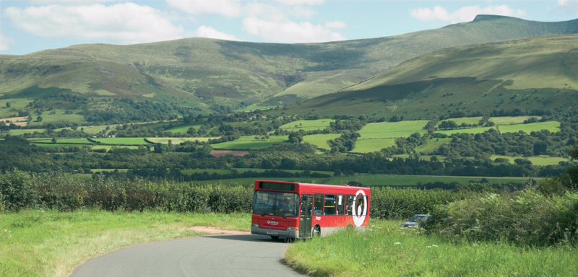

Slide 6
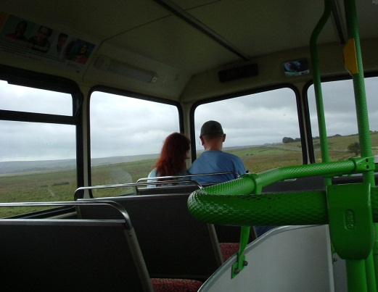
Why Buses?
Use road network,
  so potentially same reach as cars
Greater range of destinations than railway network
Potential to enhance visitor experience
More sustainable and less intrusive than individual car use
However, present a number of problems,
  not least image and information

Slide 7
History of the Project

Slide 8
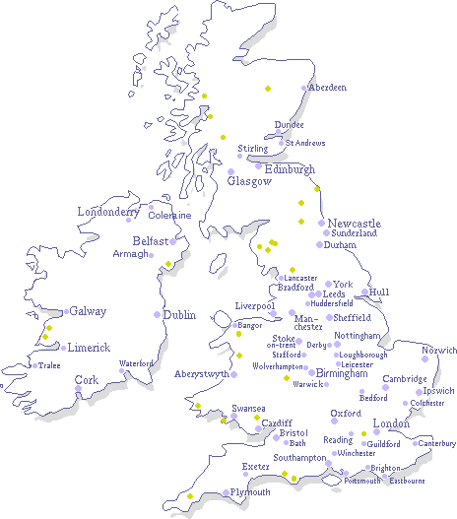
2004
2005-2006
2007-2009
2010-2011

Slide 9
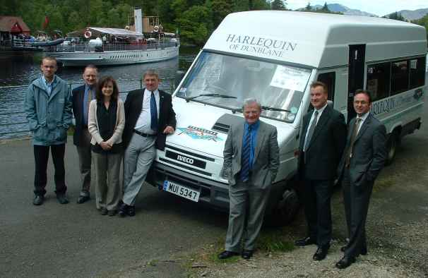
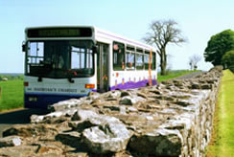
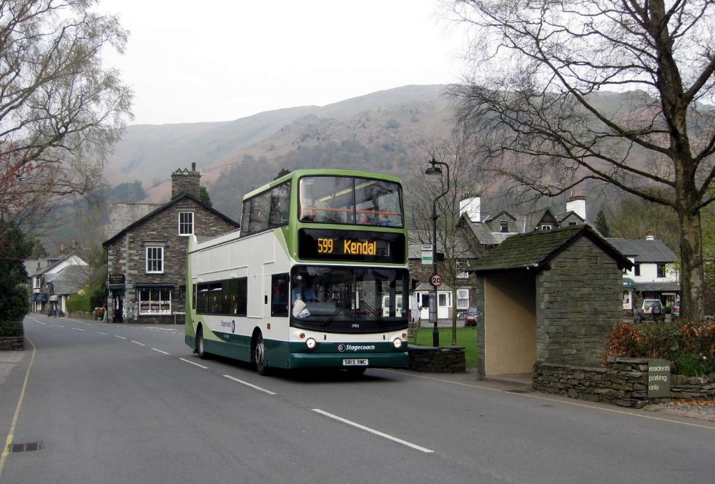
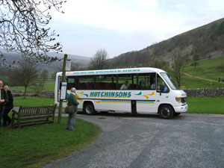
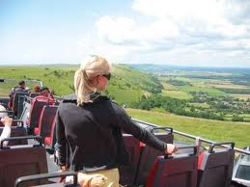
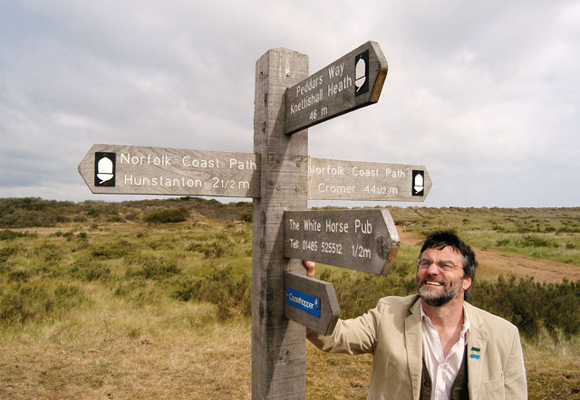
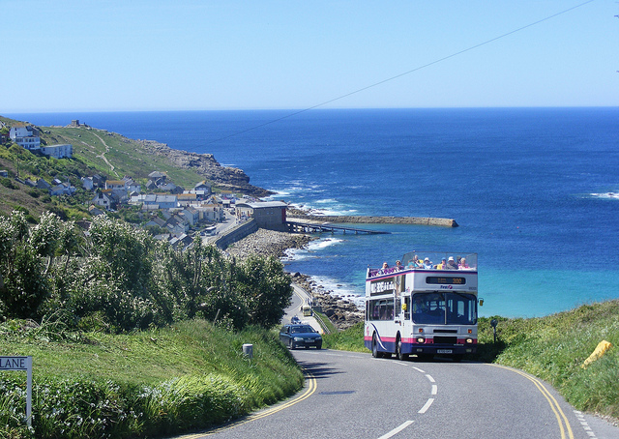
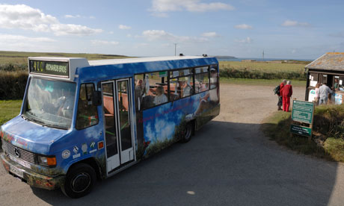
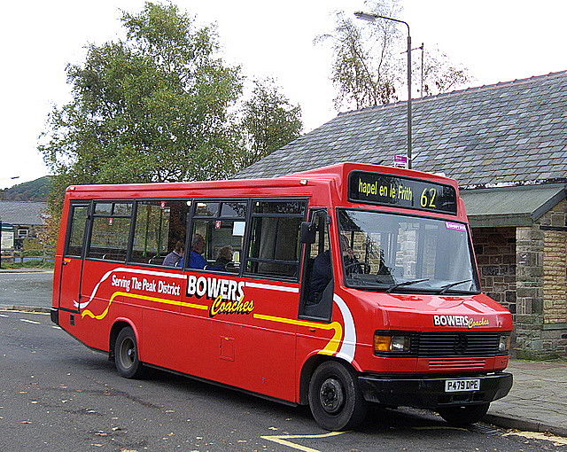
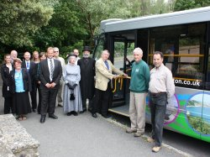
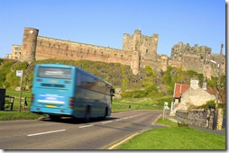

Slide 10
Rationale
Previous surveys:
  Costs
  Skills
  Combining data: bigger picture
Produce off-the-shelf, easy to use system To maximise the skills of the University and minimise costs to users.

Slide 11
How it worked
University designed survey template
Spread sheet allowed easy inputting of survey data
Macros in spread sheet generated instant report

Slide 13
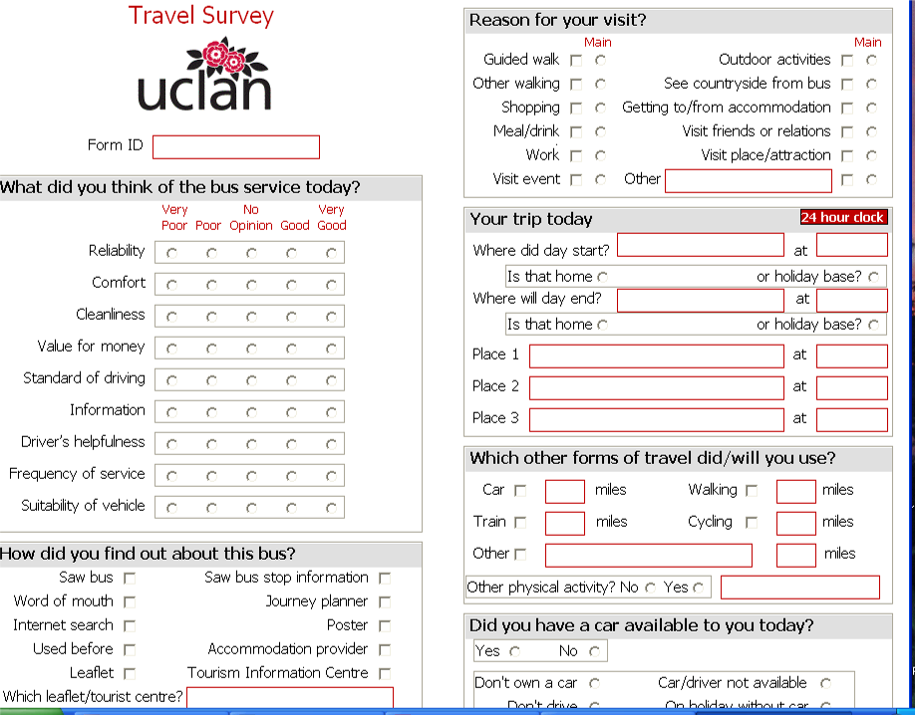

Slide 14
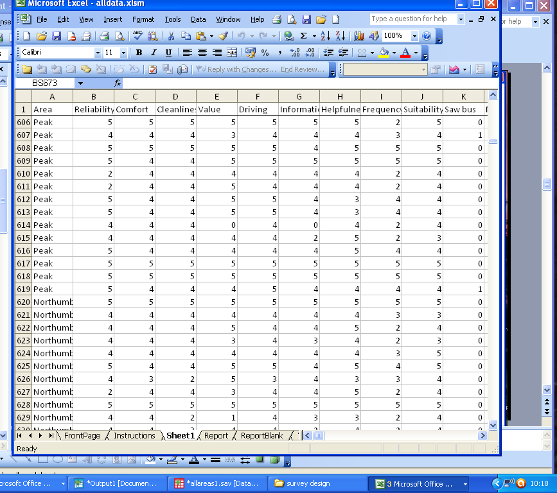

Slide 15
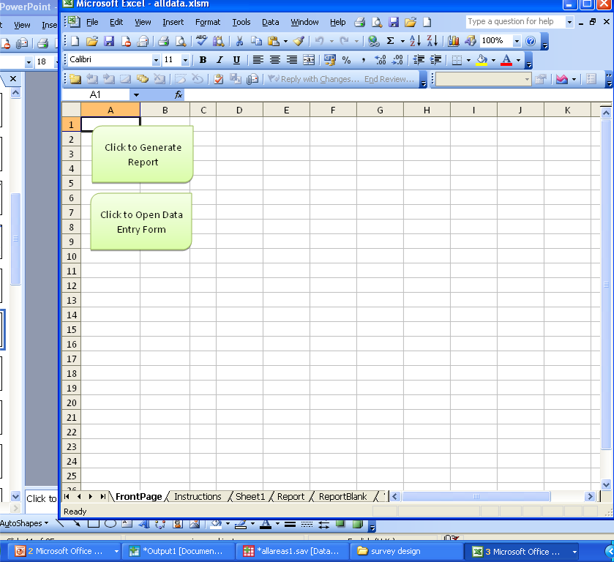

Slide 16
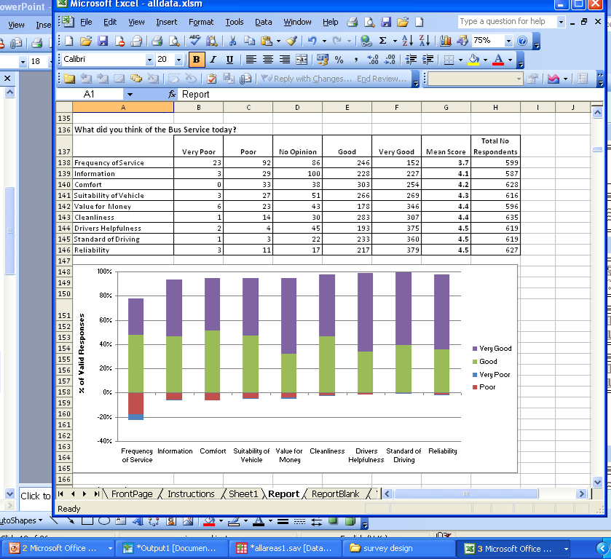

Slide 17
Findings: Passengers

Slide 18
Findings: Passengers
1118 respondents
Older profile (52% over 60)
Lower income groups (37% under £10,000, but 10% £50,000+)
9% (86) with disability restricting mobility
51% no car available on day
8% (92) from overseas

Slide 19
How knew about bus

Slide 20
Reason for Visit

Slide 21
Reason for Visit

Slide 22
Visiting Area and Using Bus

Slide 23
Alternatives if Bus not running

Slide 24
Alternatives
35% would stay at home
64% would not visit area
  (Stay at home 35%
    + Different destination 29%)
27% would use a car
47% would change day of travel to use bus

Slide 25
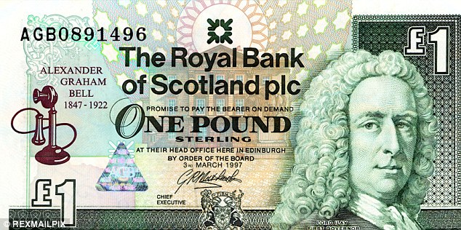

Spending

Slide 26
Spending
Average Spending per day
  £16.47 excluding accommodation
  £25.89 with accommodation for one night

Slide 27
Spending

Slide 28
Visitors and Income lost without bus

Slide 29


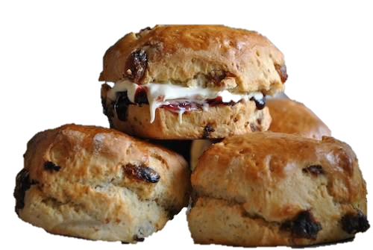

Slide 30



Slide 31

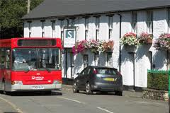
Accommodation
47% stayed at least one night
in holiday accommodation
Average length of stay was 5 nights

Slide 32
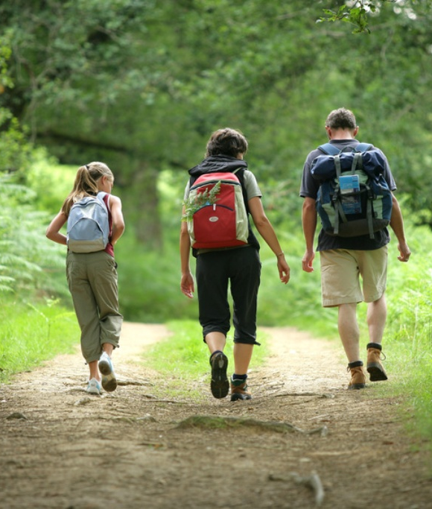
health and Well-being and Satisfaction

Slide 33
74% of respondents did some form of physical activity
  469 (65%) people walked
  14 (2%) people cycled
  127 (18%) said they did other physical activity

Slide 34
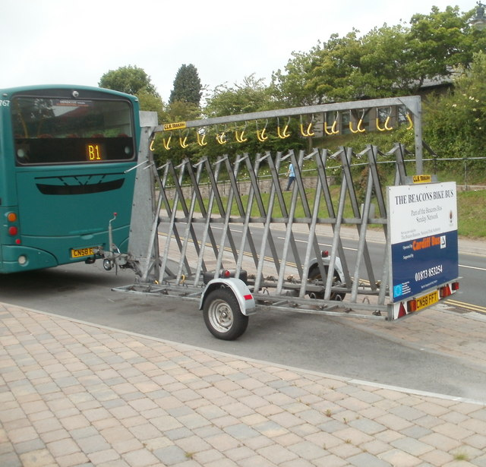

Slide 35
Satisfaction with Service

Slide 36
Satisfaction
Comfort, Information and Frequency ‘good’
Most Factors ‘very good’
64% had a great time
89% would recommend service to a friend

Slide 37
In Summary
We have evidence that these buses are helping to:
  Reduce Social Exclusion
  Reduce car use
  Generate Local Spending
  Are used for physical activity
High satisfaction
  suggests they help well-being

Slide 38
How to Evaluate the Benefits?
Can apples, pears and grapes be added up as units of fruit?
Do we need to attribute relative values to the benefits?

Slide 39
Game at Seminar
Participants sat at different tables according to their roles:
  Volunteer Sector
  Local authorities
  National Parks, Areas of Outstanding Natural Beauty, etc
  Bus operators
  Academics
  Consultants

Slide 40
Sequence
Asked to give their personal priorities in terms of %s among:
  Health and well-being
  Local Spending
  Social Inclusion
  Car use reduction
In groups asked to allocate budget of £1,000 using (fictitious) table of benefits

Slide 41
Rates of Return

Slide 42
Original Allocation of Priorities

Slide 43
Allocation of £1,000 Budget

Slide 44
Decision-making
Stronger voices have more influence
Some just averaged individual budgets
Budget allocation reflects priorities rather than efficiency
Types of beneficiary important as well as abstract ideas
Difficult to isolate benefits

Slide 45
Questions Arising
Are Decisions to allocate Public Money rational?
Is evidence useful?
Should we be comparing the benefit/cost ratios of these buses with other expenditure?

Slide 46
Where to now?
Enlarge data collection?
Extrapolate survey findings to whole season?
Look at costs?
More investigation into what works/what doesn‘t ?
Applications to other types of service?

Slide 47
Thank you!
Any Questions or Suggestions?
Jo Guiver
Institute of Transport and Tourism
University of Central Lancashire
jwguiver@uclan.ac.uk

